Slide 1
Introduction
Lecture 1
Presented by
Md. Mahbubul Alam, PhD
Professor
Dept. of AEIS, SAU

Slide 2
Overview
Importance of Leadership
Leadership Defined
- Ways of conceptualizing leadership
- Definition and components
Leadership Described
- Trait vs. process
- Assigned vs. emergent
- Leadership and power
- Leadership and coercion
- Leadership and management
Notes:
Importance of leadership/why do you need leadership
Leadership is a way to improve personal, social, and professional lives. Therefore, corporations seek those with leadership ability because they believe they bring special assets to their organizations, and ultimately improve the bottom line.

Slide 3
The Evolution of Leadership Definitions
1900-1929 – Control and centralization of power
1930s – Trait approach (influence rather than domination)
1940s – Group approach (behavior of an individual while involved in directing group activities)
1950s – Three themes: Group theory (what leaders do in groups), shared goals (leadership based on the leader), and effectiveness (ability to influence overall group effectiveness)
1960s – Leadership as behavior (acts by persons which influence other persons in a shared direction)
1970s – Organizational behavior (initiating & maintaining groups or organizations to accomplish group or organizational goals)

Slide 4
The Evolution of Leadership Definitions
1980s – Explosion of research (on the nature of leadership)
- (Do as the) Leader wishes, (do what the leaders wants)
- Influence (noncoercive influence)
- Traits
- Transformation (“when one or more persons engage with others in such a way that leaders and followers raise one another to higher levels of motivation & morality” (Burns, 1978))
21st century – Complexity of leadership (complex process having multiple dimensions)

Slide 5
Conceptualizing Leadership
Some definitions view leadership as:
The focus of group processes (leader is at the center of group change and activity)
A personality perspective (a combination of special traits or characteristics that some individuals possess)
An act or behavior (things leaders do to bring about change in a group)
The power relationship between leaders & followers (leaders have power that exert to effect change in others)
A transformational process (moves followers to accomplish more than in usually expected to them)
A skills perspective (stress on capabilities (knowledge & skills) that make effective leadership possible)
Notes:
Leader at center of group change & activity – represents the “will” of the group
combo of special traits/characteristics - allows them to affect others to accomplish tasks.
3. Things leaders do that bring about change
4. Leaders have power and use it to cause change
5. In helping group members achieve their goals/meet needs

Slide 6
Leadership Defined
Leadership
is a process whereby an individual influences a group of individuals to achieve a common goal.
Process means it is not trait or characteristics but rather a transactional event that occurs between the leader and the followers.
Leadership is not a linear, one-way event, but rather an interactive event.

Slide 7
Components Central to the Phenomenon of Leadership
Leadership
Leaders
Is a process
Involves influence
Occurs within a group context
Attends to common goals
And followers are involved together
And followers need each other
Often initiate and maintain the relationship
Are not above or better than followers

Slide 8
Leadership Described
Trait vs. Process Leadership
Assigned vs. Emergent Leadership
Leadership and Power
Leadership and Coercion
Leadership and Management

Slide 9
Leaders were born NOT Made

Slide 10
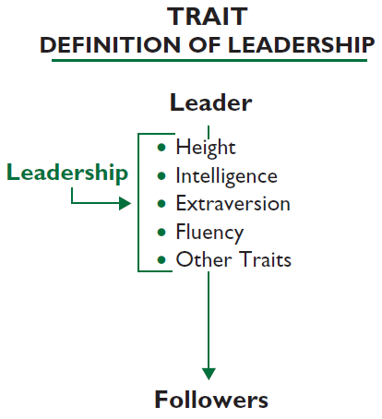
Trait vs. Process Leadership
Certain individuals have special innate characteristics or qualities that differentiate them from nonleaders.
  Resides in select people
  Restricted to those with inborn talent

Slide 11
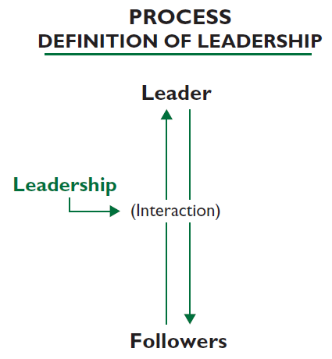
Trait vs. Process Leadership
Leadership is a property or set of properties possessed in varying degrees by different people (Jago, 1982).
  Observed in leadership behaviors
  Can be learned

Slide 12
Assigned vs. Emergent Leadership
Assigned
Emergent
Leadership based on occupying a position within an organization
  Team leaders
  Plant managers
  Department heads
  Directors
An individual perceived by others as the most influential member of a group or organization regardless of the individual’s title
  Emerges over time through communication behaviors
    Verbal involvement
    Being informed
    Seeking others’ opinions
    Being firm but not rigid
  Affected by personality (more dominant, more intelligent, more confident) and gender
Notes:
1. Emergent leadership: Social Identify Theory (Hogg, 2001)-> “degree to which a person fits with the identify of the group as a whole” -> group prototype.

Slide 13
Leadership & Power
Power
Bases of Social Power
French & Raven (1959)
The capacity or potential to influence.
  Ability to affect others’ beliefs, attitudes, & actions
  Dyadic relation: person influencing & person being influenced
Referent
Expert
Legitimate
Reward
Coercive
Power is a relational concern for both leaders and followers.
Notes:
1. How power is related to leadership? Or what is common in both? “Influence process”!

Slide 14
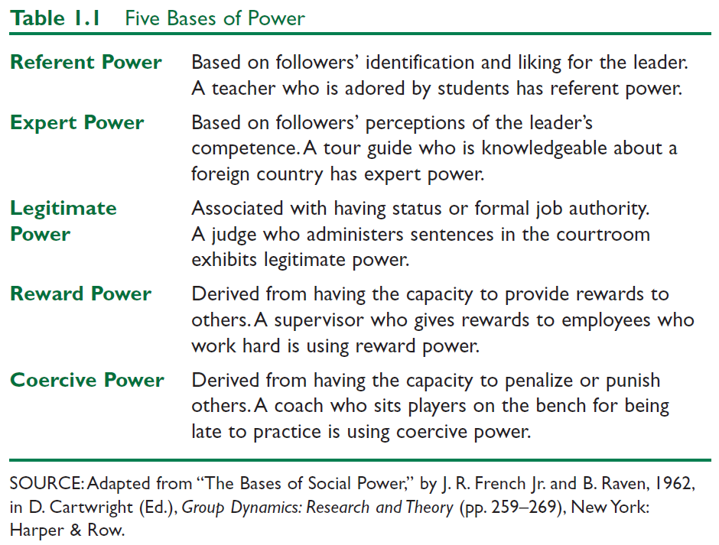
Leadership & Power

Slide 15
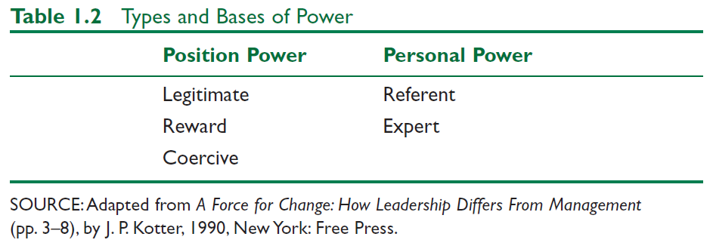
Leadership & Power
Position Power derived from office or rank in an organization
Personal Power is influence derived from being seen as likable & knowledgeable

Slide 16
Leadership & Coercion
Coercion Involves
Examples of Coercive Leaders
Use of force to effect change
Influencing others to do something by manipulating rewards and penalties in the work environment
Use of threats, punishments, & negative rewards
Adolf Hitler
Power & restraint used to force followers to
engage in extreme
behavior

Slide 17
Leadership & Management Kotter (1990)
Management
Activities
Leadership
Activities
“Produces order
and consistency”
“Reduce chaos in organizations”
“Produces change
and movement”
Planning & Budgeting
Organizing & Staffing
Controlling & Problem Solving
Establishing direction
Aligning people
Motivating / Inspiring
Major activities of management & leadership
are played out differently; BUT, both are essential
for an organization to prosper.
Notes:
Common in Leadership and Management: influence, working with people, goal achievement.
Management without leadership: results in ‘stifling and bureaucratic’ , on opposite, outcome can be meaningless or misdirected.

Slide 18
Leadership & Management Zaleznik (1977)
Managers
Unidirectional Authority
Leaders
Multidirectional Influence
Are reactive
Prefer to work with people solving
Low emotional involvement
Accomplish activities and master routines.
Are emotionally active & involved
Shape ideas over responding to them
Act to expand available options
Change the way people think about what is possible
Influence others & create visions for change.

Slide 19
Bass’ Theory of Leadership (Bass, 1990)
Explains how people become leaders
Some personality traits may lead to people naturally into leadership roles.
  Trait theory
A crisis or important event may cause a person to rise to the occasion, which brings out extraordinary leadership qualities in an ordinary person
  Great Events theory
People can choose to become leaders. People can learn leadership skills.
  Transformational or process Leadership

Slide 20
Question Please
?

