Slide 1
COMB354: Fisheries Information Systems Exercise 2 Database Management Systems by Md. Mahbubul Alam, PhD

Slide 2
Learning Objectives
Describe the problems of managing data resources in a traditional file environment and how are they solved by a database management system.
Describe the major capabilities of database management systems.
Apply important principles of database design.
Evaluate principle tools and technologies for accessing information from database to improve business performance and decision making.

Slide 3
File Organization: Concepts
A computer system organizes data in a hierarchy that starts with bits & bytes followed by fields, records, files & databases.
Bit, represents the smallest unit of data a computer can handle.
Byte, a group of bits, represents a single character, which can be a letter, a number, or another symbol.
Field, a group of characters into a word, a group of words, or a complete number.
e.g., a person’s name or age.
Record, a group of related fields.
e.g., student’s name, course taken, the data & the grade
File, a group of records of the same type.
Database, a group of related files.
Record describes an entity (person, place, thing on which we store information).
Each characteristic, or quality, describing a particular entity is called an attribute.
e.g., Student_ID, Date, & Grade are attributes of the entity COURSE.

Slide 4
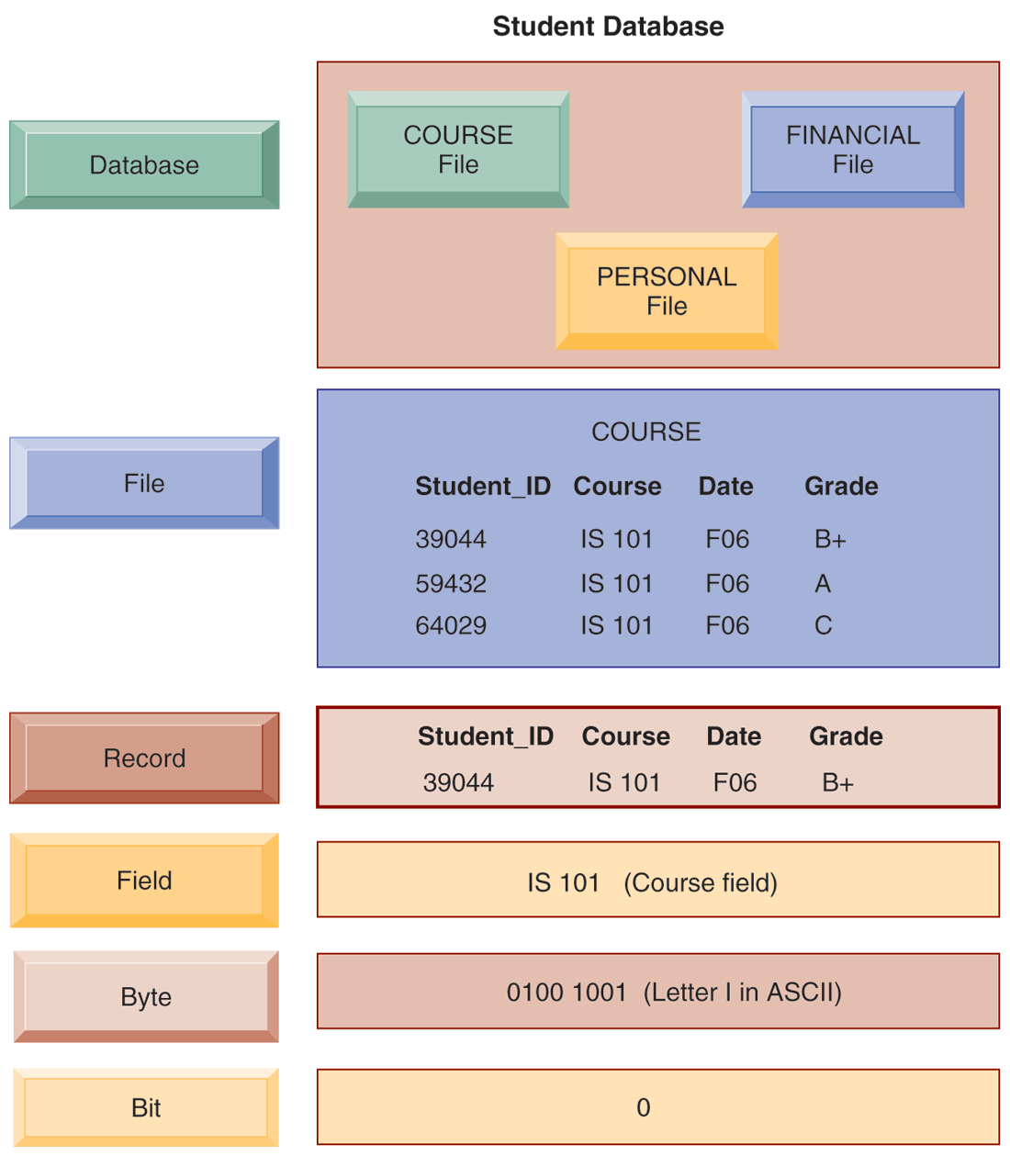
The Data Hierarchy
A computer system organizes data in a hierarchy that starts with the bit, which represents either a 0 or a 1.
Bits can be grouped to form a byte to represent one character, number, or symbol.
Bytes can be grouped to form a field, and related fields can be grouped to form a record.
Related records can be collected to form a file, and related files can be organized into a database.

Slide 5
Traditional Data Management: Problems
Files maintained separately by different departments.
Systems tended to grow independently without a company-wide plan.
Every dept. developed its own systems & data files independently.
Data redundancy, presence of duplicate data in multiple data files.
Same data are stored in more than place or location.
Wastes storage resources, lead to data inconsistency.
Data Inconsistency, same attribute may have different value.
Use of different name for same attribute (Student_ID or ID), use of different codes (“extra large” or “XL”).
Program-Data Dependence, coupling of data stored in files and the specific programs required to update and maintain those files that changes in program require changes to the data.
e.g., if the original data file were changed from 5-digit to 9-digit PIN codes, then other programs that required the 5-digit PIN would no longer work properly.
Notes:
Every traditional computer program has to describe the location and nature of the data with which it works.
In a traditional file environment, any change in a software program could require a change in the data assessed by that program.

Slide 6
Traditional Data Management: Problems (cont’d)
Lack of flexibility
Can deliver routine scheduled reports after extensive programming efforts, however cannot delivery ad-hoc reports or respond to unanticipated information requirement in a timely fashion.
Poor security
Little control or management of data
Access to and dissemination of information may be out of control.
No way of knowing who is accessing or even making changes to the data.
Lack of data sharing and availability
Information sharing is problematic (pieces of information in different files and different parts of the organization cannot be related to one another).
Information cannot flow freely across different functional areas or different departments of the organization.
Finding different values of the same piece of information decreases the authenticity of the data.

Slide 7
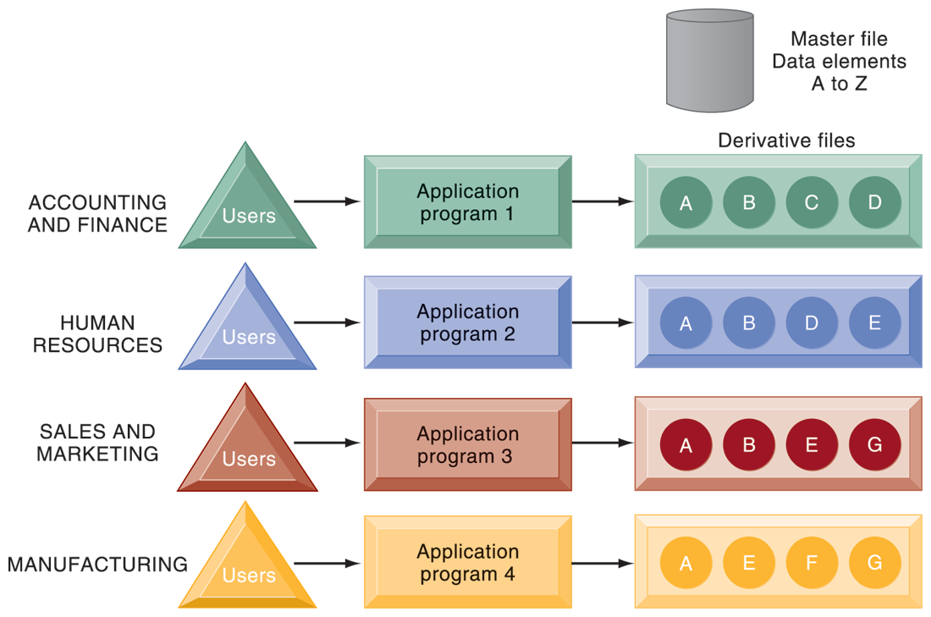
Traditional File Processing
In traditional file processing, each functional area develops specialized applications.
Each application requires a unique data file that is likely to be a subset of the master file.
These subsets of the master file lead to data redundancy and inconsistency, processing inflexibility, and wasted storage resources.

Slide 8
Database Approach to Data Management
Database
A collection of data organized to serve many applications efficiently by centralizing the data and controlling redundant data.
Data are stored in one location, rather stored in separate files.
e.g., a single HRM database contained personal, payroll and benefit records
Database Management System (DBMS)
A software that permits an organization to centralize data, manage them efficiently, and provide access to the stored data by application programs.
Acts as interface between application programs and the physical data files.
Separates logical and physical views of data.
Logical view, presents data as they would be perceived by end users or business specialists.
Physical view, shows how data are actually organized & structured on physical storage media.
Solves problems of traditional file environment.

Slide 9
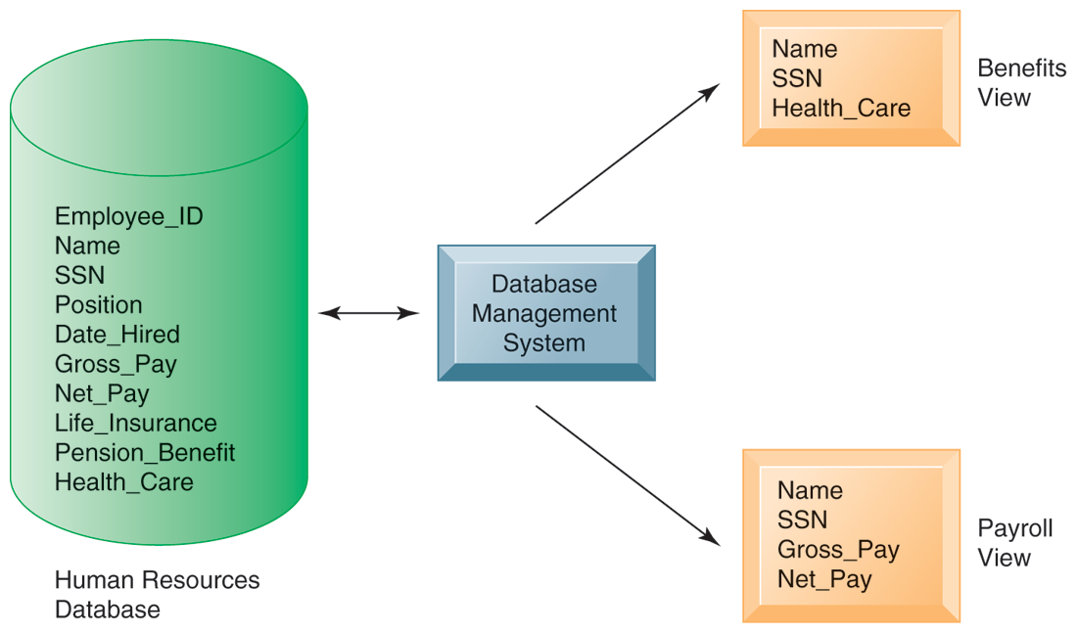
A HR Database with Multiple Views
A single human resources database provides many different views of data, depending on the information requirements of the user.
Illustrated here are two possible views, one of interest to a benefits specialist and one of interest to a member of the company’s payroll department.
Notes:
1. Orange rectangle represent two different views in an HR database, one for reviewing employee benefit and other for accessing payroll records. The students can think of the green cylinder as the physical view, which shows how the data are actually organized and stored on the physical media. The physical data do not change, but a DBMS can create many different logical views to suit different needs of users.

Slide 10
Relational DBMS (RDBMS)
Most popular type of DBMS for PCs as well as for larger computers.
Represent data as two-dimensional tables (called relations).
Tables refer to as files.
Each file contains data on an entity and its attributes.
Examples:
Microsoft Access (for desktop)
DB2, Oracle Database, Microsoft SQL Server (for large mainframes & midrange computers)
MYSQL is a popular open-source DBMS

Slide 11
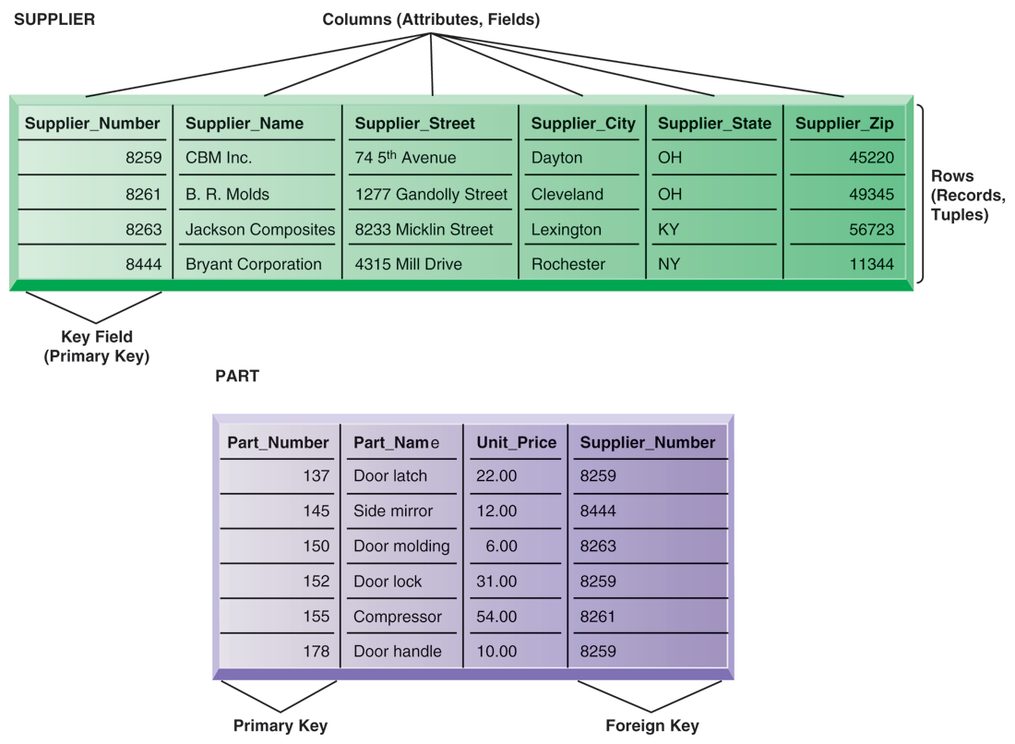
Relational Database Tables
Rows (tuples): Records for different entities
Fields (columns): Represents attribute for entity
Key field: Field used to uniquely identify each record
Primary key: Field in table used for key fields
Foreign key: Primary key used in second table as look-up field to identify records from original table

Slide 12
Operations of a Relational DBMS
Describes how information is retrieve from a relational database.
Three basic operations
Select
Creates a subset consisting of all records in the file that meet stated criteria.
In other way, it creates a subset of rows that meet certain criteria.
Join
Combines relational tables to provide user with more information than is available in individual tables.
Project
Creates a subset of columns in a table,
Creates tables with only the information required.

Slide 13
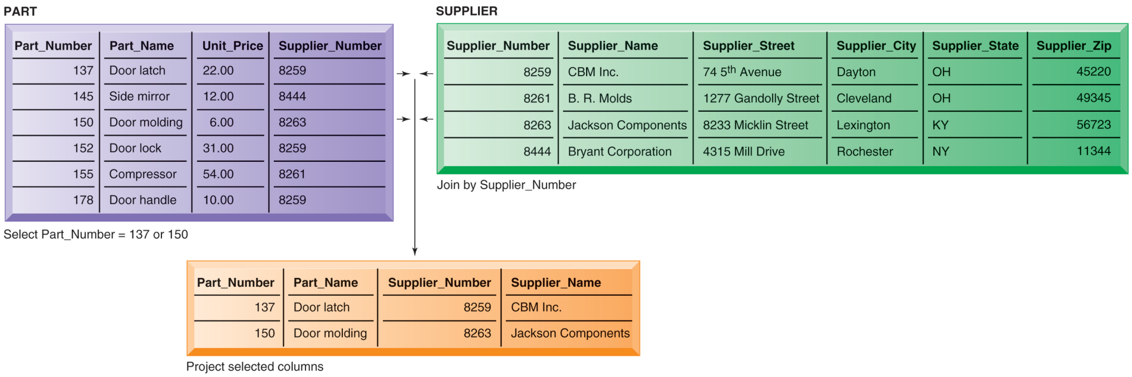
3 Basic Operations of RDBMS
The select, join, and project operations enable data from two different tables to be combined and only selected attributes to be displayed.
Task:
Select records (rows) from the PART table where the Part_Number equlas 137 or 150.
Join the new-shortened table (137 or 150 presented) and the SUPPLIER table into a single new table.
Project (extract) from the new table only the following columns: Part_Number, Part_Name, Supplier_Number, Supplier_Name.

Slide 14
Object-Oriented Database (OODBMS)
OODBMS
Stores the data and procedures that act on those data as objects that can be automatically retrieved and shared.
Objects can be graphics, multimedia, Java applets used in Web applications, which typically integrate pieces of information from a variety of sources.
Relatively slow compared with relational DBMS for processing large numbers of transactions
Hybrid object-relational DBMS: Provide capabilities of both OODBMS and relational DBMS
Databases in the cloud
Typically less functionality than on-premises DBs
Amazon Web Services (non-relational database, SimpleDB), MYSQL Azure
Notes:
A Java applet is a small application which is written in Java and delivered to users in the form of bytecode. The user launches the Java applet from a web page, and the applet is then executed within a Java Virtual Machine (JVM) in a process separate from the web browseritself. A Java applet can appear in a frame of the web page, a new application window, Sun's AppletViewer, or a stand-alone tool for testing applets. Java applets were introduced in the first version of the Java language, which was released in 1995.

Slide 15
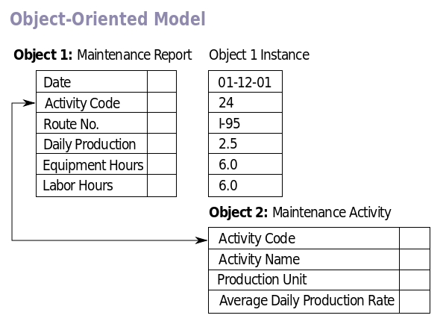
Object-oriented DBMS

Slide 16
Capabilities of Database Management System
Data definition capability
Specifies structure of database content, create database tables and define characteristics of fields in each table.
Data dictionary
Automated or manual file storing definitions of data elements and their characteristics.
Data manipulation language
Used to add, change, delete, retrieve data from database. Permits extraction of data from database.
Tool that requests operations such as SELECT and JOIN to be performed on data.
Structured Query Language (SQL)
Microsoft Access user tools for generation SQL
Many DBMS have report generation capabilities for creating polished reports (Crystal Reports).
Notes:
1. What type of data would be stored by a data dictionary: Name, description, size, type, format. For larger companies, usage, ownership, authorization, security, users)

Slide 17
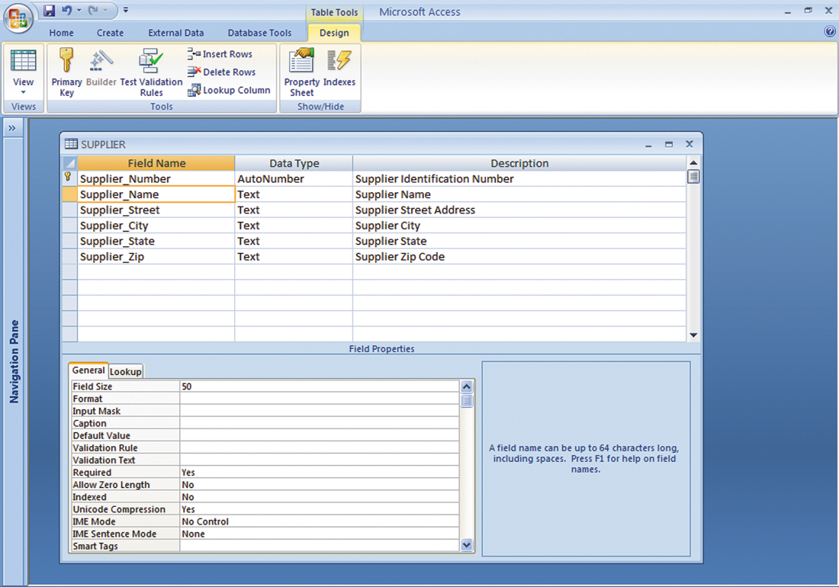
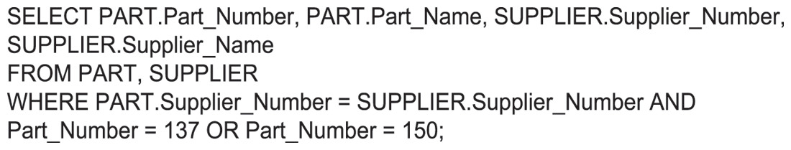
MS Access Data Dictionary and SQL Query
Notes:
Top pane: Supplier Name,
Bottom pane: General tab, shows general characteristics

Slide 18
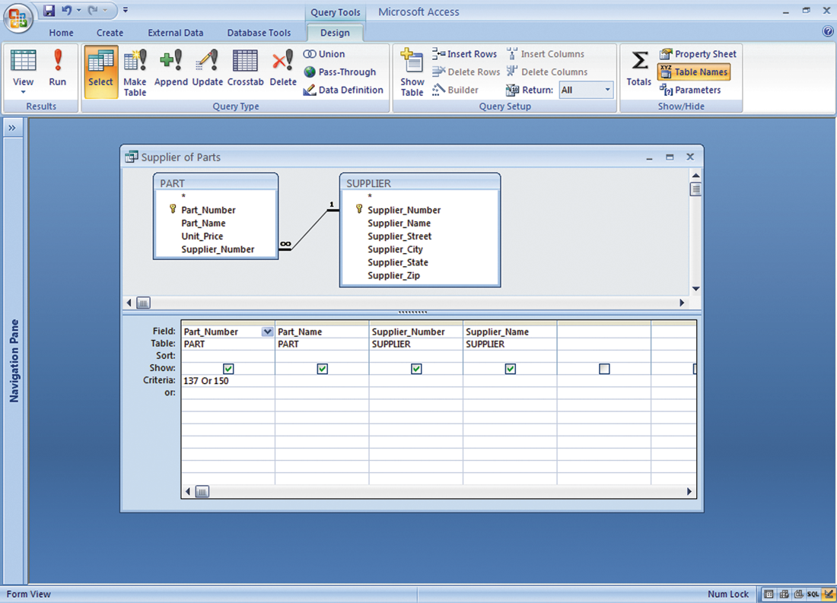
An Access Query
Illustrated is how the query would be constructed using Microsoft Access query building
tools.
It shows the tables, fields, and selection criteria used for the query.
Notes:
1. This graphic illustrates a Microsoft Access query that performs the same operation as the SQL query in the last slide. The query pane at the bottom shows the fields that are requested (Fields), the relevant Tables (Table), the fields that will be displayed in the results (Show), and the criteria limiting the results to Part numbers 137 and 150 (Criteria).

Slide 19
Designing Database
Conceptual (logical) design
An abstract model of the database from a business perspective.
Concerned with how the data elements will be grouped, what data in what tables will make the most efficient organizations.
Physical design
How the database is actually arranged on direct-access storage devices.
Design Process Identifies…..
Relationships among data elements, redundant database elements.
The most efficient way of grouping data elements
Normalization
Streamlining complex groupings of data to minimize redundant data elements & awkward many-to-many relationships.
Creating small, stable yet flexible and adaptive data structures from complex group of data.
Notes:
To create an efficient database, you must know what the relationships are among the various data elements, the types of data that will be stored, and how the organization will need to manage the data.
Note that the conceptual database design is concerned with how the data elements will be grouped, what data in what tables will make the most efficient organizations.

Slide 20
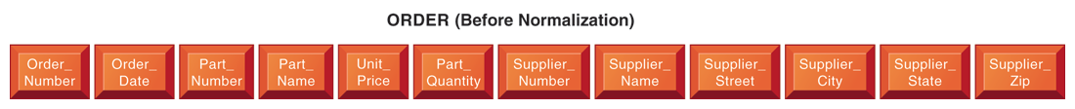
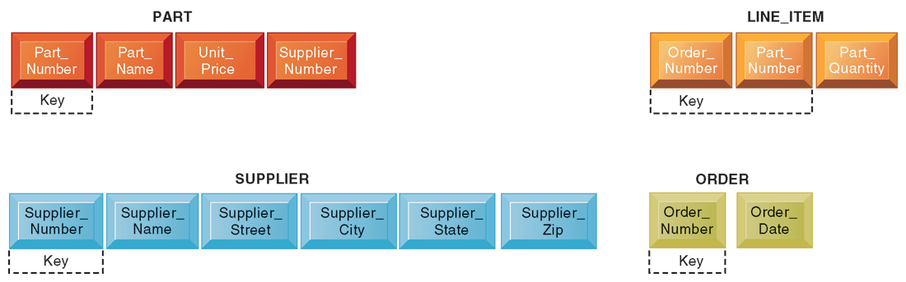
Normalization
An unnormalized relation contains repeating groups. For example, there can be many parts and suppliers for each order. There is only a one-to-one correspondence between Order_Number and Order_Date
After normalization, the original relation ORDER has been broken down into four smaller relations. The relation ORDER is left with only two attributes and the relation LINE_ITEM has a combined key consisting of Order_Number and Part_Number.
Notes:
1. The graphics on this slide and the next illustrate the process of normalization. Here, one table lists the relevant data elements for the entity ORDER. These include all of the details about the order, the part, the supplier.
An order can include more than one part, and it may be that several parts are supplied by the same supplier. However, using this table, the supplier’s name, and other information might need to be stored several times on the order list.
2. This graphic shows the normalized tables. The Order table has been broken down into four smaller, related tables. Notice that the Order table contains only two unique attributes, Order Number and Order Date. The multiple items ordered are stored using the Line_Item table. The normalization means that very little data has to be duplicated when creating orders, most of the information can be retrieved by using keys to the Part and Supplier tables.
It is important to note that relational database systems try to enforce referential integrity rules to ensure that relationships between coupled tables remain consistent. When one table has a foreign key that points to another table, you may not add a record to the table with the foreign key unless there is a corresponding record in the linked table. For example, foreign key Supplier_Number links the PART table to the SUPPLIER table. Referential integrity means that a new part can’t be added to the part table without a valid supplier number existing in the Supplier table. It also means that if a supplier is deleted, any corresponding parts must be deleted also.

Slide 21

Entity-Relationship Diagram
Database designers use this process to document the data model.
Illustrates relationships between entities SUPPLIER, PART, LINE_PART, & ORDER.
Box → entities, line → relationship
Short marks → one-to-one relationship, Crow’s foot with a short mark → one-to-many relationship
Order may contain many LINE_ITEMs (a PART can be ordered many times & appear many times as a line item in a single order)
Each PART can have only one SUPPLIER, but many PARTs can be provided by the same SUPPLIER.
This diagram shows the relationships between the entities SUPPLIER, PART, LINE_ITEM, and ORDER that might be used to model the database.
Notes:
1. This slide continues the discussion about designing databases. One technique database designers use in modeling the structure of the data is to use an entity-relationship diagram (illustrated on the next slide). Symbols on the diagram illustrate the types of relationships between entities. Ask students what different types of relationships there are between entities. (One-to-one, one-to-many, many-to-many.)
2. This graphic shows an example of an entity relationship diagram. It shows that one ORDER can contain many LINE_ITEMs. (A PART can be ordered many times and appear many times as a line item in a single order.) Each LINE ITEM can contain only one PART. Each PART can have only one SUPPLIER, but many PARTs can be provided by the same SUPPLIER.

Slide 22
Ways of using Databases to Improve Business Performance
Why should business use database?
Keep track the basic transactions, such as paying suppliers, processing orders, keeping track of customers, & paying employees.
Provide information that help to run business more efficiently
Help managers and employees to make better decisions.
To know which product is the most popular or who is the most profitable customer.
For large companies
To analyze large quantities of data
To access data from multiple systems.
Techniques
Data Warehouse & Data Marts
Online Analytical Processing (OLAP)
Data Mining, Text Mining, Web Mining, Predictive Analysis
Database and the Web

Slide 23
Data Warehouse and Data Marts
Data warehouse
Is a database that stores current and historical data from many core operational transaction systems, such as sales data, customer data, manufacturer information.
It consolidates and standardizes information from different operational databases so that information can be used across enterprise.
Data warehouse system will provide query, analysis, and reporting tools.
Data marts:
A subset of data warehouse
Summarized or highly focused portion of firm’s data is placed in a separate database for a specific population of users.
Typically focuses on single subject or line of business.
e.g., developing marketing and sales data marts to deal with customer information.

Slide 24
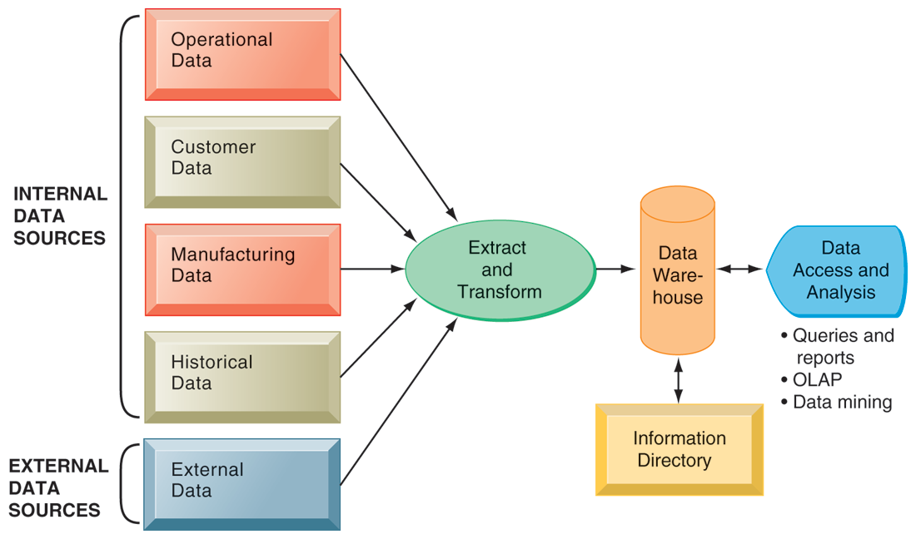
Data Warehouse: Components
The data warehouse extracts current and historical data from multiple operational systems inside the organization. These data are combined with data from external sources and reorganized into a central database designed for management reporting and analysis. The information directory provides users with information about the data available in the warehouse.

Slide 25
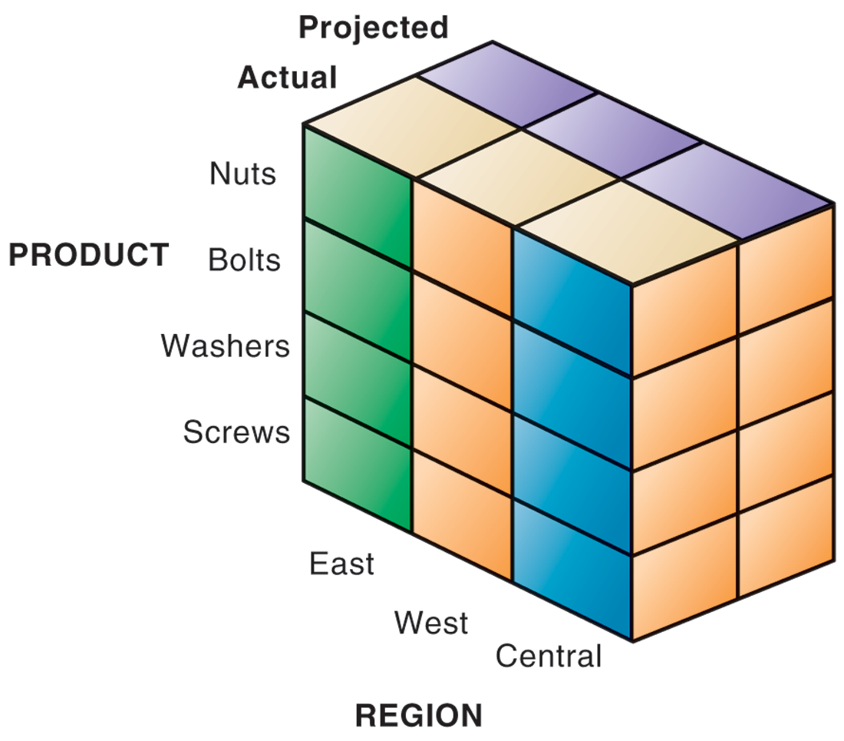
OLAP (Online Analytical Processing)
Supports multidimensional data analysis
Viewing data using multiple dimensions
Each aspect of information (product, pricing, cost, region, time period) is different dimension
e.g., how many washers sold in the East in June compared with other regions?
OLAP enables rapid, online answers to ad hoc queries
The view that is showing is product versus region. If you rotate the cube 90 degrees, the face that will show is product versus actual and projected sales. If you rotate the cube 90 degrees again, you will see region versus actual and projected sales. Other views are possible.

Slide 26
Data Mining
More discovery driven than OLAP
Finds hidden patterns, relationships in large databases and infers rules to predict future behavior.
e.g., Finding patterns in customer data for one-to-one marketing campaigns or to identify profitable customers.
Types of information obtainable from data mining
Associations, occurrence linked to a single event, e.g., corn chips and cola drink.
Sequences, events linked over time, e.g., new house and refrigerator, oven.
Classification, recognizes patterns that describe the group to which item belongs, e.g., losing/retaining of existing customers (telephone or credit card).
Clustering, similar to classification when no groups have yet been defined; finds groupings within data, e.g., partitioning a database based on demographics & types of invest or purchase.
Forecasting, uses series of existing values to forecast what other values will be, e.g., estimate the future value of continuous variables, such as sales figures.

Slide 27
Data Mining: Types
Predictive analysis
Uses data mining techniques, historical data, and assumptions about future conditions to predict outcomes of events, e.g., probability a customer will respond to an offer.
Text mining
Extracts key elements from large unstructured data sets, discover patterns & relationships. (e.g., analyze transcripts of calls of customer service centers).
Web mining
Discovery and analysis of useful patterns and information from WWW, e.g., Google Trends, Google Insights.
Understand customer behavior, evaluate effectiveness of a particular Web site, or quantify the success of a marketing campaign.
Web content mining, knowledge extracted from content of Web pages
Web structure mining, links to and from Web page
Web usage mining, user interaction data recorded by Web server.

Slide 28
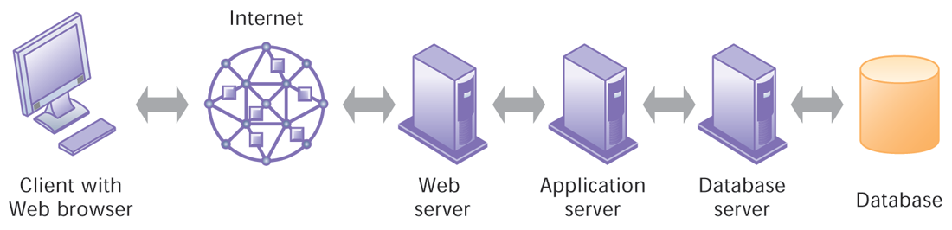
Database and The Web
Many companies use Web to make some internal databases available to customers or partners.
Typical configuration includes:
Web server
Application server/middleware/CGI scripts
Database server (hosting DBM)
Advantages of using Web for database access:
Ease of use of browser software
Web interface requires few or no changes to database
Inexpensive to add Web interface to system
Notes:
Using the Web to place an order or view a product catalog. That is, a website that linked to an internal corporate database.
Client sends a command in HTML format which processed through application server or middleware.
Many database can not read the HTML, so application or middleware convert the HTML command into SQL. Therefore, DBMS receives SQL requests and provides the required data.
The Middleware transfers information from the organization’s internal database back to the web server for delivery.

Slide 29
Managing Data Resources
Establishing an information policy
Data administration, specific policies & procedures to manage data.
Data governance, policies & processes for managing the availability, usability, integrity, & security of enterprise data.
Database administration, defining & organizing the structure & content of the database & maintain the database.
Ensuring data quality
Data quality audit, structured survey of the accuracy & level of completeness of the data.
Survey samples from data files, or
Survey end users for perceptions of quality
Data cleansing, detecting & correcting data in a database that are incorrect, incomplete, improperly formatted, or redundant.
Enforces consistency among different sets of data that originated in separate information systems.
Software is available to automatically survey data file, correct error in the data & integrate the data in a consistent company-wide format.

Slide 30
Question Please
?

