Slide 1
COMB 453: Fisheries Information Systems
Lecture 2:
Global E-business & Collaboration by
Md. Mahbubul Alam, PhD
Dept. of AEIS, SAU

Slide 2
Learning Objectives
Define and describe business processes and their relationship to information systems.
Evaluate the role played by systems serving the various levels of management in a business and their relationship to each other.
Explain how enterprise applications improve organizational performance.
Explain the importance of collaboration and teamwork in business and how they are supported by technology.
Assess the role of the information systems function in a business.
Notes:
This is a good time to get students to talk about their experience working in organizations. How is collaboration and teamwork important in their business experience? Or the lack of team work. What kinds of work experiences do your students have? What did they think were the key organizational goals where they worked? How were information systems important (or not important)?

Slide 3
Business Processes
Business processes:
  Workflows of material, information, knowledge
  Sets of activities, steps
  May be tied to functional area or be cross-functional
Businesses: Can be seen as collection of business processes
Business processes may be assets or liabilities
Notes:
Business processes are at the heart of every business. Ask students if they can give any examples of business processes that they come in contact with everyday. This could include anything from ordering a hamburger at McDonalds, to applying for a driver’s license at the DMV. Emphasize that studying a firm’s business processes is an excellent way to learn a great deal about how that business actually works. How could a business process be a liability? Think of some dysfunctional business processes or ask the students to come up with some really poor business processes.

Slide 4
Business Processes (Cont’d)
Examples of functional business processes
  Manufacturing and production
    Assembling the product
    Checking for quality
  Sales and marketing
    Identifying customers
    Making customers aware about the product
    Selling the product
  Finance and accounting
    Creating financial statements
    Managing cash accounts
  Human resources
    Hiring employees
    Evaluating employees’ job performance
Notes:
Other examples include checking the product for quality (manufacturing and production), selling the product (sales and marketing), paying creditors (finance and accounting), and evaluating job performance (human resources). You could ask students to contribute other examples of business processes and describe which of the four types they are.

Slide 5
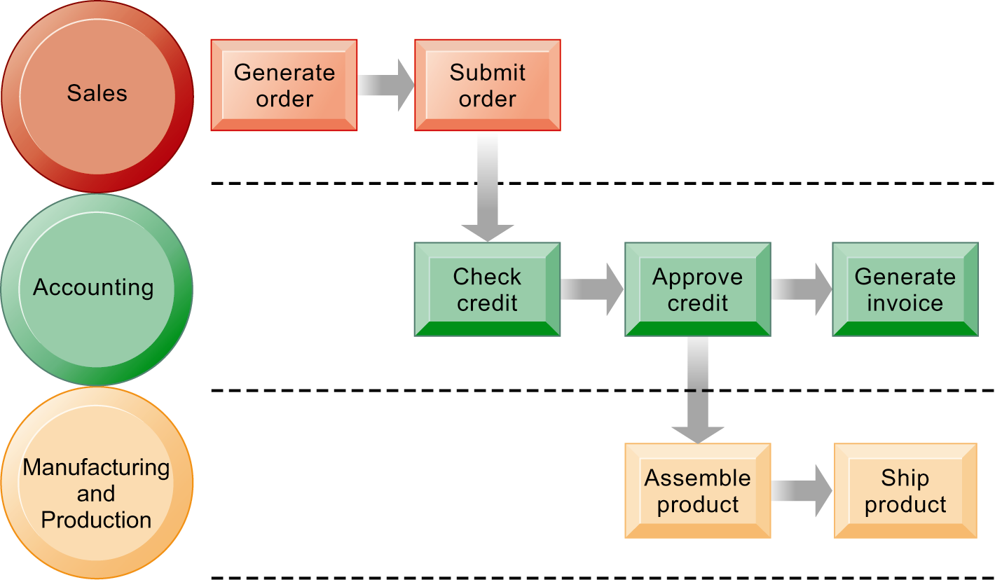
The Order Fulfillment, a business process
Functional areas
Business processes
Fulfilling a customer order involves a complex set of steps that requires the close coordination of the sales, accounting, and manufacturing functions.
Notes:
A business process or business method is a collection of related, structured activities or tasks that produce a specific service or product (serve a particular goal) for a particular customer or customers. It often can be visualized with a flowchart as a sequence of activities with interleaving decision points or with a Process Matrix as a sequence of activities with relevance rules based on the data in the process.
Emphasize that each rectangle represents one part of the larger business process of order fulfillment. Notice that this business process spans several different functional areas of the business from sales (orders), to accounting, and to manufacturing. Important business processes typically span several different functional areas or divisions in a business.

Slide 6
IS & Business Processes
Information technology enhances business processes in two main ways:
  Increasing efficiency of existing processes
    Automating steps that were manual
  Enabling entirely new processes that are capable of transforming the businesses
    Change flow of information
    Replace sequential steps with parallel steps
    Eliminate delays in decision making

Slide 7
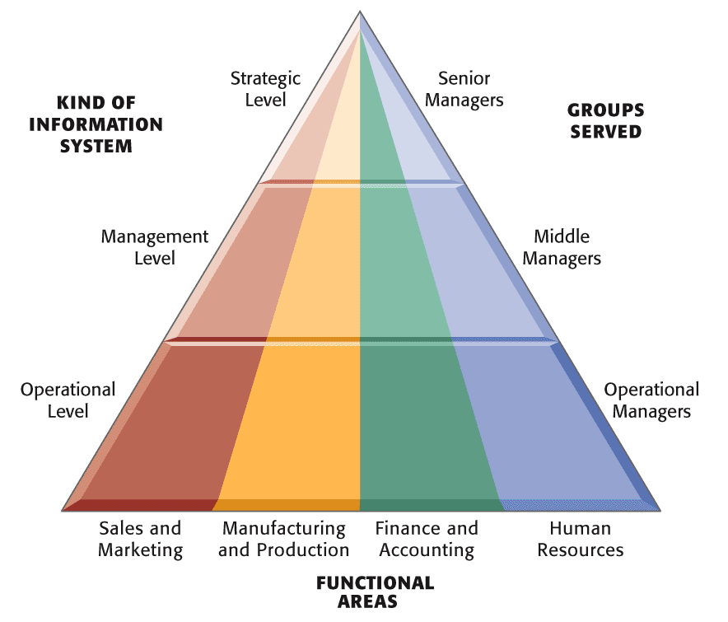
Information Systems & Functional Areas of Organization
Operational level
Support operational managers, track activities & transactions
Management level
Monitoring, controlling, decision-making, & administrative activities
Strategic level
help senior management tackle & address strategic issues
Notes:
Three main categories of IS Serves at different organizational level
Operational-level systems: support operational managers, keeping track of the elementary activities and transactions
Management-level systems: serve the monitoring, controlling, decision-making, and administrative activities
Strategic-level systems: help senior management tackle and address strategic issues

Slide 8
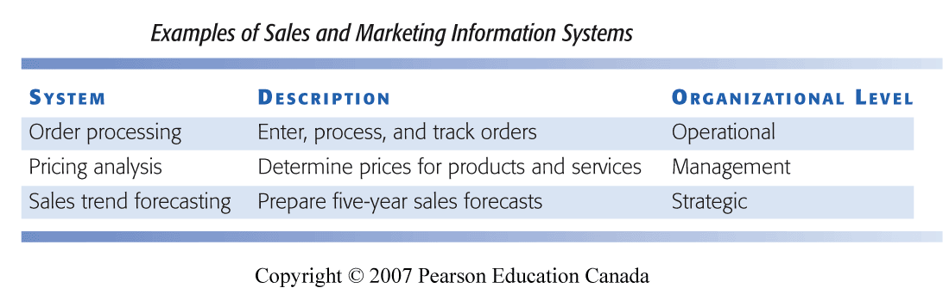
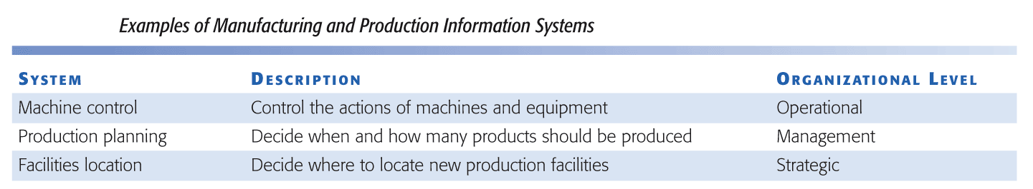
Information Systems & Functional Areas of Organization (cont’d)

Slide 9
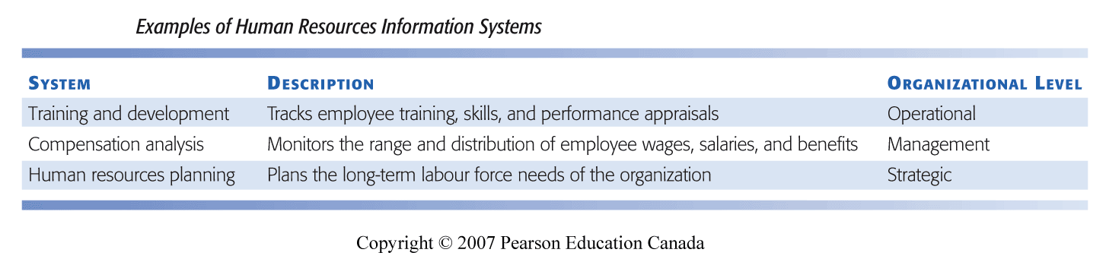
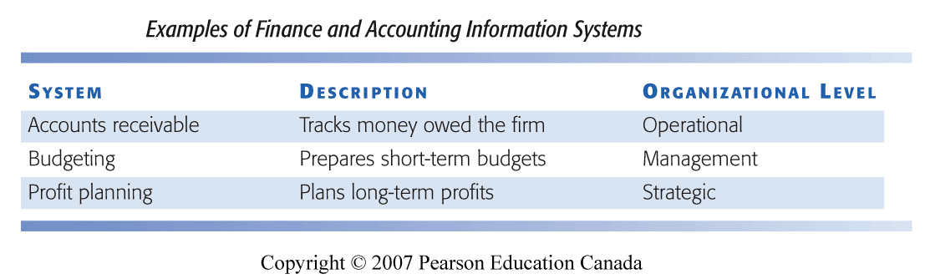
Information Systems & Functional Areas of Organization (cont’d)

Slide 10
Transaction processing systems
  Perform and record daily routine transactions necessary to conduct business
    Examples: sales order entry, payroll, shipping
  Allow managers to monitor status of operations and relations with external environment
  Serve operational levels
  Serve predefined, structured goals and decision making
Notes:
The purpose of these systems is to answer routine questions about the flow of transactions through the organization. These systems are a necessity for any business.

Slide 11
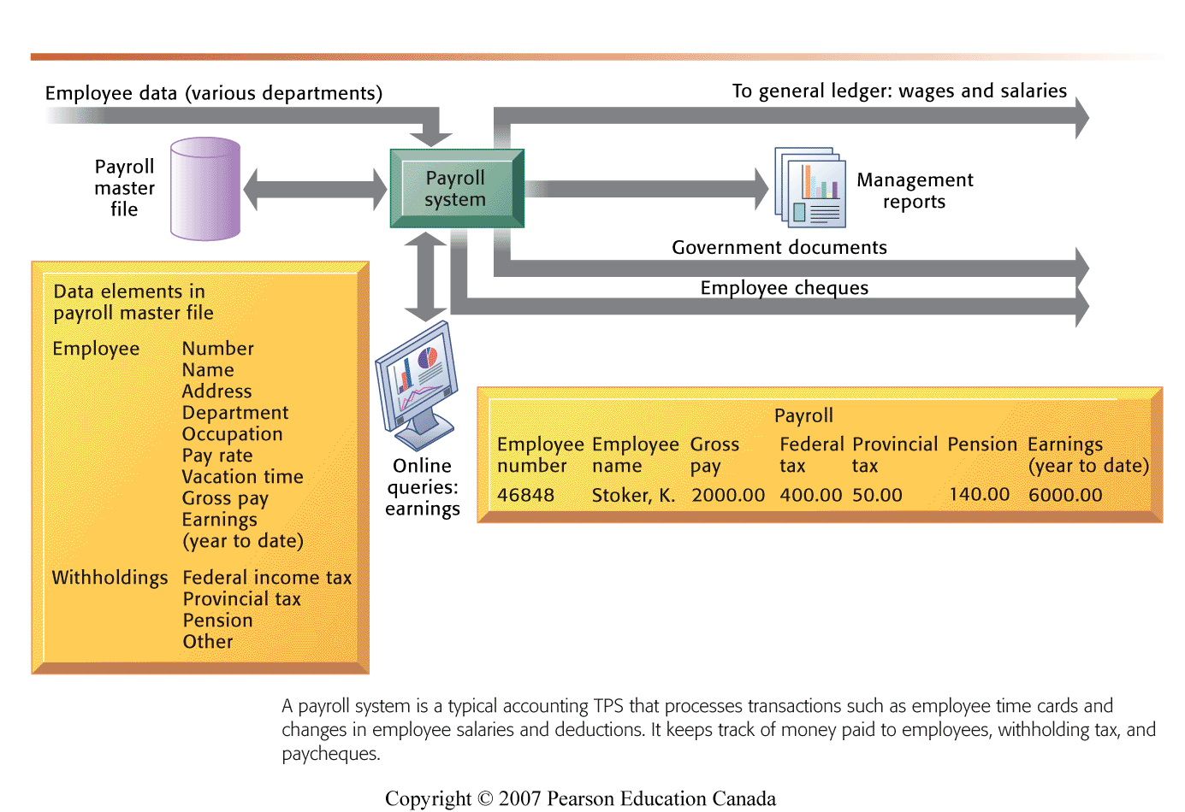
Payroll Process (TPS )
A TPS for payroll processing captures employee payment transaction data (such as a time card). System outputs include online and hard-copy reports for management and employee paychecks.
Notes:
Note that the outputs of the payroll system are useful not only within the company to managers, but also to regulatory agencies and other entities relying on the accuracy of the reported data.
Input-Employees’ payment transaction data
Output- online and hard-copy reports
Produce reports-e.g., income, expenses, balance sheets, employee’s payment history, tax & insurance

Slide 12
Management Information Systems
  Serve middle management
  Provide reports on firm’s current performance, based on data from TPS
  Provide answers to routine questions with predefined procedure for answering them
    e.g., summary or comparison of total sales figures for specific product
  Typically have little analytic capability
  MIS Vs. IS?
Notes:
Emphasize to students that management information systems is a specific category of information systems for middle management. It has the same name, but a very different meaning from the term introduced in Chapter 1 (the study of information systems in business and management). In other words, the study of management information systems involves looking at all the systems used in business. An MIS system is a specific type of an IS. It’s easy to get the two confused.

Slide 13
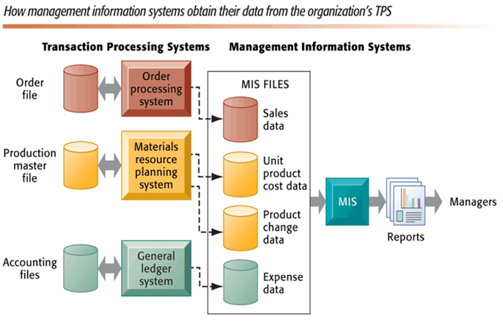
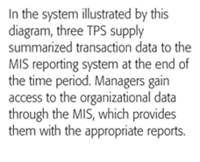
MIS & TPS
Notes:
Emphasize the relationship between TPS and MIS here. MIS receive data from an organization’s TPS systems and create outputs that management can use to make strategic decisions.
MIS provides reports on org’s “current performance”
Weekly, monthly & yearly reports

Slide 14
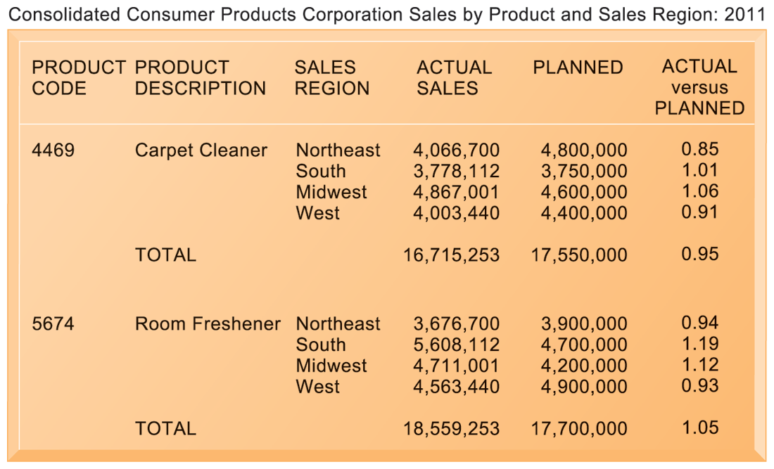
Sample MIS Report
Notes:
This graphic represents the “reports” portion of the previous figure, 2-3. Emphasize this to students, perhaps referencing that slide again to drive home that point. Students may not understand the decimals in the “ACTUAL versus PLANNED” category, where anything above 1.00 represents more sales than planned and anything less represents a disappointing result of fewer sales than planned.

Slide 15
Decision Support Systems
Serve middle management
Support non-routine decision making
  Focus on problems that are unique & rapidly changing
  Example: What is impact on production schedule if December sales doubled?
  What would happen to our return on investment if a factory schedule were delayed for six months?
Often use information from
  External sources: e.g., stock prices, product prices of competitors
  Internal sources: e.g., TPS, MIS
Model driven DSS
    Voyage-estimating systems, calculates financial & technical voyage details
Data driven DSS
    Intrawest’s marketing analysis systems, collects & stores large amounts of customer data
    Analyze data to determine value, revenue potential & customer loyalty
Notes:
Model driven DSS: Voyage, Shipping company
Financial calculation: ship/time cost (fuel, labor, capital), port costs, freight rates.
Technical cost: ship cargo capacity, port distances, fuel and water consumption, loading patterns
Given a delivery schedule and an offered freight rate, which vessel should be assigned at what rate to maximise profits?
What is the optimal speed at which a particular vessel can maximize its profits and still meet its delivery schedule? Or, what is the optimal loading pattern?
Intrawest ltd.
Ski operator in North America

Slide 16
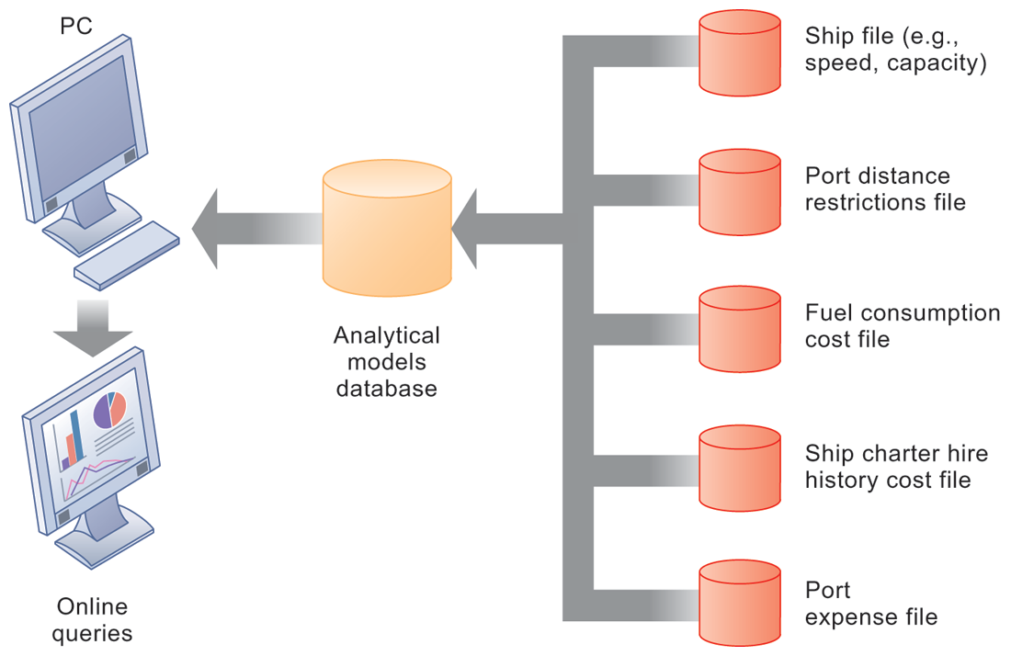
Decision Support Systems
This DSS operates on a powerful PC. It is used daily by managers who must develop bids on shipping contracts.
Notes:
DSS can rely on either analytical models or large databases to provide valuable information. You could ask which of these two types the above figure best resembles (analytical models). You could also ask them what types of decisions does this system help its users make? Examples include what vessels to send to particular destinations to maximize profit, the optimal loading pattern for cargo, and the optimal rate at which vessels should travel to maximize efficiency while still meeting their schedules, and so forth.

Slide 17
Business Intelligence (BI)
Class of software applications
Analyze current and historical data to find patterns and trends and aid decision-making
Used in systems that support middle and senior management
  Data-driven DSS
  Executive support systems (ESS)
    e.g.,
    What are the long-term industry cost trends, & where does our firm fit in?
    What new acquisitions would protect us from cyclical business swings?
Notes:
This slide emphasizes the relationship between the class of software called “business intelligence” and the decision-support systems used by middle and senior management, DSS and ESS. Business intelligence is a type of software used in analyzing data, and is used in both DSS and ES. As an example, the BMW Oracle boat described in the chapter opening case was using business intelligence – the software analyzed huge amounts of data, including real-time data, to determine hidden factors and correlations that make a sailboat go faster, and help the sailors make decisions in navigating and managing the boat.

Slide 18
Executive Support Systems
Support senior management
Address non-routine decisions
  requiring judgment, evaluation, and insight
  presents graphs & data from many sources
Incorporate data about external events (e.g. new tax laws or competitors) as well as summarized information from internal MIS and DSS
  e.g., Digital dashboard presents real-time graphical overview (graphs & charts) of firm’s key performance indicators
    working capital, accounts receivable, accounts payable, cash flow, and inventory
Notes:
Emphasize the connection between ESS, MIS, and DSS. ESS rely on accurate inputs from a firm’s MIS and DSS to provide useful information to executives. These systems should not exist in isolation from one another. If they are isolated from each other, it is a kind of organizational dysfunction, probably inherited from the past. Note that the digital dashboard is a common feature of modern-day ESS. Emphasize that a critical feature of ESS is ease of use and simplicity of display. Executives using an ESS want quick access to the most critical data affecting their firm.
Digital dashboard- displays graphs and charts on a screen.

Slide 19
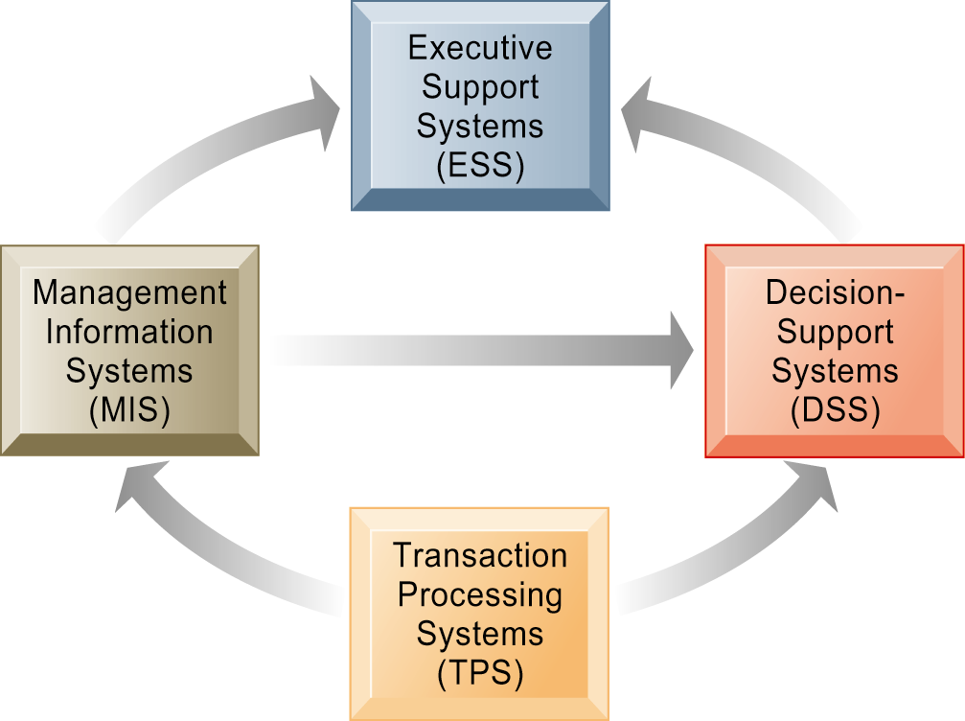
Systems from a constituency perspective and interrelationships
  Transaction processing systems: supporting operational level employees
  Management information systems and decision-support systems: supporting managers
  Executive support systems: supporting executives
Relationship of systems to one another
TPS: Major source of data for other systems
ESS: Recipient of data from lower-level systems
Data may be exchanged between systems
Notes:
This slide is a recap of the previous slides describing these types of systems. In a constituency perspective, systems are distinguished on the basis of who uses the system– operational managers, middle management, senior management. Systems are often designed to fit the specific needs of each of these groups in a firm. These groups form “constituencies” that CIOs must appeal to for support.
This slide once again emphasizes the relationship between different types of systems, but explain that actually achieving such a high level of integration is rare. You could ask students to offer reasons why it might be difficult to do this. Firms have been and continue to make large investments in enterprise-wide systems that promise to integrate the many data flows that exist in all large organizations.

Slide 20
Enterprise Applications
Systems that
  Span functional areas
  Focus on executing business process including all levels of management across the business firm
  Support organization-wide process of coordination and integration.
4 major enterprise applications
  Enterprise systems (ERP)
    Linking the enterprise
  Supply chain management systems
    Inter-organizational system
  Customer relationship management systems
  Knowledge management systems
    Capturing and applying knowledge and expertise.
Notes:
Enterprise applications are used to manage the information used in the systems discussed previously. In other words, enterprise applications are used to ensure that TPS, MIS, DSS, and ESS work together smoothly.

Slide 21
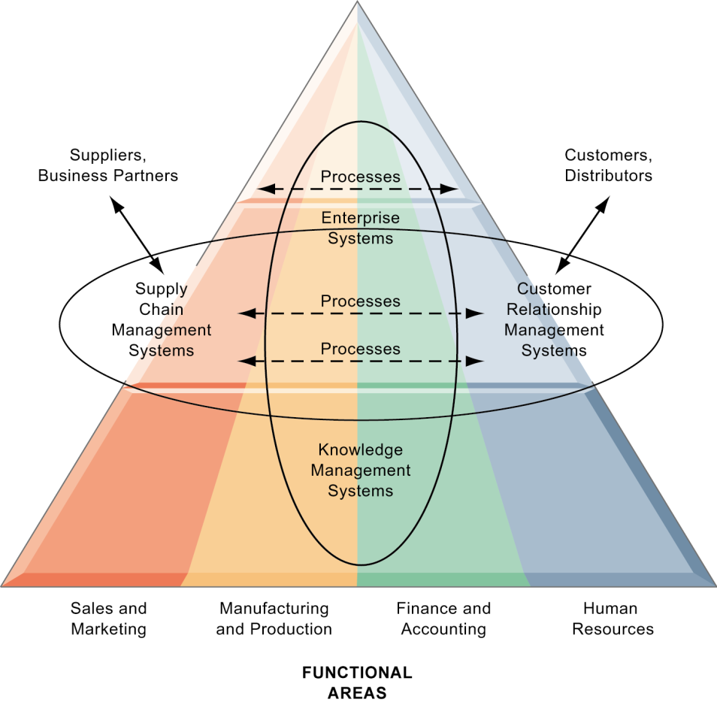
Enterprise Application Architecture
Enterprise applications automate processes that span multiple business functions and organizational levels and may extend outside the organization.
Notes:
The purpose of this graphic is simply to illustrate that enterprise systems are very large and diverse databases that pull information from many parts of the firm and enable processes both across the firm, at different organizational levels, as well as with suppliers and customers.
The triangle represents the organization, with different colors for the four main business functions. The ovals show that an enterprise application architecture incorporates systems used in sales and marketing, enabling these to communicate with each other and externally, with suppliers and customers. It also incorporates information supplied by knowledge management systems, manufacturing and finance systems, and other enterprise systems. The purpose of incorporating data and information from all of these sources is to enable and automate cross-functional business processes and supply accurate information to aid decision making.

Slide 22
Enterprise Systems
Also known as enterprise resource planning (ERP) systems
Collects data from different systems and stores data in a single central data repository
Resolves problem of fragmented, redundant data sets and systems
Enable:
  Coordination of daily activities
  Efficient response to customer orders (production, inventory)
  Provide valuable information for improving management decision making

Slide 23
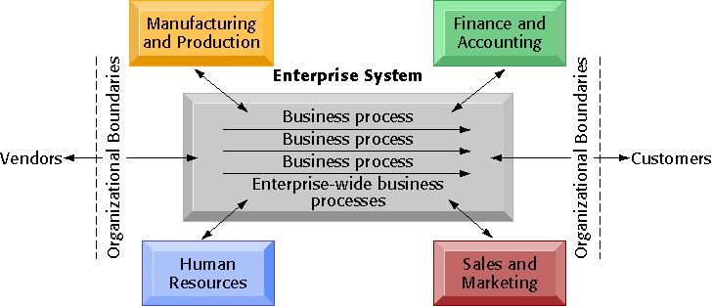
Enterprise Systems

Slide 24
Supply Chain Management (SCM)
Manage firm’s relationships with suppliers
Share information about
  Orders, production, inventory levels, delivery of products and services
The close linkage and coordination of activities involved in buying, making, and moving a product
SCM integrates business processes to speed information, product, and fund flows up and down a supply chain
Goal:
  Reduces time, redundant effort, and inventory costs
One type of interorganizational system
  Automate the flow of information across organizational boundaries

Slide 25
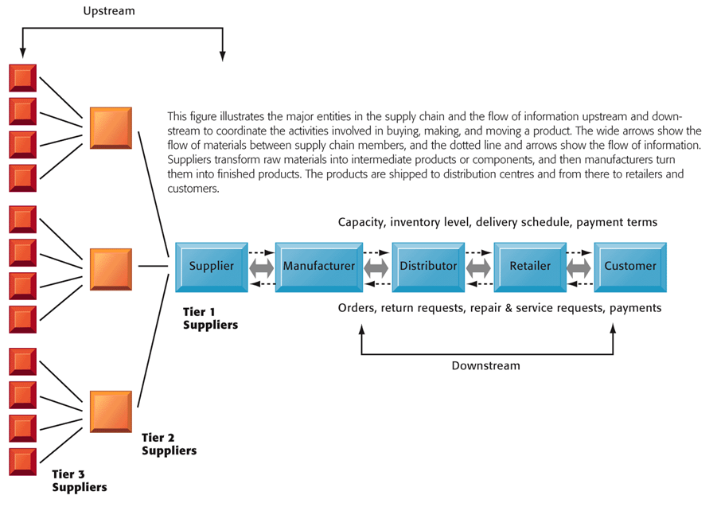
Supply Chain Management

Slide 26
Customer Relationship Management (CRM)‏
Business and technology discipline for managing customer relationships to optimize revenue, profitability, customer satisfaction, and customer retention
Applications of a CRM system
  Capture and integrate customer data from all over the organization
  Consolidate and analyze the data
  Distribute results to various systems and customer touch points across the enterprise
  Provide a single touch point for the customer
Notes:
Customer relationship management (CRM) is a widely implemented model for managing a company’s interactions with customers, clients, and sales prospects.

Slide 27
Knowledge Management Systems (KMS)
Support processes for acquiring, creating, storing, distributing, applying, integrating knowledge
  How to create, produce, distribute products and services
Collect internal knowledge and experience within firm and make it available to employees
  Link to external sources of knowledge
4 systems
  Knowledge discovery systems
  Knowledge capture systems
  Knowledge sharing systems
  Knowledge application systems
Notes:
The idea that business firms are repositories of knowledge may be new to many students. Ask students for examples of firm knowledge; for instance, the knowledge required to run a fast food restaurant, or the knowledge required to operate a Web site like Amazon.
Explain that knowledge management systems are useful for helping a firm’s employees understand how to perform certain business processes or how to solve problems. What might the consequences be for a firm with poor knowledge management systems?

Slide 28
Other Systems
Intranets
  Internal company Web sites accessible only by employees
Extranets
  Company Web sites accessible externally only to vendors and suppliers
  Often used to coordinate supply chain
E-business
  Use of digital technology and Internet to drive major business processes
E-commerce
  Subset of e-business
  Buying and selling goods and services through Internet
E-government
  Using Internet technology to deliver information and services to citizens, employees, and businesses
Notes:
Enterprise applications are typically extremely expensive as well as difficult to implement. Ask students why this would be so…
Intranets and extranets use Internet technology to communicate internally to employees, allow employees to communicate with each other and share documents, and to help communication with vendors. They are essentially password protected Web sites. The simplest intranets and extranets may use static web pages to relay information, while more sophisticated versions may be database-driven and enable key business processes. Ask students if they have used an intranet or extranet before and what services or information it provided. Does their school have an intranet/extranet? Generally universities have a Web site with different levels of access for the general public, registered students, faculty and administrators. The public-facing part of the Web site can be thought of as the “extranet,” while the part of the Web site serving students and faculty can be thought of as the “intranet.” These terms (intranet and extranet) are fading from use, but students will occasionally find firms still using these terms.
The use of Internet technology has transformed and continues to transform businesses and business activity. This slide aims to distinguish different terminology used in the book. E-business refers to the use of the Internet and networking to enable all parts of the business, while e-commerce refers to just that part of business that involves selling goods and services over the Internet.
Internet technology has also brought similar changes in the public sector – the use of Internet and networking technologies in government is referred to as e-government. Ask students what changes in businesses or government due to new Internet technologies they have noticed.

Slide 29
Systems for Collaboration and Teamwork
Collaboration is working with others to achieve shared and explicit goals.
Why collaborate?
  Changing nature of work
  Growth of professional work
  Changing organization
  Changing scope of the firm
  Emphasis on innovation
  Changing culture of work
  and business
Advantages
Quality
Innovation
Customer service
Financial performance (profitability, sales, and sales growth)
Productivity

Slide 30
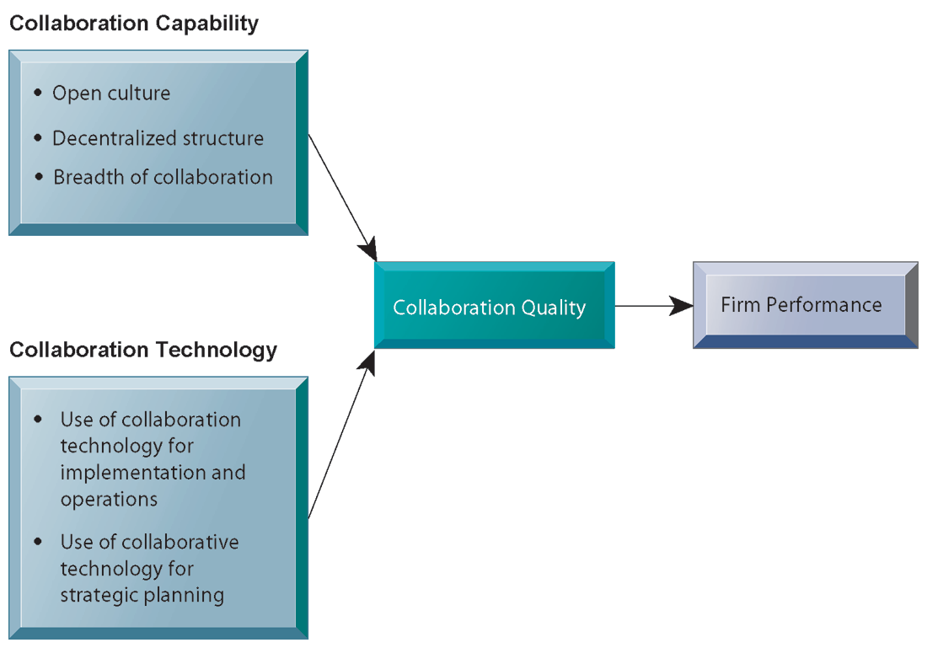
Systems for Collaboration and Teamwork
Successful collaboration requires an appropriate organizational structure and culture, along with appropriate collaboration technology.
Notes:
This slide graphically describes how collaboration is believed to impact business performance. Two primary ingredients are needed: Collaboration capability (including how much collaboration is possible) and collaboration technology or means. The quality of these two factors directly affects firm performance – the higher quality of collaboration means better firm performance. Ask students how collaboration can be high or low quality? An example of low-quality collaboration could be a team put together to solve a business problem but is unable to effectively work together because of internal politics. Have students any experience of poor collaboration?

Slide 31
Collaboration Tools
  E-mail and instant messaging
  Collaborative writing/editing
  Event scheduling
  File sharing
  Screen sharing
  Audio/Video conferencing
  White boarding
  Web presenting
  Work scheduling
  Document sharing (including wikis)
  Mind mapping
  Large audience Webinars
  Co-browsing
  Social Networking
  Wikis
  Virtual Worlds
  Internet-Based Collaboration Environments
    Virtual meeting systems (telepresence)
    Google Apps/Google sites
    Microsoft SharePoint
    Lotus Notes
Notes:
Information systems enable collaboration. There are thousands of tools available ranging from free to very expensive. Ask students which of these tools they have used for work or schoolwork – and which of these they have found the most useful.
The text goes into more depth on each of these tools. Give an example for each type of tool . A business use of social networking is Facebook accounts for businesses; using wiki’ as extended, more complete FAQs, and virtual worlds to conduct online meetings for employees around the world. Distinguish these individual tools from Internet-based collaboration environments, which are suites of collected collaboration tools, enabling communication and data-sharing between tools.

Slide 32
Technology & Tools
Telepresence technology
  an integrated audio and visual environment that allows a person to give the appearance of being present at a location other than his or her true physical location.
Microsoft SharePoint
  Most widely used collaboration system
  A browser-based collaboration & document management platform, combined with a powerful search engine that is installed in corporate servers.
  It can be used to host Web sites that organize and store information in one central location to enable teams to coordinate work activities, collaborate on and publish documents, maintain task lists, implement workflows, and share information via wikis, blogs, and Twitter-style status updates.

Slide 33
SharePoint’s major capabilities
Provides a single workspace for teams to coordinate schedules, organize documents, and participate in discussions, within the organization or over an extranet.
Facilitates creation and management of documents with the ability to control versions, view past revisions, enforce document-specific security, and maintain document libraries.
Provides announcements, alerts, and discussion boards to inform users when actions are required or changes are made to existing documentation or information.
Supports personalized content and both personal and public views of documents and applications.
Provides templates for blogs and wikis to help teams share information and brainstorm.
Provides tools to manage document libraries, lists, calendars, tasks, and discussion boards offline, and to synchronize changes when reconnected to the network.
Provides enterprise search tools for locating people, expertise, and content.
Lotus Notes for Very Large Firms,
Notes:
Lotus note, every participants able to see and display information from others and other activities.
Gropware collaboration and electronic meetings

Slide 34
Dimensions of Collaboration Technologies
Two dimensions of collaboration technologies
  Space (or location) – remote or colocated
  Time – synchronous or asynchronous
Six steps in evaluating software tools
  What are your firm’s collaboration challenges?
  What kinds of solutions are available?
  Analyze available products’ cost and benefits
  Evaluate security risks
  Consult users for implementation and training issues
  Evaluate product vendors
Notes:
When evaluating collaboration tools for your businesses, the first step is to identify the kind of problem you have. The key problems are time and location. Generally, no one has enough time and often key people are not in the right place. Some teams may need to work together in real-time, while others may simply need shared documentation. In analyzing collaboration tools by the space/time dimensions you can determine what types of tools will solve your problem. The six steps in evaluating software is applicable not only for collaboration tools but any software solution for your company. First determine the challenge or problem, look for solutions for this particular problem and so forth.

Slide 35
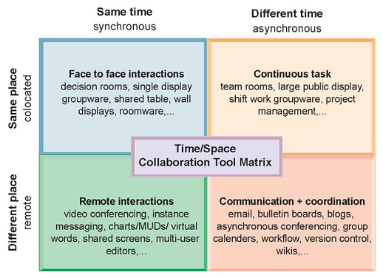
TIME/SPACE COLLABORATION TOOL MATRIX
Collaboration technologies can be classified in terms of whether they support interactions at the same or different time or place whether these interactions are remote or co-located.

Slide 36
IS DEPARTMENT
Programmers
  highly trained technical specialists who write the software instructions for computers.
Systems analysts
  constitute the principal liaisons between the information systems groups and the rest of the organization.
Chief Information Officer (CIO)
  A senior manager who oversees the use of information technology in the firm
Chief Security Officer (CSO)
  in charge of information systems security
Notes:
Defined simply, the information systems department of a firm is responsible for coordinating all of the systems previously mentioned in this chapter. How the department is organized depends on the nature and size of the business. Small companies may not have a formal department, while large companies may have several departments for different business functions, or they have an IT Department in each corporate division. Ask students what types of information systems departments they have had experience with.

Slide 37
IS DEPARTMENT (cont’d)
Chief Privacy Officer (CPO)
  responsible for ensuring that the company complies with existing data privacy laws
Chief Knowledge Officer (CKO)
  responsible for the firm’s knowledge management program.
End users
  representatives of departments outside of the information systems group for whom applications are developed.
IT Governance
  Strategies and policies for using IT in the organization
  Decision rights
  Accountability
  Organization of information systems function
    Centralized, decentralized, etc.

Slide 38
Question Please
?

