Slide 1
AEIS 529: Livestock Extension Chapter 2: Extension Communication
Prof Md Mahbubul Alam, PhD
Dept. of AEIS, SAU

Slide 2
Outline
Concept of Extension Communication
Types and forms of communication
Models of communication
Elements of communication process
Feedback
Communication Pattern in Organization

Slide 3
Concept of Communication

Slide 4
Communication
An act of transferring information from one place, person or group to another.
Basic Elements
Sender
Message
Receiver
Two way process of conveying information, ideas, feelings or opinion between two or more persons either verbally or non-verbally using a medium.
“Shared (Common) understanding”

Slide 5
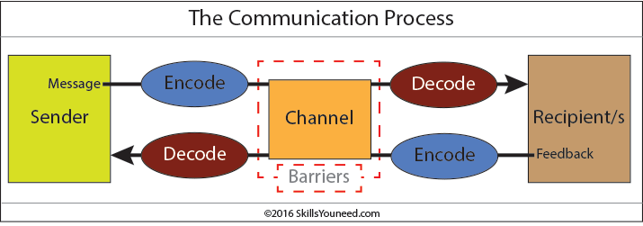
Sender encodes the message into a form that is appropriate to the communication channel, and the receiver(s) decodes the messages to understand its meanings and significance.
Feedback helps sender as to how the message is understood and attempt to correct any misunderstanding.
Receivers use techniques such as clarification and reflection as effective ways to ensure that the message sent has been understood correctly.

Slide 6
Types and Forms of Communication

Slide 7
Types of Communication
Communication
Based on Channel
Based on Purpose
Verbal Communication
Non-verbal Communication
Visual Communication
Formal Communication
Informal Communication
Oral Communication
Written Communication
Vertical Communication
Horizontal Communication
Diagonal Communication

Slide 8
7C’s Communication
Clarity
Completeness
Concreteness
Conciseness
Coherence
Courtesy
Correctness

Slide 9
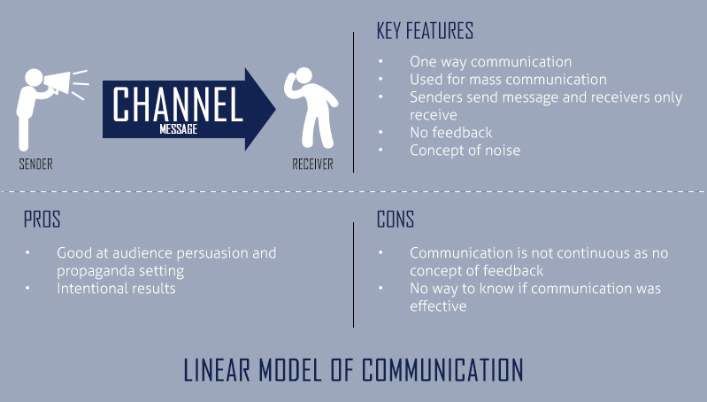

Slide 11
Models of Communication

Slide 12
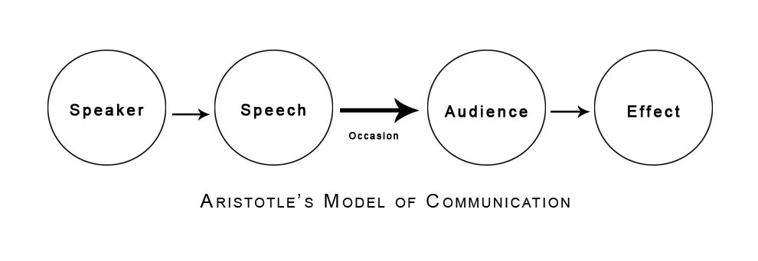
Speaker prepares different speeches for different audience on different time (i.e. occasion) and for different effects.
Notes:
It is about 2000 yrs old model
Represents interpersonal and Face to Face Communication

Slide 13
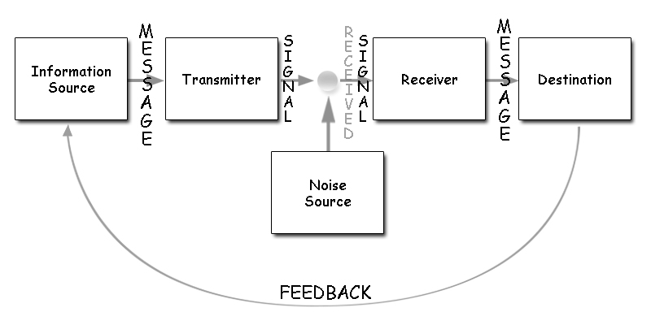
Shannon-Weaver Model (1949)
Notes:
Telephone cables and radio wave as channels of communication.
How maximum messages can be sent through a particular channel and how to ascertain the efficiency of carrying messages.
It is linear model.
Highly related to mathematics and engineering.
First four elements are functional ingredients and last one is called dysfunctional ingredient.

Slide 14
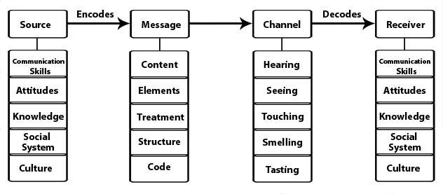
Berlo’s Model (1960)
Notes:
S-M-C-R Model
Limitations: No feedback, no concept of noise or barrier, linear model no two-way communication,

Slide 15
Leagan’s Model of Community (1961)
A process by which two or more people exchange ideas, facts, feelings, impressions, in ways that each gains a clear understanding of the meaning, intent and use of the message.
Communication
Message
Channel
Treatment
Audience
Response
Successful communication in extension education requires a skilled communicator sending a useful message through a proper channel, effectively treated to an appropriate audience responds as desired.
Notes:
Response: “reaction to something”, means feedback which taps basic human needs to improve, to compete, to be accurate.

Slide 16
Rogers & Shoemaker’s Model of Community (1971)
A source sends a message via certain channel to the receiving individual which causes some effects, i.e. changing the existing behavior pattern of the receiver.
Communication
Message
Channel
Receiver
Effects
Communication, in extension, as two way ‘stimulus response’ situation in which the necessary stimulus is provided by the communicator, the extension worker, in the form of a message, which produces certain response on the audience, the farmers, and vice-versa. A favorable response by the audience reinforces learning.
Notes:
Response: “reaction to something”, means feedback which taps basic human needs to improve, to compete, to be accurate.

Slide 17
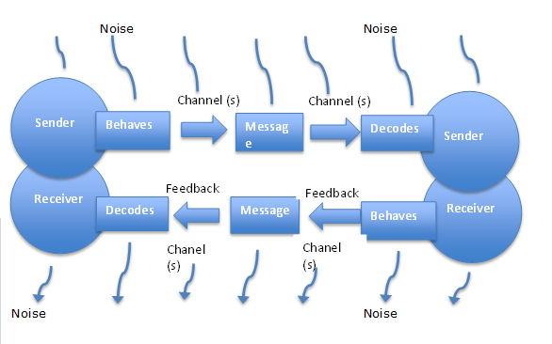
Transactional Model of Communication
Exchange of message where each take turns to send or receive messages.
Both sender and receiver are known as communicators and their role reverses each time in the communication process.
Notes:
Mostly used for interpersonal communication and is also called circular model of communication.
Both sender and receiver are important to keep the communication alive.
Transactional is not possible if receiver not listening.
General model, e.g. everyday talk and interactions.
Factors: Social (e.g. norms, values, laws; greetings, thanking; the way a person communicate), Cultural (e.g. lifestyle & identity, e.g. race, ethnicity, gender; same cultural group, better communication;, Relational context (relationship history and manners; e.g. a person talks with an old friend differently than a stranger)
Criticism: As the communication is simultaneous, noise might be higher; when more people talk simultaneously in a meeting, communication purpose may be compromised.

Slide 18
Elements of Communication

Slide 19
Elements of Communication Process
Communicator, a person who puts the process into operation,
Communication Manager, Communication Technician, Pseudo-Communicator
Message, is the information a communicator wishes his audience to receive, understand accept and act upon.
Treatment of Message, the way a message is handled, dealt with, so that information gets access to the audience,
Channel, the medium through which information flows from a sender to one or more receivers,
Audience, the last destination of the communication process,
Audience Response, how the audience acted upon the messages, (result of communication process), both mental and physical
Notes:
Communication Manager: initiate communication, Technician encodes the message, Pseudo-communicator sends or presents the message but nothing to do with actual content of the message.
Treatment of message: Factors: Choice of the channel and audience type.

Slide 20
Channel: Classification
Channel
Interpersonal channels
(e.g.Face-to-Face)
Cosmopolite channel
(e.g. Extension workers, Development experts)
Mass Media
(e.g. Radio, TV, Web, Publication)
Localite channel
(e.g. Opinion leader, neighbor, F&F, input dealers)
Notes:
1. Cosmopolite channel: carriers of technological information bringing from the outside of the receivers’ own social system.

Slide 21
Feedback

Slide 22
Feedback
Transmission of receiver’s reaction to the sender,
Enables sender to adjust his performance to the needs and responses of the audience,
“action-reaction interdependence” , evaluates the effectiveness of the communication process,
Mass Media vs. Interpersonal Media
Importance: removes noise in communication, provides fidelity of communication, controls effect of next course of action
Type: Positive Vs. Negative
Notes:
1. Communication process never end without feedback.

Slide 23
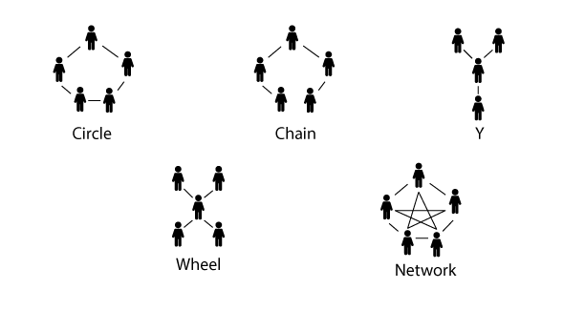
Communication Patterns in Organization
Harold J. Leavitt (1950)
Ref. https://www.businesstopia.net/communication/communication-patterns
Notes:
1. Structures in which communication flows in organization.

Slide 24
Thank you

