Slide 1
AEIS 529: Livestock Extension Chapter 3: Learning and Motivation
Prof Md Mahbubul Alam, PhD
Dept. of AEIS, SAU

Slide 2
Outline
Principles and Laws of Learning
Teaching-Learning Process in Extension
Concept of Motivation and its Application

Slide 3
Principle and Laws of Learning

Slide 4
Learning
An experimental process
Resulting in a relatively permanent change
Elements:
Learning involves a behavioral change which can be better or worse.
This behavioral change should take place as a result of practice and experience.
This behavioral change must be relatively permanent and last for a relatively long time enough.

Slide 5
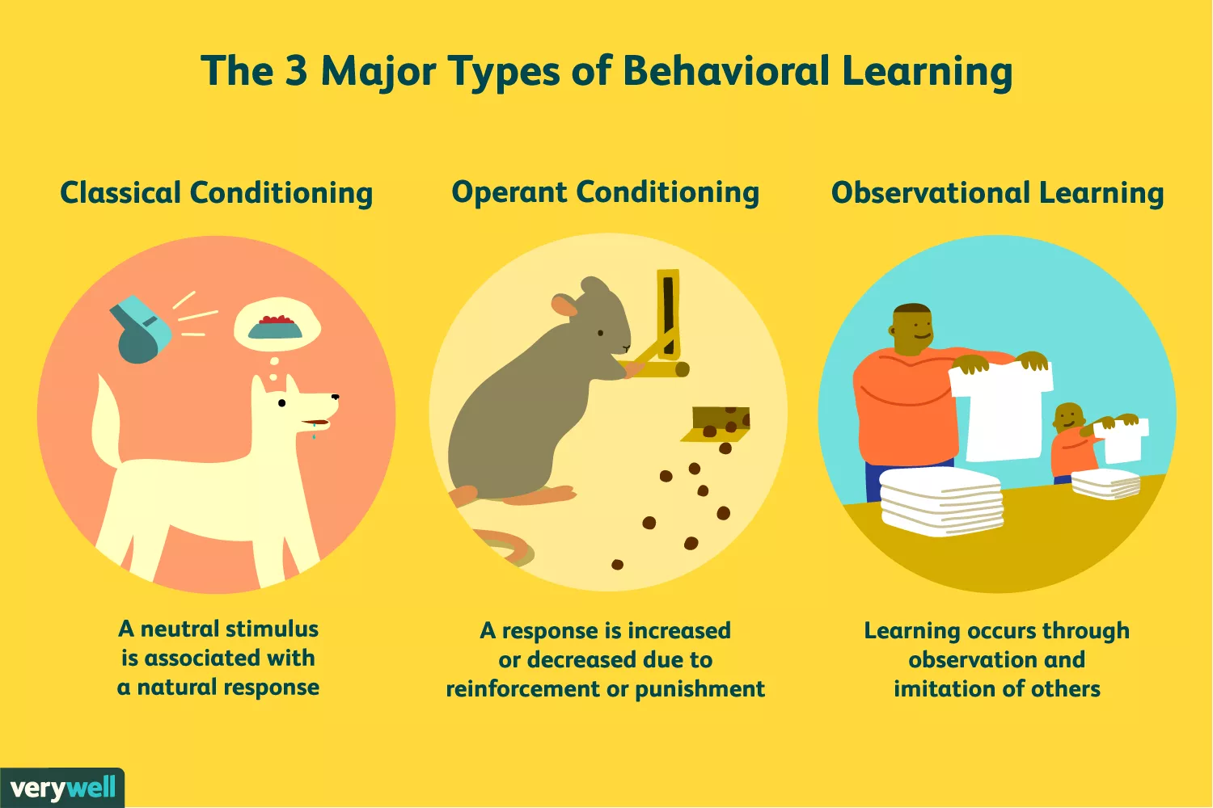
Notes:
1. Classical Conditioning: we learn to associate events, or stimuli, that frequently happen together; as a result of this, we learn to anticipate events.
2. Operant conditioning: behaviors are reinforced or punished, thus strengthening or extinguishing a response. Edward Thorndike coined the term “law of effect,” in which behaviors that are followed by consequences that are satisfying to the organism are more likely to be repeated, and behaviors that are followed by unpleasant consequences are less likely to be repeated.
3. Observational learning: Observational learning occurs through observing the behaviors of others and imitating those behaviors—even if there is no reinforcement at the time. Albert Bandura noticed that children often learn through imitating adults, and he tested his theory using his famous Bobo-doll experiment.

Slide 6
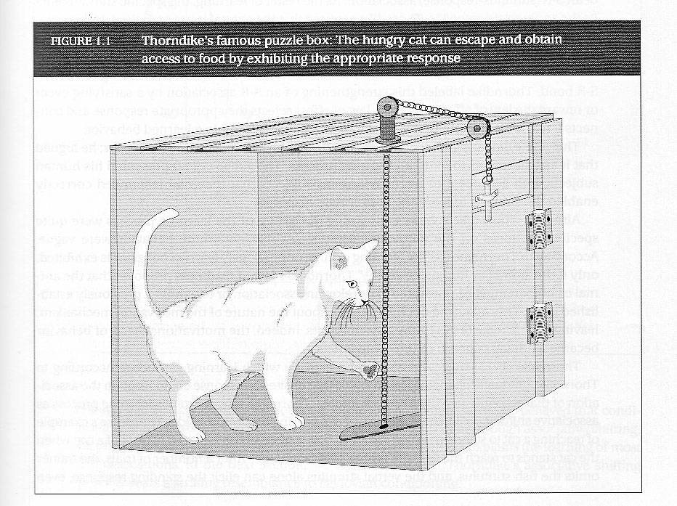
Thorndike’s Puzzle Box
Learning occur through trial and error.
Connection between stimulus and response is not always obvious, and may need to be discovered through trial and error.
https://www.youtube.com/watch?v=xZVtU08D0Rs
Notes:
Trial and Error Theory
“When an action brings a reward, that action becomes stand into the mind”

Slide 7
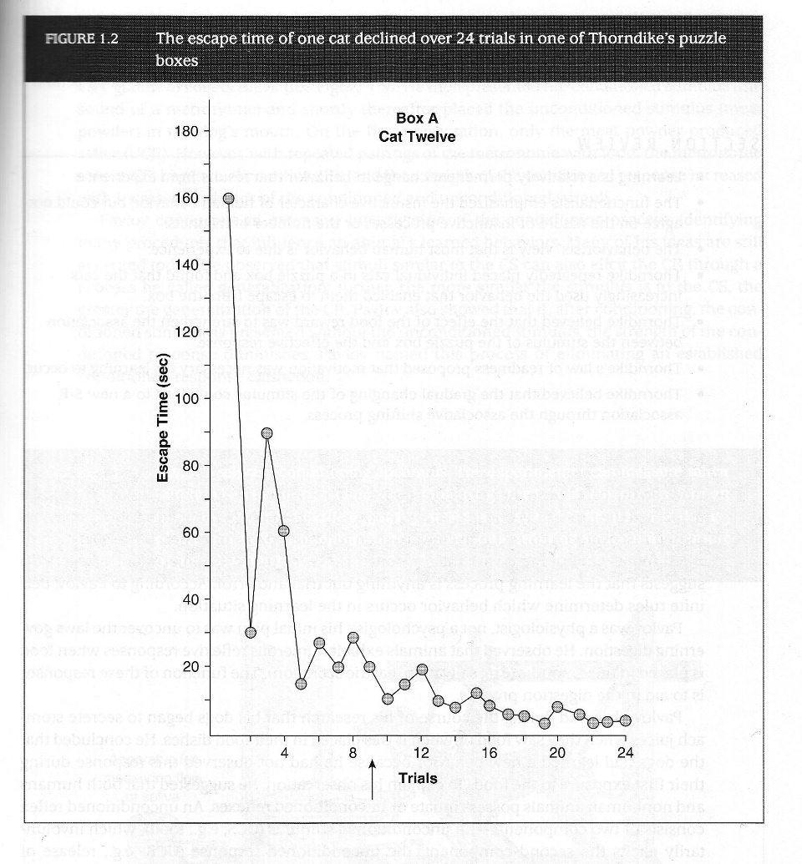
Learning Curve for Cats in Box

Slide 8
Thorndike’s Laws (1898)
Law of effect
All learning involves the formation of connections and connections are strengthened or weakened according to the law of effect.
Any behavior that is followed by pleasant consequence is likely to be repeated, and any behavior followed by unpleasant consequence is likely to be stopped.
Law of exercise
S-R connection is strengthened by use and weakened with disuse.
“Use it or lose it”.
Learners has to practice what has been learned in order to understand and remember the learning.
Notes:
1. Thorndike, E. L. (1898). Animal intelligence: An experimental study of the associative processes in animals. Psychological Monographs: General and Applied, 2(4), i-109.

Slide 9
Thorndike’s Laws (Cont’d)
Law of readiness
Basic needs of the learner must be satisfied (i.e. reasons) before he or she is ready or capable of learning.
Motivation is needed to develop an association or display changed behavior.
A learner must be motivated and ready to learn.
Associative shifting
A learned behavior (response) can be shifted from one stimulus to another.
Once a behavior is learned, the stimulus is gradually changed.

Slide 10
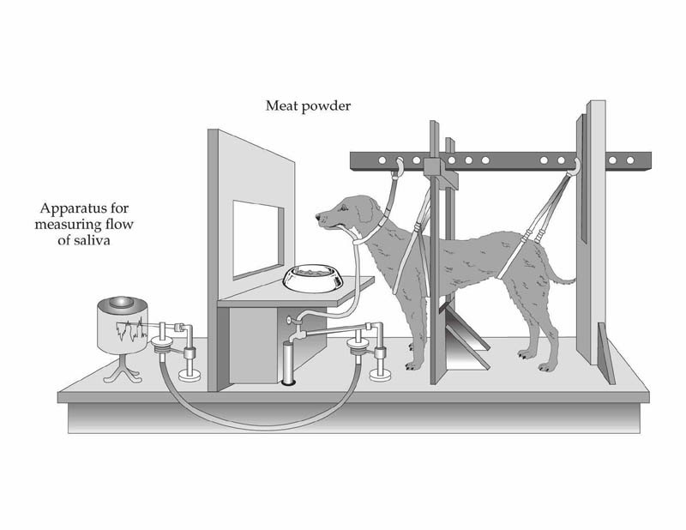
Pavlov’s Studies (1927)
Conditioning
A stimulus that initially produces no response can acquire the ability to produce one.
Learning occurs through pairing in time and place of one stimulus with another stimulus that produces a response.
This is a kind of associative shifting, but the response is involuntary.
https://www.youtube.com/watch?v=hhqumfpxuzI
Notes:
1. Whereas classical conditioning depends on developing associations between events, operant conditioning involves learning from the consequences of our behavior.

Slide 11
Terminology of Conditioning
Unconditioned stimulus (US or UCS)
Produces a reflexive response without learning.
Unconditioned response (UR or UCR)
The response that occurs, typically a reflex, involuntary and automatic.
Neutral stimulus
A stimulus not capable of producing an unconditioned response.
Conditioned stimulus (CS)
A previously neutral stimulus that has acquired the ability to evoke a response.
Conditioned response (CR)
The learned response, similar to the UCR, an involuntary reflex.

Slide 12
Prior to conditioning
Neutral stimulus
(tone)
(Orientation to sound
but no response)
UCS
(food powder in mouth)
UCR
(salivation)
Conditioning
Neutral stimulus
CS (tone)
CR
(salivation)
+
UCS
(food powder)
After conditioning
CS
(tone)
CR
(salivation)

Slide 13
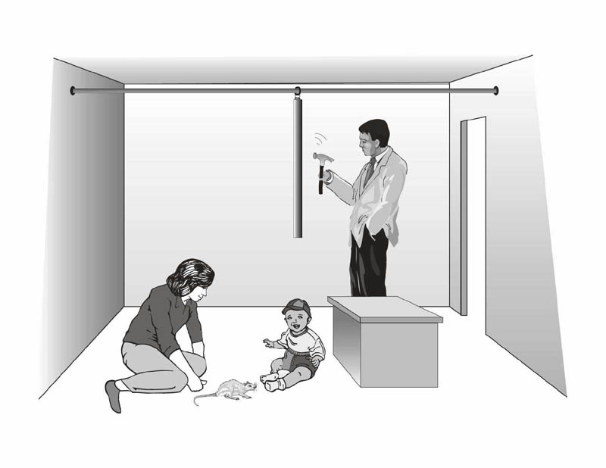
Little Albert (1920) by Watson
https://www.youtube.com/watch?time_continue=125&v=PqqRdZ8x9Ws

Slide 14
Watson & Raynor
Human fears can be acquired through Pavlovian conditioning.
Rat paired with loud noise
Stimulus generalized to other white objects (white rabbit, white fur coat)
Mary Cover Jones developed counterconditioning -- a technique for eliminating conditioned fears.
Acquisition of fear-inhibiting response

Slide 15
Classical Conditioning: 4 Common Phenomena
Generalization – stimuli like the CS become able to evoke the conditioned response.
Discrimination – conditioned response happens to some stimuli BUT not to others.
Extinction – if the UCS and CS are not paired, the CS loses its ability to produce a conditioned response.
Spontaneous recovery – an extinguished CS briefly returns but quickly goes away again.

Slide 16
Albert Bandura’s Bobo Doll Experiment (1965)
https://www.youtube.com/watch?v=dmBqwWlJg8U
“Learnt behavior”- children watch adults and mimic them. Learn through observing the way people behave. If you show them to be gentle, they in turn will be gentle. If you show them aggressive, they too will act aggressively.
Learning-Performance Distinction
Social Cognition Theory (SCT)
Attention, Memory, Imitation, Motivation
Learning occurs in a social context with a dynamic and reciprocal interaction of personal, environment and behavioral factors
Notes:
1. A blow-up doll that can be punched.

Slide 17
2. Teaching-Learning Process in Extension

Slide 18
Teaching-Learning Process
Teachers
Subject matter
Learners
Physical Facilities
Teaching Materials
Notes:
1. Learning situation is one in which all the essential elements for promoting learning are present in a dynamic relationship with one another (Ray, 1991).

Slide 19
Elements of Teaching-Learning Process
Learners:
Individuals who intend to learn with all their abilities and efforts
Occupy central position
Characteristics
Able to learn, have interest in the subject, have need for the information offered, able to use information once it is gained
Teachers:
Both the sources and provider of knowledge
Impart training to the learners
Characteristics
Have purposeful teaching objectives, subject-specific knowledge, emphasis in learners’ interest, encourage learners to learn, skilled in using teaching aids

Slide 20
Elements of Teaching-Learning Process (Cont’d)
Subject matters:
Content or topic of learning the teacher teaches.
Characteristics
Logical and clearly organized contents, objective oriented, useful and satisfying to learners.
Teaching materials:
Aids that used by teachers for making learning meaningful.
Characteristics:
Suitable to present subject matter and for physical situation, teachers are familiar with.
Physical facilities:
Where learning take place without any kind of hindrance.
Characteristics
Well ventilated class room, comfortable setting arrangements, compatible with teaching aids

Slide 21
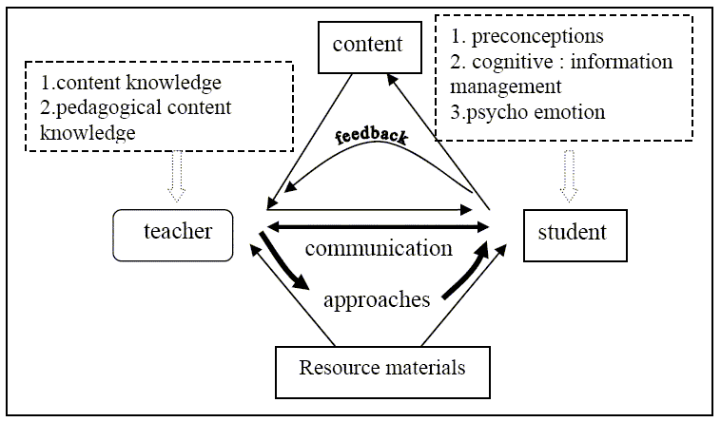
https://www.eduhk.hk/apfslt/v8_issue1/hendon/hendon5.htm#5
Notes:
HOBP (Holistic approach for Best Practice Model
the model for holistic approach to best practices. There are three important elements in the model; the teacher, the student and the content. HOBP Model considers that both teacher and the students are participants of the teaching learning process. The teacher characteristics are the content knowledge and the pedagogical knowledge while the student characteristics are preconceptions, cognition of information management and the psycho-emotional state of the students. It is communication that determines the effectiveness of the teaching learning process. This in turn is determined by the teaching approaches and the feedback between students and teachers. However there are two other factors that affect the teaching learning process. These are the content as prescribed by the syllabus and the resource materials.

Slide 22
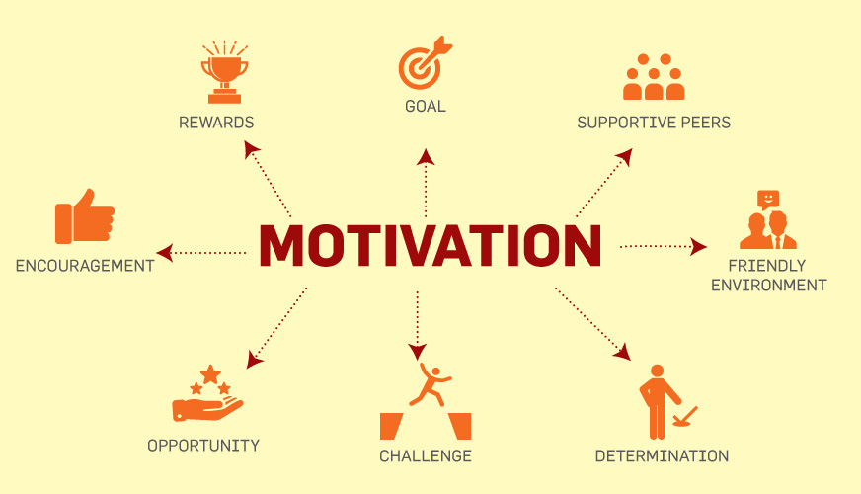

Slide 23
Motivation
Derived from the word “motive”- meaning needs, desires, wants or drives
A process of stimulating people to actions to accomplish the goals.
Factors that stimulate people’s behavior
Desire for money, success, recognition, job-satisfaction, team performance, etc.
Management function
Create willingness amongst the employees to perform in the best of their abilities.
To arouse interest in the performance of employees in their jobs.
Stages of motivation
A felt need or drive
A stimulus in which needs have to be aroused
When needs are satisfied, the satisfaction or accomplishment of goals.
Notes:
1. ref. https://www.managementstudyguide.com/what_is_motivation.htm

Slide 24
Motivation Cycle
Individual’s activities (instrumental behavior) to achieve certain motive is drive.
Act of nervous system, without drive one cannot attain motive.
Stimulating things towards which individual’s best effort is directed to achieve it.
Drive
Tension free mental condition after achieving the motive.
Motives
Satisfaction
Need
What is (present situation) vs. what could be (ideal situation) vs. what ought to be (realistic goal)
Felt needs (aware of) vs. Unfelt needs (unaware at present but can be aware of)
Discrimination between what is (existing situation) and what should be (desire situation)
Notes:
1. Motives: Physiological motives (e.g. hunger, thrust, sleep, rest, sex, etc.), and Social motives (e.g. security, love, belonging, esteem, dignity, power, freedom, etc.)

Slide 25
Why Motivation is Important for Job?
Performance = ∫ (Ability x Motivation)
When ability has low value, increments in motivation will result in smaller increases in performance than ability has high value.
When motivation has low value, increments in ability will result in smaller increases in performance than motivation has high value.
Notes:
1. Ref. Vroom (1964)

Slide 26
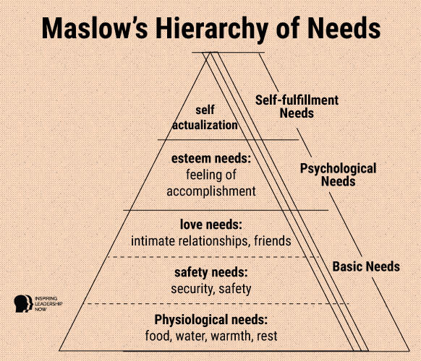
Human behavior is goal-directed.
Motivation causes goal-directed behavior.
Individual’s needs serve as driving force in human behavior.
Notes:
Esteem needs: e.g. self-respect, recognition, respect from others.
Self-actualization: Highest need; found in person whose previous four needs are satisfied. e.g. Social service, creativity, higher achievement

Slide 27
Theory X | Theory Y
Inherent dislike for work. | Work is natural like rest or play.
Unambitious and prefer to be directed by others. | Ambitious and capable of directing their own behavior.
Avoid responsibility. | Accept and seek responsibility under proper conditions.
Lack creativity and resist change. | Creativity widely spread.
Focus on lower-level (physiological and safety) needs to motivate workers. | Both lower-level and higher-order needs like social, esteem and self-actualization are sources of motivation.
External control and close supervision required to achieve organization objectives. | Self-direction and self-control.
Centralization of authority and autocratic leadership. | Decentralization and participation in decision-making. Democratic leadership.
People lack self-motivation. | People are self-motivated.
Notes:
1. Ref. Douglas McGregor (1960)

Slide 28
Job Dissatisfaction | Herberg’s Two-Factor Principles | Job Satisfaction
Influenced by Hygiene Factors |  | Influenced by Satisfier Factors
Pay Administrative policies (not too rigid, e.g. flexible work hours, dress code, vacation) Fringe benefit (e.g. health care, communication allowance) Working condition (e.g. safe, clean, hygiene) Status Job security Interpersonal relations | Improving the satisfier factors increases job satisfaction | Recognition (e.g. praised for accomplishing tasks) Sense of achievement Growth and promotional opportunities Responsibilities (e.g. ownership of work, more authority, minimize control) Meaningfulness of work (e.g. assign for higher/challenging tasks)
 | Improving the hygiene factors decreases job dissatisfaction
Notes:
Ref. https://www.managementstudyguide.com/herzbergs-theory-motivation.htm
Motivators (Satisfaction to No satisfaction); Hygiene factors (No dissatisfaction to Dissatisfaction)

Slide 29
Thank you

