Slide 1
Lecture 3
Map Projections
Md. Mahbubul Alam, PhD
Dept. of AEIS, SAU

Slide 2
Intended Learning Outcomes (ILOs)
Map and Map Projections
Map Projections: Classification
Map Projections: Principles

Slide 3
Map Construction: Ways
Select projection
Select a model for the shape of the earth (sphere or ellipsoid)
Transform geographic coordinates (longitude and latitude) to plane coordinates (x,y)
Reduction of scale
We think Earth is Sphere but it is ellipsoidal, slightly larger in radius at the equator than at the poles.
Notes:
One projection can be changed to other projection
Vector data is easier to change than raster data
Earth is mainly a ‘oblate Spheroid’.

Slide 4
Maps?
Models of reality
Attempts to represent the two-dimensional curved surface of the Earth a flat surface
Main data sources for GIS

Slide 5
Map projection: Why?
Earth is NOT a perfect spheroid (Oblate Spheroid)
Map projection of a particular country may not suitable for a other country of different spatial features
However, each country should present in its true shape
If shape changes, size/total area of the country will change
Universal projections may not be truly universal
SHAPE OF A COUNTRY SHOULD NOT BE CHANGED, because ‘area changes, if shape changes’
Notes:
Map projection is a model, a model of reality

Slide 6
Map Projections (cont’d)
Used to display locations on the curved surface of the earth on a flat sheet according to some set of rules.
Rules are:
  Shape (of a region)
  Distance (between two points)
  Direction (bearing from one point to another)
  Area (of a region)

Slide 7
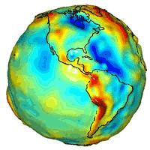
Map Projections: Principles
At many instances the earth is assumed as a perfect sphere,
However there is a difference between the distance around the earth between the poles vs. the equator.
The circumference of the earth is about 1/300th smaller around the poles.
This type of figure is termed an oblate spheroid (alternatively, ellipsoid), and is the three-dimensional shape obtained by rotating an ellipse about its shorter axis.
Lumpy Earth is Geoid.
An estimate of the earth’s surface based on an ellipsoid provides a determination of the elevation of every point on the earth’s surface, including sea level, and is often called a datum.
Concept of projecting is required to express three dimensional space as a two dimensional map.

Slide 8
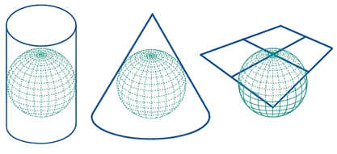
Cylindrical
Conic
Azimuthal
Major types of Map Projections
Notes:
All types of map projections have their pros and cons but they are incredibly versatile.
It’s nearly impossible to create an entirely accurate map projections there are uses for even the most imperfect depictions of the Earth.
Map projections are created for certain purposes and should be used for those purposes.

Slide 9
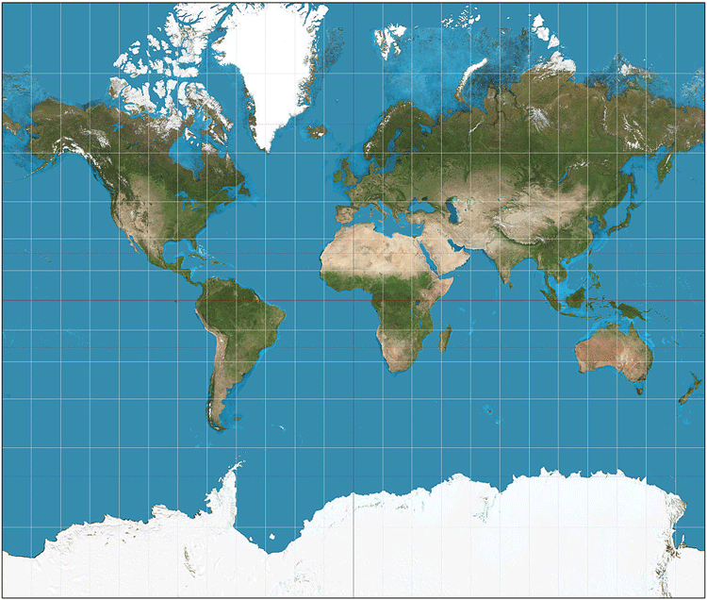
Cylindrical Map Projection:
Has straight coordinate lines with horizontal parallels crossing meridians at right angles.
All meridians are equally spaced and the scale is consistent along each parallel.
They are rectangles but are called cylindrical because they can be rolled up and their edges mapped in a tube or cylinder.
The only factor that distinguishes different cylindrical map projections from one another is the scale used when spacing the parallel lines on the map.
Disadvantage: Severely distorted at the poles.
Areas near the Equator are the most likely to be accurate compared to the actual Earth, the parallels and meridians being straight lines don’t allow for the curvature of the Earth.
Advantage: Great for comparing latitudes to each other & useful for study and visualize the Earth.
Types: Mercator projection, Cassini, Gauss-Krugger, Miller, Hobo-Dyer
Preserves shape and direction BUT distorts areas & distances
Ref. https://www.geolounge.com/types-map-projections/

Slide 10
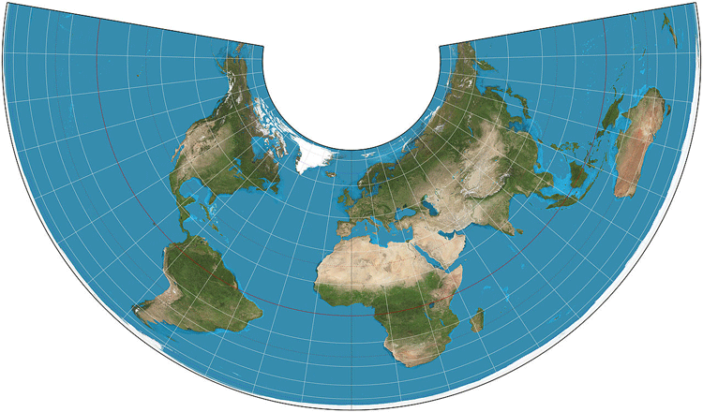
Conic Map Projection:
Defined by the cone constant which dictates the angular distance between meridians.
These meridians are equidistant and straight lines which converge in locations regardless of its poles.
Like cylindrical they have parallels that cross the meridians at right angles.
Disadvantage: It designed to be able to be wrapped around a cone on top of a sphere (globe), but aren’t supposed to be geometrically accurate.
It’s not a complete world map.
Advantage: Best suited for use as regional or hemispheric maps.
Distortion in a conic map makes it inappropriate for use as a visual of the entire Earth but does make it great for use visualizing temperate regions, weather maps, climate projections & so on.
Types: Equidistant conic, Lambert Conformal conic, Albers conic
Preserves areas & distances BUT distorts shape & direction
Ref. https://www.geolounge.com/types-map-projections/

Slide 11
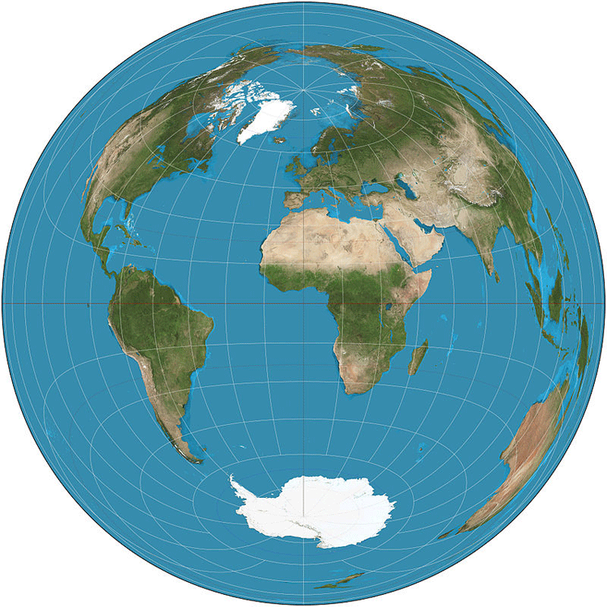
Azimuthal Map Projection:
Azimuthal map projection is angular.
Angles dictate the directions & distance from one to two points to all other points as straight lines.
These angular relationships are most commonly known as great circle arcs or geodesic arcs.
The main features of azimuthal map projections are straight meridian lines, radiating out from a central point, parallels that are circular around the central point, and equidistant parallel spacing.
Light paths in three different categories (orthographic, stereographic, & gnomonic) can also be used.
Advantage: Beneficial for finding direction from any point on the Earth using the central point as a reference.
Preserves areas & distances along the point of contact
Ref. https://www.geolounge.com/types-map-projections/

Slide 12
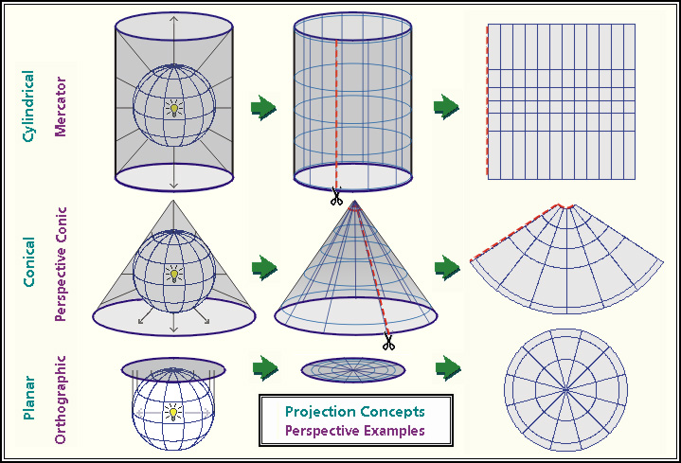

Slide 13
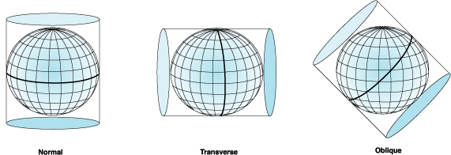
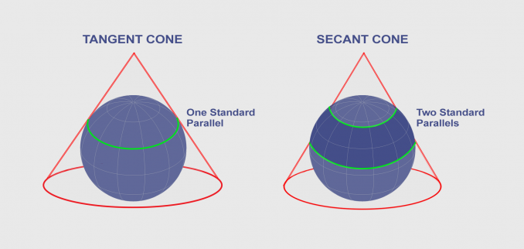
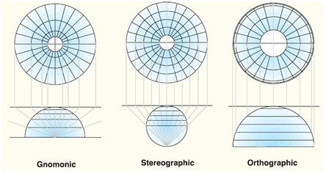
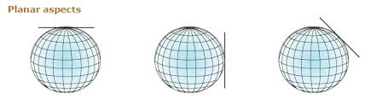

Slide 14
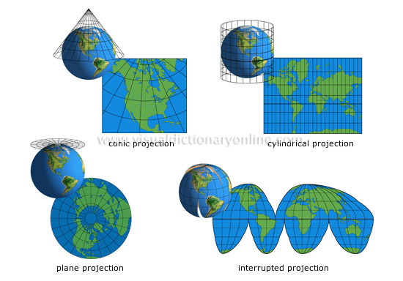

Slide 15
Properties of Map Projections
Equal-area: Correctly represents areas sizes of the sphere on the map, e.g. Lambert Cylindrical equal-area projection
Equidistant: Correctly represents distances, e.g. Plate Carrée projection
Conformal: Represents angles and shapes correctly at infinitely small locations, e.g. Mercator Projection
Notes:
UTM: Equal and conformal, that is called Universal Mercator Transverse Projection, widely used projection. Conformal Cylindrical Projection

