Slide 1
MIS 207: E-Business Lecture 5: Selling to Business Online (Book chapter 6)
Md Mahbubul Alam, PhD
Professor

Slide 2
Intended Learning Outcomes
How businesses use the Internet to improve purchasing, logistics, and other support activities
Electronic data interchange and how it works
How businesses have moved some of their electronic data interchange operations to the Internet
Supply chain management and how businesses are using Internet technologies to improve it
Electronic marketplaces and portals that make purchase-sale negotiations easier and more efficient
Notes:
2

Slide 3
Purchasing, Logistics & Support Activities

Slide 4
Purchasing, Logistics, and Support Activities
Objectives:
Cost reduction
Business process improvements
Flexibility, important characteristics 0f purchasing, logistics and support activities
Outsourcing: use of other organization to perform specific activities
Offshoring: when outsourcing is done by organization in other countries
Business process offshoring: outsourcing of nonmanufacturing activities, e.g., purchasing, R&D, record keeping, information management
Impact sourcing or smart sourcing: offshoring activities done by organization who support training or charitable activities in less developed parts of the world

Slide 5
Purchasing
Purchasing includes
Identifying & evaluating vendor, Selecting specific products, Placing orders, Resolving any issue after receiving the products like late deliveries, incorrect quantities, incorrect items, defective items.
Supply chain: the part of an industry value chain that precedes a particular strategic business unit
Sourcing: Identifying supplier and determining the qualifications of those suppliers
E-Sourcing: use of IT in sourcing activities
Spend: total dollar amount of the goods and services that a company buys during a year

Slide 6
Steps in a typical business purchasing process

Slide 7
Direct vs. Indirect Materials Purchasing
Direct materials
Become part of finished product
Direct materials purchasing: two types
Replenishment purchasing (contract purchasing), company negotiates long-term material contracts
Spot purchasing, purchases made in loosely organized market (spot market)
Indirect materials
All the other materials that a company purchases
Factory supplies, office supplies, etc.
Indirect material purchased on a recurring basis
Standard items (commodities) with price as main criterion
Maintenance, repair, and operating (MRO) supplies

Slide 8
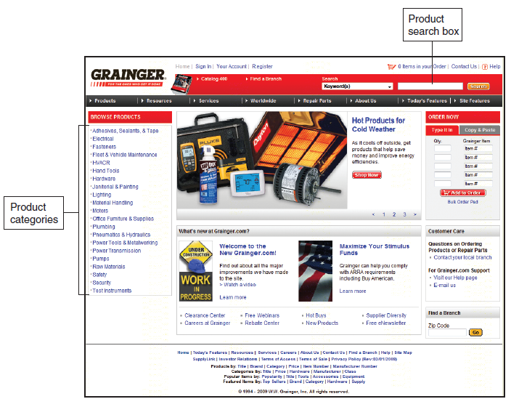
Grainger.com Web store, a MRO supplier

Slide 9
Logistics Activities
Objective
Provide the right goods in the right quantities in the right place at the right time
Managing the movements of inbound materials and supplies and outbound finished goods and services
Web and the Internet
Providing increasing number of opportunities to better manage activities
Providing real-time shipment information to customers’ browsers
Example
Schneider Track and Trace system, Ryder Supply Chain, J.B. Hunt
Third-party logistics (3PL) provider, operates all (large portion) of customer’s materials movement activities, e.g., Ryder and Whirlpool, FedEx, UPS

Slide 10
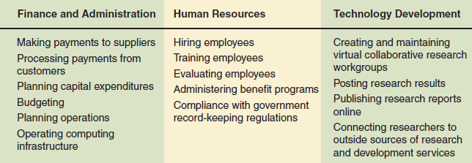
Support Activities
Categories of support activities
Notes:
1. One common support activity that underlies multiple primary activities is training.

Slide 11
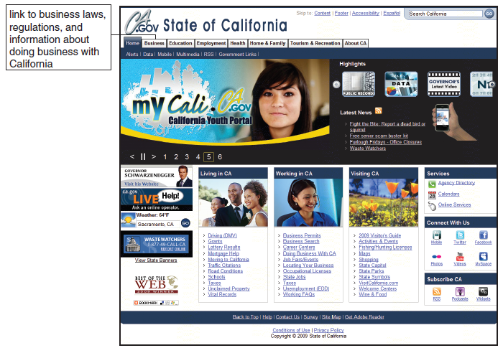
E-Government
Use of electronic commerce by governments and government agencies
Enhances functions performed for stakeholders
Enhances businesslike activity operations
U.S. government examples
Financial Management Service (FMS): Pay.gov site
Bureau of Public Debt: TreasuryDirect site
Department of Homeland Security (DHS)
State government: California’s one-stop portal site: my.ca.gov
Examples in other countries
United Kingdom: Department for Work and Pensions Web site
Singapore Government Online site

Slide 12
Electronic Data Interchange

Slide 13
Electronic Data Interchange
Computer-to-computer business information transfer
Between two businesses using a standard format
Trading partners
Two businesses exchanging information
EDI compatible
Firms exchanging data in specific standard formats
Reasons to be familiar with EDI:
Most B2B e-commerce adapted from EDI or based on EDI principles
Current method for most electronic B2B transactions
Single most commonly used technology in online B2B transactions

Slide 14
Early Business Information Interchange Efforts
1800s and early 1900s
Need to create formal business transactions records
1950s
Computers store, process internal transaction records
Information flows: printed on paper
1960s: large volume transactions
Exchanged on punched cards or magnetic tape
1960s and 1970s
Transferred data over telephone lines
Efforts increased efficiency, reduced errors
Issue: incompatible data translation programs

Slide 15
How EDI Works?
EDI purchasing process: there elements
Mail service replaced with EDI network data communications
Paper flows within buyer’s and vendor’s organizations replaced with computers
Running EDI translation software
Notes:
Paper vs. EDI (18 vs. 8 steps)

Slide 16
Information flows in a paper-based purchasing process
Information flows in an EDI purchasing process

Slide 17
Value-Added Networks (VAN)
EDI network key elements
EDI network, two EDI translator computers
Direct connection EDI
Businesses operate on-site EDI translator computers
Connected directly to each
Few companies use direct connection EDI
Dedicated leased lines: expensive
Modems and dial-up telephone lines: slow, unreliable
Indirect connection EDI
Trading partners use VAN to retrieve EDI-formatted messages
Value-added network (VAN)
Receives, stores, forwards electronic messages containing EDI transaction sets
Companies providing VAN services
CovalentWorks, EsayLink Services, GXS, Kleinschmidt, SPS Commerce
Advantage: Support one communication protocol, nonrepudiation

Slide 18
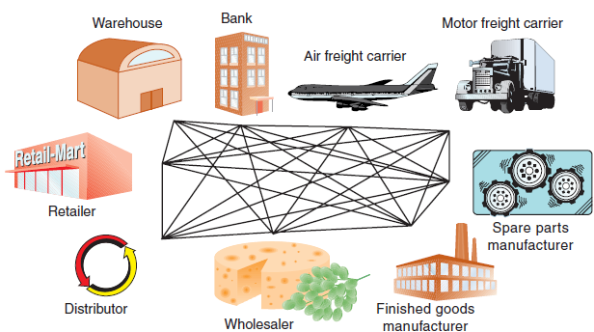
Direct connection EDI
Indirect connection EDI through a VAN
Notes:
1. EDI Payments: ACH (Automated Clearing House)

Slide 19
SCM using IT

Slide 20
Value Creation in the Supply Chain
Objectives
Reduced cost
Add value in the form of benefits to the ultimate consumer
Supply chain participants share information and work together to create value
Each level of suppliers can share the benefits of reduced cost and more efficient operations
Create new network form of organization among members of supply chain
Clear communication up and down the supply chain can keep each participant informed of what the ultimate consumer demands
Clear communication and quick responses to those communications are the key elements of SCM
Notes:
1. How SCM Creates values in business?

Slide 21
Value Creation in the Supply Chain (cont’d.)
Tier-one suppliers
Small number of very capable suppliers
Original business establishes a long-term relationship (“Supply Alliances”)
Tier-two suppliers
Larger number of suppliers who tier-one suppliers develop long-term relationships with for components, raw materials
Tier-three suppliers
Next level of suppliers
Key element: trust

Slide 22
Advantages of using Internet technologies in supply chain management

Slide 23
Increasing Supply Chain Efficiencies
Internet and Web technologies managing supply chains can
Yield increases in efficiency throughout the chain
Increase process speed, reduce costs, increase manufacturing flexibility
Allows response to changes in quantity and nature of ultimate consumer demand
Example: Boeing
Invested in new information systems increasing production efficiency of the supply chain
Also launched spare parts Web site

Slide 24
Increasing Supply Chain Efficiencies (cont’d.)
Example: Dell Computer
Famous for use of Web to sell custom-configured computers
Also used technology-enabled supply chain management
Give customers exactly what they want
Reduced inventory amount (three weeks to two hours)
Top suppliers have access to secure Web site
Tier-one suppliers better can plan their production
Dell accesses suppliers’ information

Slide 25
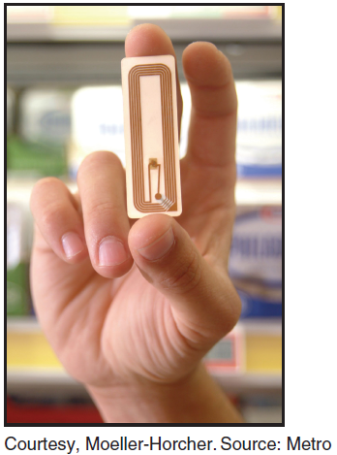
Materials-Tracking Technologies
Bar-coded elements from
EDI transaction set 856
Radio Frequency Identification Devices (RFIDs)

Slide 26
Electronic Marketplaces & Portals

Slide 27
Characteristics of B2B marketplaces

Slide 28
Question Please
?
Acknowledgement:
“E-Business” by Gary Schneider, International Edition

