Slide 1
Lecture 1 & 2
Introducing Computer Systems
Md. Mahbubul Alam, PhD

Slide 2
Objectives
1
Evolution and Categorization of Computer
2
Importance of Computers in Society
3
Parts of a Computer System
4
The Information Processing Cycle

Slide 3
The Computer Defined
In basic terms, a computer is an electronic device that processes data, converting it into information that is useful to people.
Any computer regardless of its type, is controlled by programmed instructions, which give the machine a purpose and tell it what to do.
A basic classification of computer is-
  Analog computer
  Digital computer

Slide 4
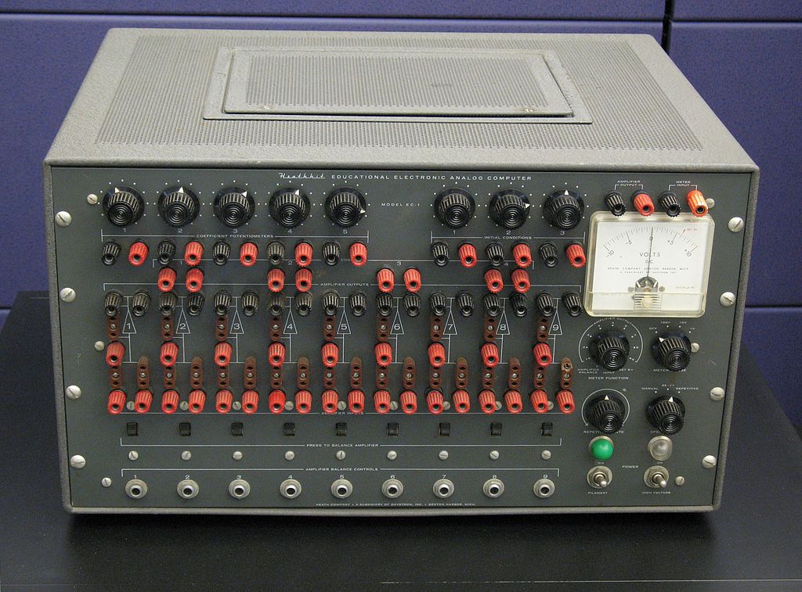
Analog Computer
Analog computers are mechanical devices, weighing several tons and using motors and gears to perform calculations.
Analog systems, represent data as variable points along a continuous spectrum of values, but not so precise and reliable if we computer to the performance of digital computers.
Example: Heathkit EC-1 educational analog computer

Slide 5
Digital Computer
Digital computers work by the numbers, as they break all types of information into tiny units, and use numbers to represent those pieces of information.
Digital computers also work in very strict sequences of steps, processing each unit of information individually, according to the highly organized instructions they must follow.
Digital systems represent data as having one distinct value or another, with no other possibilities.
Example: Modern Desktop Computers

Slide 6
Generations of Computers
Computers, at various stages of their evolution, have been divided into six generations.
Every new generation has certain dramatic improvements when compared to its previous generations.
These improvements were the result of the technology used for building the computers, programming languages used and the computer system’s internal organization.
The six generations of computers are:
  First-Generation Electronic Computers (1937 – 1953)
  Second-Generation (1954 – 1962)
  Third-Generation (1963 – 1972)
  Fourth-Generation (1972 – 1984)
  Fifth-Generation (1984 – 1990)
  Sixth-Generation (1990 – till date)

Slide 7
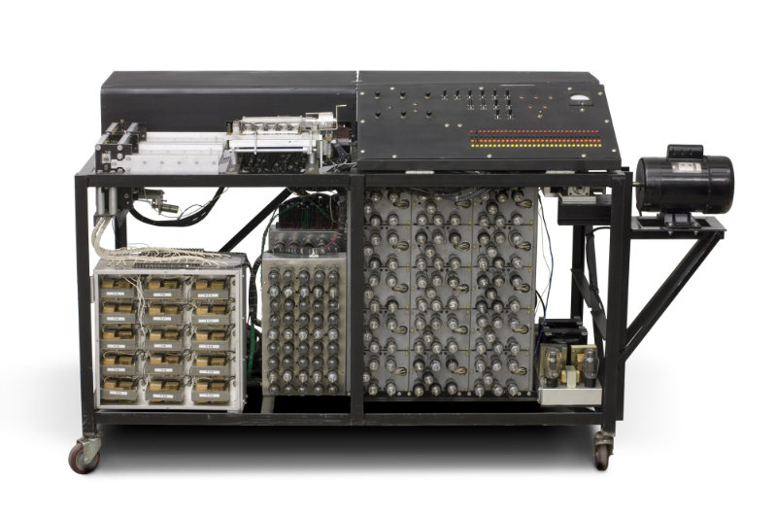
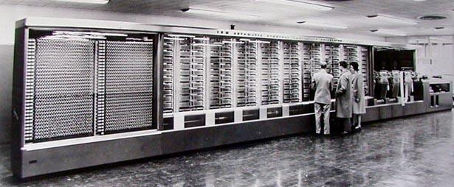
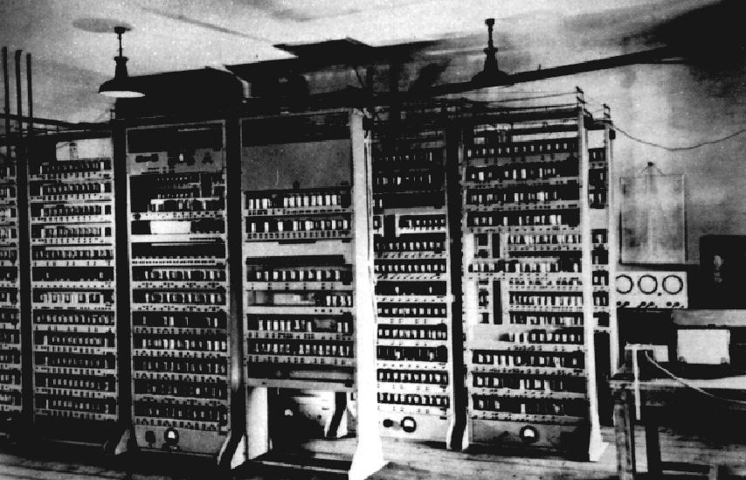
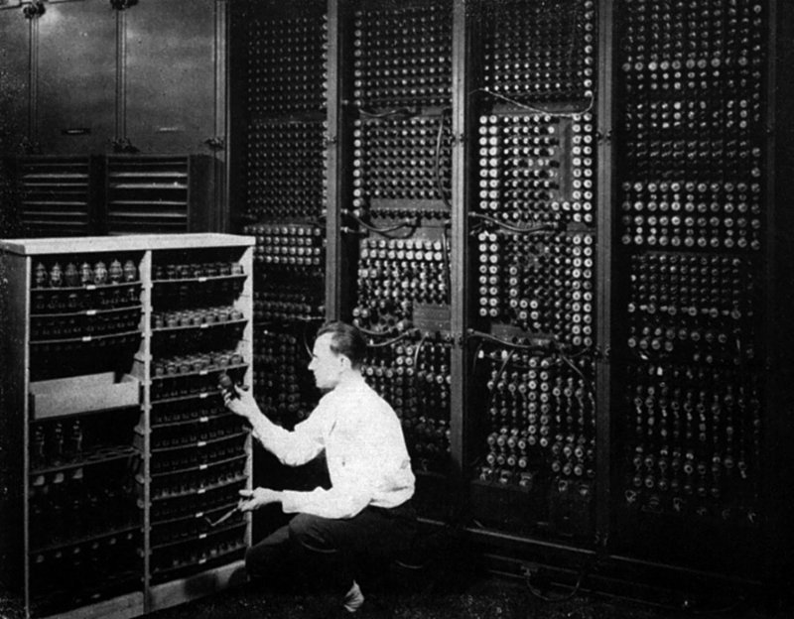
First-Generation Electronic Computers
Atanasoff-Berry Computer (ABC)
Harvard Mark-I
ENIAC
EDVAC

Slide 8
First-Generation Electronic Computers
Device | Year | Inventor | Information
Atanasoff-Berry Computer (ABC) | 1942 | Prof. John Vincent Atanasoff and Cliff Berry | Arguably the first patented computer but it was never fully functioned.
Harvard Mark-I | 1944 | Howard Aiken | Relay-based calculator as big as a room.
Electronic Numerator Integrator And Computer (ENIAC) | 1946 | John Mauchly and J Presper Eckert | First large general purpose computer which was made operational. It worked on vacuum tubes.
Electronic Discrete Variable Automatic Computer (EDVAC) | 1949 | John Mauchly and J Presper Eckert | It had more internal memory and started using binary numbers instead of decimal numbers.

Slide 9
Second-Generation Computers
Device | Year | Inventor | Information
TRAnsistor Digital Computer (TRADIC) | 1955 | Bell Laboratory, USA | First computer which used only transistors and diodes, no vacuum tubes.
IBM 704 | 1954 | IBM | First commercial computer
TX-0 | 1956 | MIT | First programmable general purpose computer.
Livermore Atomic Research Computer (LARC) | 1960 | Sperry Rand Corporation | Supposedly one of the first supercomputers.
IBM 7030 | 1961 | IBM | Had the capability of multiprogramming, flexibility in the input and output, good memory capacity and speed.

Slide 10
Third-Generation Computers
Device | Year | Inventor | Information
SYSTEM/360 | 1964 | IBM | Family of 40 peripherals and six mutually compatible computers which had the capacity to work together.
PDP-8 | 1965 | Digital Equipment Corporation | First minicomputer which was commercially successful, sold for $18,000.
CDC 7600 | 1969 | Seymour Cray | Came with small core memory with a clock speed of 27 nanoseconds
INTEL 4004 | 1971 | Intel | First microprocessor with a single chip.
INTEL 8008 | 1972 | Intel | First microprocessor which had the capability of holding letters of both upper and lower cases, 10 numerals and symbols with punctuations.

Slide 11
Fourth-Generation Computers
Device | Year | Inventor | Information
ALTO | 1974 | Xerox | First workstation which had a built-in mouse used for input.
APPLE I | 1976 | Apple | Single board computer which had two upper rows for video and two lower rows for the computer.
VAX 11/78 | 1978 | Digital Equipment Corporation | Capable of addressing a maximum of 4.3 gigabytes of virtual memory.
IBM PC | 1981 | IBM | Ignited the personal computer market.
LISA | 1983 | Apple | First personal computer which had a graphical user interface.
MACINTOSH | 1984 | Apple | First successful mouse driven computer with a graphical user interface.

Slide 12
Fifth-Generation Computers
Device | Year | Inventor | Information
IBM PC-AT | 1984 | IBM | Included more internal memory and floppy disk.
PC/RT | 1986 | IBM and MIPS | First RISC-based computer. Performed 2 million instructions per second.
PS/2 | 1987 | IBM | Came up with two BIOS (Advanced BIOS and Compatible BIOS).
Intel 80486 | 1989 | Intel | Microprocessor with more than a million transistors.
Video Toaster | 1990 | NewTek | Had a production and video editing system.

Slide 13
Sixth-Generation Computers
Device | Year | Inventor | Information
PowerBook | 1991 | Apple | Computer in silver case introduced a classy dimension in design.
Pentium Microprocessor | 1993 | Intel | Pentium processor series introduced.
Sun Ultra Workstation | 1996 | Sun Micro Systems | Processor based workstation having 64-bit performance.
iMac | 1998 | Apple | A colorful all-in-one system.
Apple iMac Pedestal Computer | 2002 | Apple | Computer with a flat panel LCD screen.
Power Mac G5 | 2003 | Apple | Professional grade computer, was one of the most powerful computers in Apple’s lineup.

Slide 14
Classification of Computers
Computers can broadly be categorized into the following:
  Computers for Individual Users
  Most computers are meant to be used by only one person at a time.
  Such computers are shared by several people (such as those in computer labs), but only one user can work with the machine at any given moment.
  Computers for Organizations
    Some computers handle the needs of many users at the same time.
    These powerful systems are most often used by organizations, such as businesses or schools, and are commonly found at the heart of the organization’s network.

Slide 15
Computers for Individual Users
Desktop Computers
  The desktop computer is the most common type of personal computer.
  This computer is designed to sit on top of a desk or table, and comes in two basic styles (horizontally oriented system unit PC and vertically oriented system unit PC)
Workstations
  A workstation is a specialized, single-user computer that typically has more power and features than a standard desktop PC.
  This is popular among scientists, engineers and animators who need a system with greater than average speed and the power to perform sophisticated tasks.

Slide 16
Computers for Individual Users (cont’d)
Notebook Computers
  Notebook is fully functional microcomputers, which is used by the persons who need the power of a full-size desktop computer wherever they go.
Tablet Computers
  A table PC is another type of portable PC, but it can accept handwritten input when the user touches the screen with a special pen called stylus or digital pen.
Handheld Computers
  Handheld personal computer is a computing device that fit in user’s hand, the personal digital assistant (PDA) is an example of a handheld computer.
Smart Phones
  Smart phone is digital cellular phone that has features found in personal computers, such as web browsers, e-mail capacity and more.

Slide 17
Computers for Organizations
Network Servers
  A network server is a powerful personal computer that is used as the central computer in organization’s network.
Mainframe Computers
  Mainframe is powerful, special-purpose computer that can support the needs of hundreds or thousands of users.
Minicomputers
  Minicomputer or midrange computer is powerful computer that can cater the needs of hundreds of users at a time.
Supercomputers
  Supercomputer is the largest and most powerful computers made.

Slide 18
Find the Right Computer
Required Task to Perform | Type of Computer
Be able to work anywhere | Notebook
Make note on the fly
Set up complex hardware configurations
Manage a list of contracts
Send faxes and email
Design or use multimedia products
Work with graphic intensive software
Manage schedule on hourly basis
Communicate and share data from any location
Carry your data with you

Slide 19
Find the Right Computer
Required Task to Perform | Type of Computer
Be able to work anywhere | Notebook
Make note on the fly | Handheld/ Smartphone
Set up complex hardware configurations | Desktop
Manage a list of contracts | Handheld/ Smartphone
Send faxes and email | Handheld/ Smartphone
Design or use multimedia products | Desktop
Work with graphic intensive software | Workstation
Manage schedule on hourly basis | Handheld/ Smartphone
Communicate and share data from any location | Notebook
Carry your data with you | Notebook

Slide 20
Importance of Computers in Society
Computer is more impact than any other invention because it has changed work and leisure activities and is used by all demographic groups.
Computers are important because:
  Provide information to users
  Information is critical to our society
  Managing information is difficult

Slide 21
Importance of Computers in Society (cont’d)
Computers at home
  Many homes have multiple computers
  Most American homes have Internet
  Computers are used for
    Business work done at home
    Entertainment
    Communication
    Education
Computers in education
  Computer literacy required at all levels of institutions
Computers in small business
  Makes businesses more profitable
  Allows owners to manage

Slide 22
Importance of Computers in Society (cont’d)
Computers in industry
  Computers are used to design products
  Assembly lines are automated
Computers in government
  Necessary to track data for population
  Monitoring government officials
  Tax calculation and collection
  Governments were the first computer users
Computers in health care
  Revolutionized health care
  New treatments possible
  Scheduling of patients has improved
  Delivery of medicine is safer

Slide 23
Parts of Computer System

Slide 24
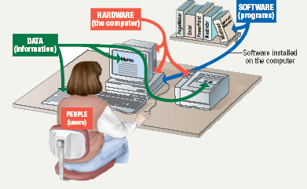
Parts of Computer System
A complete computer system consists of four parts:
  Hardware
  Software
  Data
  Users

Slide 25
Hardware
The mechanical devices that make up the computer are called hardware. Hardware is any part of the computer that one can touch.
Computers use the same basic hardware.
Hardware categorized into four types:
    Processing devices
    Memory devices
    Input and output devices
    Storage devices

Slide 26
Hardware (cont’d)
Processing devices
  The processor is like the brain of the computer,
  It organizes and carries out instructions that comes from either the user or the software.
  The processing unit of the computer is called the Central Processing Unit (CPU).
Memory devices
  Memory is one or more sets of chips that store data and/or program instructions, either temporarily or permanently.
  Two most important memory types are:
    Random Access Memory (RAM)
    Read Only Memory (ROM)

Slide 27
Hardware (cont’d)
Input and output devices
  Allows the user to interact
  Input devices accept data
      Keyboard, mouse
  Output devices deliver data
      Monitor, printer, speaker
  Some devices are both input and output
      Touch screens
Storage devices
  Hold data and programs permanently.
  Two types of storage devices are:
      Magnetic storage
      Optical storage

Slide 28
Software
Software is a set of instructions that makes the computer perform tasks.
In other words, software tells the computer what to do.
Software categorized into two types:
    System Software
    Application Software

Slide 29
Software (cont’d)
System Software
  System software is any program that controls the computer’s hardware or that can be used to maintain the computer in some way so that it runs more efficiently.
  There are three basic types of system software:
    An operating system tells the computer how to use its own components.
        Example: Windows, Mac OS, Linux
    A network operating system allows computers to communicate and share data across a network while controlling network operations and overseeing the network’s security.
        Example: Windows Server
    A utility is a program that makes the computer system easier to use or performs highly specialized functions.
        Example: Antivirus

Slide 30
Software (cont’d)
Application Software
  Application software tells the computer how to accomplish specific tasks, such as word processing or drawing, for the user.
  Some major categories of these applications include:
      Word processing software (Microsoft Word)
      Spreadsheet (Microsoft Excel)
      Database management software (Microsoft Access)
      Presentation program (Microsoft PowerPoint)
      Graphics program (Photoshop)
      Multimedia (Windows Media Player)
      Wed design (Microsoft Front Page)
      Web browser (Internet Explorer)

Slide 31
Computer Data
The computer reads and stores data of all kinds- whether words, numbers, images or sounds in the form of numbers.
Consequently, computerized data is digital, meaning that it has been reduced to digits, or numbers.
Within the computer, data is organized into files.

Slide 32
Computer Users
Personal computers are designed to work with a human user.
In fact the user is a critical part of a complete computer system.
When working with a personal computer, the user can take on several roles:
    Setting up the system
    Installing software
    Running program
    Managing files
    Maintaining the system

Slide 33
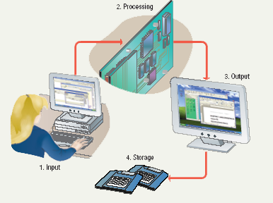
Information Processing Cycle
Using all its parts together, a computer converts data into information by performing various actions on the data such as comparing three numbers and then display the highest number.
These operations are part of a process called the information processing cycle. The information processing cycle has four parts and each part involves one or more specific components of the computer:
    Input
    Processing
    Output
    Storage

Slide 34
Information Processing Cycle (cont’d)
Input. During this part of the cycle, the computer accepts data from some source, such as the user or a program, for processing.
Processing. During this part of the cycle, the computer’s processing components perform actions on the data, based on instructions from the user or a program.
Output. Here, the computer may be required to display the results of its processing.
Storage. In this step, the computer permanently stores the results of its processing on a disk, or some other kind of storage medium.

Slide 35
Unit of Measures
Digital computers work with bit 0 and 1 (0 represents the absence of electricity and 1 represents the presence of electricity)
8 Bits = 1 Byte
1,024 (approx. 1000) Bytes = 1 Kilobyte (1 KB)
1,024 (approx. 1000) Bits = 1 Kilobit (1 Kb)
1,048,576 (approx. 1 million) Bytes = 1 Megabyte (1 MB)
1,024 Kilobyte = 1 Megabyte
1,073,741,824 (approx. 1 billion) Bytes = 1 Gigabyte (1 GB)
1,024 Megabyte = 1 Gigabyte
1,099,511,627,776 (approx. 1 trillion) Bytes = 1 Terabyte (1 TB)
1,024 Gigabyte = 1 Terabyte

Slide 36
End of Chapter

