Slide 1
Lecture 9 & 10 Application Software I & II
Notes:
This chapter discusses the kinds of software you can use to perform a variety of tasks, from simple word processing to digital image editing. We’ll also discuss how you can buy software, what the different versions of software mean, how you can legally get free software from the Web, and how you install and uninstall software safely on your system.

Slide 2

Courtesy: Technology in Action
Alan Evans • Kendall Martin
Mary Anne Poatsy
Ninth Edition

Slide 3
Chapter Highlights
Nuts and bolts of software
Web-based applications
Productivity software for home and office
Business software for home and office
Media software for home
Software for home
Buying software
Installing, uninstalling, and starting software
Getting help with software

Slide 4
The Nuts and Bolts of Software
Software refers to a set of instructions that tells the computer what to do.
Provides a means for us to interact with and use the computer.
Two basic types of software:
System software
Application software

Slide 5
System Software
Helps run the computer.
Coordinates instructions between application software and hardware.
System software includes:
Operating system
Utility programs
Notes:
System software includes software such as Windows and Mac OS X, which help run the computer and coordinate instructions between application software and the computer’s hardware devices.
System software includes the operating system and utility programs (programs in the operating system that help manage system resources).

Slide 6
Application Software
Programs used to do tasks
Writing letters
Sending e-mail
Paying taxes
Creating presentations
Editing photos
Taking an online course
Notes:
Application software is the software you use to do tasks at home, school, and work. You can do a multitude of things with application software, such as writing letters, sending e-mail, paying taxes, creating presentations, editing photos, and taking an online course, to name a few.

Slide 7
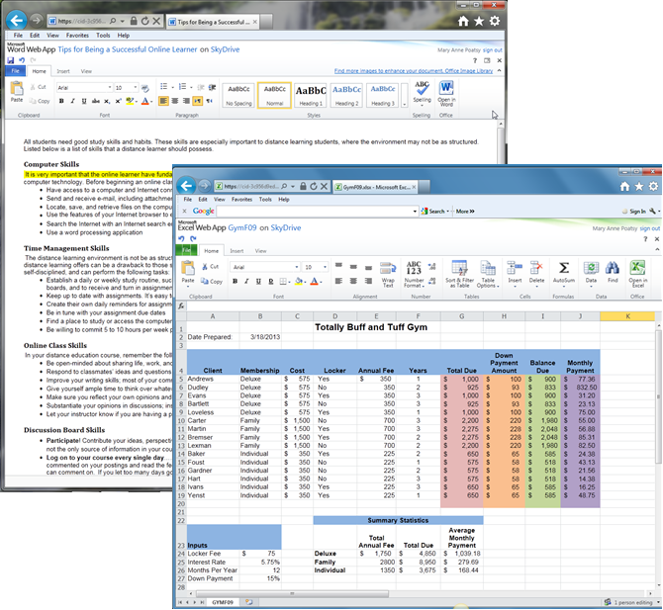
Web Based Applications
Software as a Service (SaaS)
SaaS is a software distribution model in which applications are hosted by a vendor or service provider and made available to customers over a network, typically the Internet.
Microsoft Office Web Apps have fewer tabs than installed version
Microsoft Web Apps have fewer options
Notes:
Most application software you acquire must be installed on your computer before use.
There is a relatively new trend toward a distribution model of on-demand software deployment, referred to as Software as a Service (SaaS). With the SaaS delivery model, the application is hosted online by the vendor and made available to the customer over the Internet. These applications are also referred to as Web-based applications. Web-based applications are run from software stored completely on a Web server.
Along with its release of Office 2010, Microsoft made available Microsoft Office Web Apps. Office Web Apps are online versions of Word, Excel, PowerPoint, and OneNote, but with fewer tabs than the installed versions.

Slide 8
Productivity Software for Home and Office
Programs that enable you to perform tasks required at home, school, and business.
Word processing
Spreadsheet
Presentation
Database
Personal information manager
Notes:
Productivity software includes programs that enable you to perform various tasks required at home, school, and business. This category includes word processing, spreadsheet, presentation, database, and personal information manager (PIM) programs.

Slide 9
Word Processing Software
Most widely used application
Used to create and edit documents
Research papers
Letters
Résumés
Extensive formatting options are available
Change fonts, font styles, and sizes
Adjust margins, add borders and more
Notes:
Most students use word processing software to create and edit documents such as research papers, letters, and résumés.
Word processing software is the most widely used application. You can quickly and easily insert, delete, and move pieces of text, as well as move and insert text from one document into another seamlessly.
An advantage of word processing software is that you can easily create professional-looking documents. With the extensive formatting options available, you can change fonts, font styles, and sizes; add colors to text; adjust margins; add borders to portions of text or entire pages; insert bulleted and numbered lists; and organize your text into columns. You also can insert pictures from your own files or from a gallery of images and graphics, such as clip art and SmartArt, which are included with the software.

Slide 10
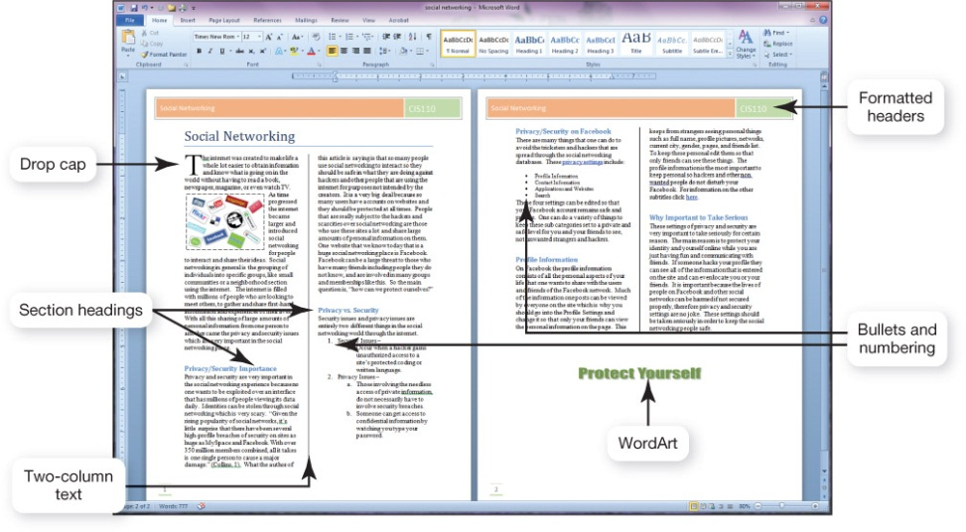
Word Processing Software (cont.)
Microsoft Word is most popular
Free options:
OpenOffice Writer
AbiWord
Include many of the same features as Word
Offer little support
Formatted document
Notes:
Microsoft Word is the most popular word processing program.
Writer, a word processing program from the OpenOffice.org suite (www.openoffice.org), and AbiWord (www.abiword.com) are gaining in popularity because they are available as free downloads from the Internet. Both AbiWord and Writer have many of the same features as the higher-priced Word, making either a great choice for cost-conscious consumers. Keep one thing in mind when you choose an open source software product: support. Unlike Microsoft Office and other proprietary applications, these applications offer little or no formal support. Instead, open source applications are supported from their community of users across Web sites and newsgroups.

Slide 11
Spreadsheet Software
Performs calculations and numerical analyses.
Features include:
Worksheets, columns, rows, cells
Text, values, formulas, and functions
Automatic recalculation
Variety of charts
Examples
Microsoft Excel
OpenOffice Calc
Notes:
Spreadsheet software—such as Microsoft Excel and OpenOffice.org Calc—enables you to do calculations and numerical analyses easily. You can use spreadsheet software to track your expenses and create a simple budget.
The basic element in a spreadsheet program is the worksheet, which is a grid consisting of columns and rows. The columns and rows form individual boxes called cells.
You can enter several types of data into a cell:
Text: Any combination of letters, numbers, symbols, and spaces. Text is often used as labels to identify the contents of a worksheet or chart.
Values: Numerical data that represent a quantity or an amount and are often the basis for calculations.
Formulas: Equations that you build yourself using addition, subtraction, multiplication, and division, as well as values and cell references. For example, in Figure 4.5, you would type the formula “=B8-B22” (without quotation marks) to calculate net income for September.
Functions: Formulas that are preprogrammed into the spreadsheet software. Functions help you with calculations ranging from the simple (such as adding groups of numbers) to the complex (such as determining monthly loan payments), without you needing to know the exact formula. Therefore, in Figure 4.5, to calculate the total of all income sources for the month of September you could use the built-in AVERAGE function, which would look like this: =SUM(B4:B7).
The primary benefit of spreadsheet software is its ability to recalculate all functions and formulas in the spreadsheet automatically when values for some of the inputs change. Because automatic recalculation enables you to see immediately the effects that different options have on your spreadsheet, you can quickly test different assumptions in the same analysis. This is called a what-if analysis.
Most spreadsheet applications allow you to create a variety of charts, including basic column charts, pie charts, and line charts, with or without three-dimensional (3D) effects.
New in Excel 2010 are sparklines, which are small charts that fit into a single cell. Sparklines make it easy to show data trends.

Slide 12
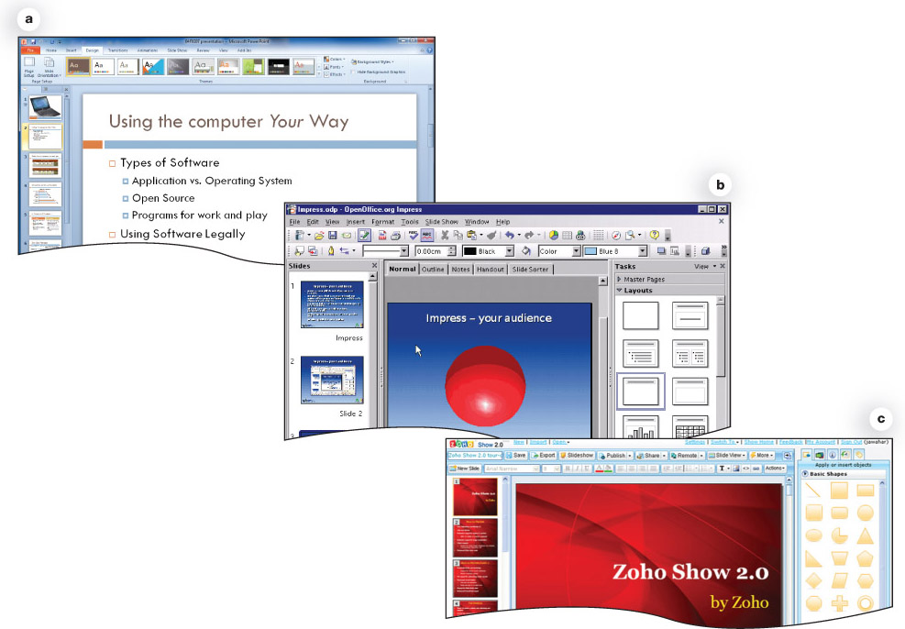
Presentation Software
Used to create dynamic slide shows.
Features include:
Slide layouts
Design templates
Animation effects
Transitions
Examples
Microsoft PowerPoint
OpenOffice Impress
Zoho Show
Microsoft Office PowerPoint 2010
OpenOffice.org Impress
Zoho Show.
Notes:
You use presentation software such as Microsoft PowerPoint, OpenOffice.org Impress, or Zoho Show to create dynamic slide shows.
Using the basic features included in presentation software, creating a slide show is simple. To arrange text and graphics on your slides, you can choose from a variety of slide layouts. These layouts give you the option of using a single or double column of bulleted text, various combinations of bulleted text, and other content such as clip art, graphs, photos, and even video clips.
You also can lend a theme to your presentation by choosing from different design templates. You can use animation effects to control how and when text and other objects enter and exit each slide. Slide transitions add different effects as you move from one slide to the next during the presentation.

Slide 13
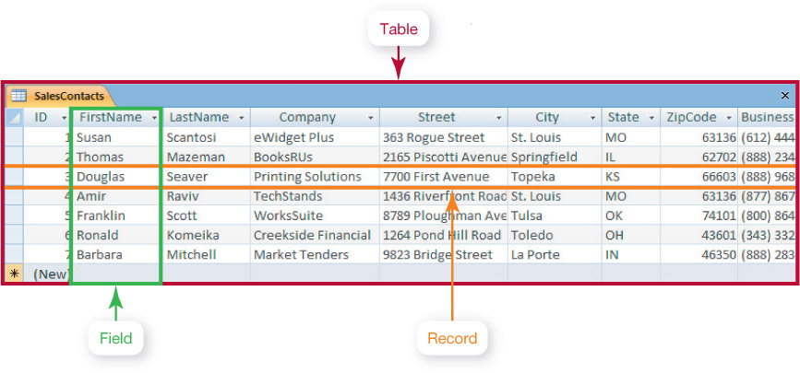
Database Software
Used to store and organize data
Features include:
Fields, records, and tables
Ability to group, sort, and filter data
Generate reports
Examples
Microsoft Access
Oracle
MySQL
Notes:
Oracle, MySQL, and Microsoft Access are powerful applications that allow you to store and organize data.
FileMaker Pro, Bento, and FileMaker Go are database alternatives for Windows, Mac, iPhone, and iPad.
Database software programs are powerful applications that allow you to store and organize data that can be used to track clients, invoices, and personnel information.
Spreadsheet applications include many database features and are easy to use for simple database tasks such as sorting, filtering, and organizing data. However, you need a more full-featured database application to manage larger and more complicated groups of data that contain more than one table or when you need to group, sort, and retrieve data and generate reports.
Traditional databases are organized into fields, records, and tables. A field is a data category such as “First Name.” A record is a collection of related fields. A table groups related records together.

Slide 14
Note Taking Software
Microsoft OneNote
Organize and maintain lecture notes
Write directly on tablet
Convert handwritten notes to digital text
Integrated Web links
Audio or video can be added
Notes:
Programs are available to help students take notes during lectures and organize and maintain their lecture notes and the recordings they create from lectures.
Microsoft OneNote allows users to write their notes directly onto the tablet and later convert the handwritten text to digital text.
OneNote works equally as well with a notebook or desktop computer, and has continued to develop into a powerful note taking and organizational tool. There is also a OneNote app for the iPad.
Notes can be organized into tabbed sections, similar to a multi-subject spiral-bound notebook, that provide further help in organizing and reorganizing pages.
With one click, Web links can be quickly integrated and audio or video recordings of lectures can be added.

Slide 15
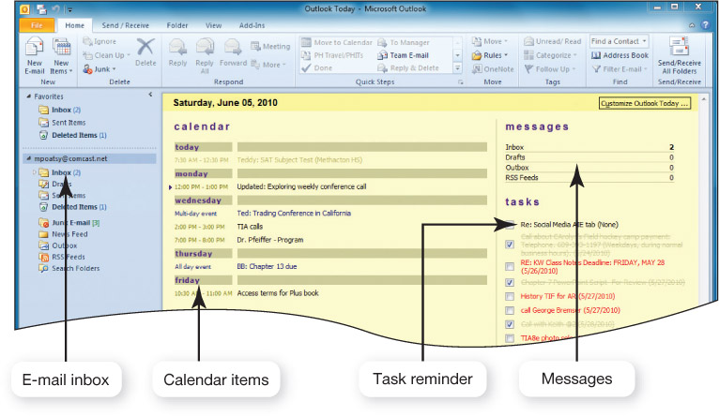
Personal Information Manager Software
Used to replace the management tools found on a traditional desk
Features include: Calendar, address book, notepad, to-do list, e-mail
Examples
Microsoft Outlook
Lotus Organizer
Chandler (free PIM)
Web-based PIMs
Notes:
Most productivity suites contain some form of personal information manager (PIM) software such as Microsoft Outlook or Lotus Organizer. Chandler (www.chandlerproject.org) is another PIM program that is open source and, therefore, free.
These programs strive to replace the management tools found on a traditional desk—a calendar, address book, notepad, and to-do list, for example.
Some PIMs contain e-mail management features so that you not only can receive and send e-mail messages, but also organize them into various folders, prioritize them, and coordinate them with other activities in your calendar
Outlook also coordinates with OneNote, so you can create appointments, meeting requests, and tasks directly in OneNote. If you’re taking notes in a lecture or meeting, and the need to create a follow-up appointment comes up, you can do so without leaving the OneNote application.
Many Web-based e-mail clients such as Yahoo! and Google, have developed coordinating calendar and contacts programs similar to Microsoft Outlook. Yahoo! includes Notepad for jotting down notes and tasks. Google’s calendar and contacts sync with Outlook so you can access your Outlook calendar information by logging into Google, giving you access to your schedule anywhere you have access to a computer and an Internet connection.

Slide 16
Productivity Software Features
Tools to increase efficiency:
Wizards
Step-by-step guides to complete a task.
Templates
Predesigned forms included with software.
Macros
Small programs that group a series of commands to run as a single command.
Used to automate a routine task or a complex series of commands that must be run frequently.
Notes:
Whether you are working on a word processing document, spreadsheet, database, or slide presentation, there are several tools you can use to increase your efficiency:
A wizard is a systematic guide that walks you through the steps necessary to complete a complicated task. At each step, the wizard asks you questions. Based on your responses, the wizard helps you complete that portion of the task.
A template is a predesigned form. Templates are included in many productivity applications. They provide the basic structure for a particular kind of document, spreadsheet, or presentation
A macro is a small program that groups a series of commands so they will run as a single command. Macros are best used to automate a routine task or a complex series of commands that must be run frequently.

Slide 17
Software Suites
Group of software programs bundled as a package.
Cheaper than buying individual programs.
Compatibility between programs.
Share common features, toolbars, menus.
Microsoft Office is standard for proprietary software suites.
Notes:
A software suite is a group of software programs that have been bundled as a package. You can buy software suites for many different categories of software, including productivity, graphics, and virus protection.
Microsoft Office 2010 is the standard for proprietary software suites, and is available for both Windows-based and Apple computers. Apple offers productivity software for Macs in its iWork suite.
It is cheaper to buy a software suite than to buy each program individually. Another benefit of software suites is the compatibility between programs. Because the programs bundled in a software suite come from the same company, they work well together (that is, they provide for better integration) and share common features, toolbars, and menus.

Slide 18
Personal Financial Software
Tax preparation→ prepare taxes. Offers a complete set of tax forms & instructions.
Intuit TurboTax
H&R Block At Home
Financial planning→ helps to manage daily finances. Include programs like electronic checkbook registers, automatic bill payment tools.
Intuit Quicken
Microsoft Money
Web-based programs
Mint.com
Yodlee MoneyCenter.com
Notes:
Tax preparation software enables you to prepare your taxes on your own instead of hiring a professional. Both Intuit TurboTax and H & R Block At Home offer a complete set of tax forms and instructions as well as videos that contain expert advice on how to complete each form. Both programs also have Web-based versions.
Financial planning software helps you manage your daily finances. These programs include electronic checkbook registers and automatic bill payment tools. With these features, you can print checks from your computer or make your regular monthly payments with automatically scheduled online payments.
Web-based programs are also gaining in popularity. These can also be accessed from smartphones.

Slide 19
Home Business Software
Programs helpful for a home business
Accounting software
Desktop publishing software
Web page creation tools
Notes:
No matter what service or product you provide, there are common types of software that will be helpful in your business.
Accounting software will help manage the flow of money, and desktop publishing and Web page creation tools will help you market and develop your new enterprise.

Slide 20
Accounting Software
Helps small-business owners manage their finances.
Tracking accounts receivable and payable
Inventory management, payroll, billing tools
Templates for invoices, statements, and financial reports
Examples
Intuit QuickBooks
Peachtree by Sage
Notes:
Accounting software helps small-business owners manage their finances more efficiently by providing tools for tracking accounts receivable and accounts payable.
In addition, these applications offer inventory management, payroll, and billing tools. Examples of accounting applications are Intuit QuickBooks and Peachtree by Sage. Both programs include templates for invoices, statements, and financial reports so that small-business owners can create common forms and reports.

Slide 21
Desktop Publishing Software
Create newsletters and other publications with complex layouts
Incorporate and arrange graphics and text
Change font, size, and style of text
Format text in columns, shapes, and patterns
Import files from other sources
Manipulate graphics: crop, flip, and rotate images
Examples
Microsoft Publisher
QuarkXPress
Adobe InDesign
Notes:
Desktop publishing (DTP) software allows you to incorporate and arrange graphics and text in your documents in creative ways. Although many word processing applications allow you to use some of the features that are hallmarks of desktop publishing, specialized desktop publishing software such as Microsoft Publisher, QuarkXPress, and Adobe InDesign allows professionals to design books and other publications that require complex layouts
Desktop publishing programs offer a variety of tools with which you can format text and graphics. With text formatting tools, you easily can change the font, size, and style of your text and arrange text on the page in different columns, shapes, and patterns.
You also can import files into your documents from other sources, including elements from other software programs (such as a chart from Excel or text from Word) and image files.
You can readily manipulate graphics with tools that crop, flip, or rotate images or modify the image’s color, shape, and size. Desktop publishing programs also include features that allow you to publish to the Web.

Slide 22
Web Page Authoring Software
Design interesting, interactive Web pages
Wizards and templates
Reference materials
Examples
Microsoft Expression Web
Adobe Dreamweaver
Some Office applications will convert a file to Web-compatible format.
Notes:
Web page authoring software allows even the novice to design interesting and interactive Web pages, without knowing any HyperText Markup Language (HTML) code.
Web page authoring applications often include wizards, templates, and reference materials to help you easily complete most Web page authoring tasks.
Microsoft Expression Web and Adobe Dreamweaver are two of the programs to which both professionals and casual page designers turn.
Some Microsoft Office applications, if you choose to save a file as a Web page, the application will automatically convert the file to a Web-compatible format.

Slide 23
Large Business Software
Specialized programs exist for almost every aspect of business
Marketing and sales
Finance
Point of Sale
General productivity
Project management
Security
Networking
Data management
E-commerce
Human Resources
Notes:
There is an application for almost every aspect of business. There are specialized programs for marketing and sales, finance, point of sale, general productivity, project management, security, networking, data management, e-commerce, and human resources, to name just a few. In the following sections, we discuss some of these specialized programs from this seemingly endless list.

Slide 24
Other Business Programs
Planning and management
Project management
Customer relationship Management (CRM)
Enterprise resource planning (ERP) system
Mapping programs
E-commerce software
Notes:
Planning is a big part of running a successful business. Software programs such as Palo Alto Software’s Business Plan Pro and Marketing Plan Pro help users write strategic and development plans for general business and marketing needs.
Another category of business planning software is project management software, such as Microsoft Project. This type of software helps project managers create and modify scheduling charts, which help them plan and track specific tasks and coordinate personnel resources.
Customer relationship management (CRM) software stores sales and client contact information in one central database. Sales professionals use CRM programs to get in touch with and follow up with their clients. These programs also include tools that enable businesses to assign quotas and create reports and charts that document and analyze actual and projected sales data. CRM programs coordinate well with PIM software such as Outlook and can be set up to work with smartphones. GoldMine from FrontRange Solutions is one example of a CRM program.
An enterprise resource planning (ERP) system lets a business consolidate multiple systems into one and improve coordination of these business areas across multiple departments. ERP systems are used to control many “back office” operations and processing functions such as billing, production, inventory management, and human resources management. Oracle and SAP are well-known companies that sell ERP software.
Mapping programs are useful for nonprofessionals traveling to unfamiliar locations. More users now turn to an online mapping service such as Google Maps, MapQuest, Yahoo! Maps, or Google Earth than to a more traditional mapping software program because the online services are easily accessible with any Internet connection and are updated more frequently than offline ones. Mapping programs, which can work in conjunction with a global positioning system (GPS), are available in versions for smartphones and for cars.
E-commerce software: It seems that every business has an online presence to display company information or products, handle online sales, or offer customer service and support. Depending on the size of the company and its specific needs, it may use products such as IBM’s WebSphere, GoEmerchant, and ProStores Business from ProStores (an eBay company). These products offer bundled Website creation and hosting services, shopping cart setup, and credit card processing services. For larger businesses, specialized software to handle each aspect of e-commerce is available; alternatively, a large business might develop proprietary software tailored to its specific needs.

Slide 25
Computer-Aided Design Software
CAD programs create automated designs, technical drawings, and 3D models
e.g., AutoDesk’s AutoCAD
Build virtual models before construction
Used in:
Architecture
Automotive industry
Aerospace
Medical engineering
Notes:
Engineers use computer-aided design (CAD) programs to create automated designs, technical drawings, and 3D model visualizations.
Specialized CAD software such as Autodesk’s AutoCAD is used in areas such as architecture, the automotive industry, aerospace, and medical engineering.
With CAD software, architects can build virtual models of their plans and readily visualize all aspects of design before actual construction. Engineers use CAD software to design everything from factory components to bridges. The 3D nature of these programs allows engineers to rotate their models and make adjustments to their designs where necessary, thus eliminating costly building errors.
Full-featured packages are available, as well as simpler open source programs and Web-based versions.

Slide 26
Specialized Business Software
Vertical market software is tailored to the needs of a particular company or industry
Estimating tools for bids on construction jobs (e.g., Sage Master Builder)
Property management for real estate
Scheduling and dispatching software
Library automation software
Other programs can be custom developed to address company’s specific needs
Notes:
Some applications are tailored to the needs of a particular company or industry. Software designed for a specific industry is called vertical market software.
For example, the construction industry uses software such as Sage Master Builder, which features estimating tools to help construction companies bid on jobs. It also integrates project management functions and accounting systems that are unique to the construction industry.
Other examples of vertical market software include property management software for real estate professionals; ambulance scheduling and dispatching software for emergency assistance organizations; and library automation software that combines cataloging, circulation, inventory, online catalog searching, and custom report printing.
In addition to these specific business applications, which companies can buy off the shelf, programs often are custom developed to address a company’s specific needs.

Slide 27
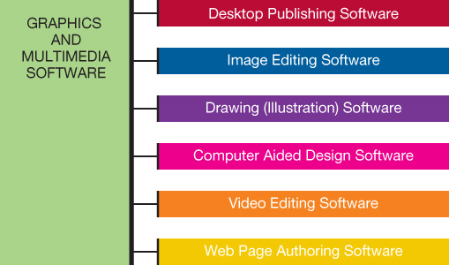
Media Software for Home
Notes:
Your computer can help you create, organize, and modify digital images, songs, and movies, if you have the right software. Multimedia software includes image, video, and audio editing software; animation software; and other specialty software required to produce computer games, animations, and movies. In this section, we look at several popular types of multimedia software, as shown in this figure.

Slide 28

Digital Image Editing Software
Used to edit photographs and other images
Remove red-eye
Modify contrast
Sharpness
Fix scratches
Examples
Adobe Photoshop Elements
Roxio PhotoSuite
Microsoft Photo Story
Google Picasa
Create collages of your favorite images using Google’s Picasa.
Notes:
Image editing software (sometimes called photo editing software) enables you to edit photographs and other images. Image editing software includes tools for basic modifications to digital images such as removing red-eye; modifying contrast, sharpness, and color casts; or removing scratches or rips from scanned images of old photos.
Image editing programs such as Adobe Photoshop Elements and Roxio PhotoSuite are geared toward the casual home user. Products such as Microsoft Photo Story and Google Picasa, which are both free downloads, make it easy for you to use your collection of digital images in new ways.

Slide 29
How Cloud Computing Works?
There are two sides to cloud computing
The front end
Side that we see as users
Computer & application that required to access the cloud computing system
e.g., Web browser like IE, Chrome, etc.
The back end
Various computers and servers that house the files and programs on the cloud.
A central server that uses a special kind of software called middleware (allows networked computers to communicate with each other).
Also monitors demands on systems to ensure everything runs smoothly.
Notes:
Technically, there are two sides to cloud computing: the front end and the back end.
The front end is the side we see as users, and includes our computer and the application required to access the cloud computing system—generally a Web browser like Internet Explorer or Google Chrome. Some systems have unique applications that provide network access to clients. The back end consists of the various computers and servers that house the files and programs you access “on the cloud.” A central server that uses a special kind of software called middleware (that allows networked computers to communicate with each other), monitors the demands on the system to ensure everything runs smoothly.

Slide 30
Digital Audio Software
Audio files include novels, newspapers, radio shows, and podcasts
MP3 is a type of audio compression format
Hundreds of applications allow you to copy, play, and organize MP3s
Features include recording, ripping, burning, encoding and decoding, and format conversion
Audio editing software perform basic tasks
e.g., Apple iTunes, Windows Media Player
Notes:
Best-selling novels, newspapers, and radio shows all can be purchased as audio files.
Huge numbers of free audio files are also available through the phenomenon of podcasting, the distribution of audio files such as radio shows and music videos over the Internet.
MP3, short for MPEG-1 Audio Layer 3, is a type of audio compression format that reduces the file size of traditional digital audio files so that they will take up less storage capacity. It is also a standard of digital audio compression, which has made it possible to transfer and play back music on personal media players.
You can find hundreds of digital audio applications that allow you to copy, play, and organize MP3 files. Most digital audio software programs, such as Apple iTunes, Windows Media Player, and Musicmatch Jukebox, enable you to do the following:
• MP3 recording allows you to record directly from streaming audio and other software or microphone sources to MP3 format.
• CD ripping allows you to copy or extract CDs and encode to the MP3 format.
• CD burning allows you to create your own CDs from your MP3 collection.
• Encoding and decoding is done by encoders, programs that convert files to MP3 format at varying levels of quality. Most ripping software has encoders built in to convert the files directly into MP3 format.
• Format conversion programs allow you to convert MP3 files to other digital audio formats such as WAV (Waveform Audio File Format), WMA (Windows Media Audio), and AIFF (Audio Interchange File Format).
Audio editing software includes tools that make editing your audio files as easy as editing your text files. These programs enable you to perform such basic editing tasks as cutting dead air space from the beginning or end of the song or clipping a portion from the middle.

Slide 31
Digital Video Editing Software
Used to create and edit digital videos
Intuitive drag-and drop features
Windows Live Movie Maker
Apple iMovie
Wide range of special effects and tools
Adobe Premiere Pro
Apple’s Final Cut Pro
MP4 format files can be watched on portable media players
Notes:
With the boom of digital camcorders and the improved graphics capabilities on home computers, many people are experimenting with digital video editing software.
Several video editing applications are available at a wide range of prices and capabilities. Although the most expensive products (such as Adobe Premiere Pro and Apple’s Final Cut Pro) offer the widest range of special effects and tools, some moderately priced video editing programs have enough features to keep the casual user happy.
Windows Live Movie Maker and Apple iMovie have intuitive drag-and-drop features that make it simple to create professional-quality movies with little or no training. Windows Live Movie Maker (download.live.com/moviemaker) is a free download from Microsoft. Other software developers offer free trial versions so that you can decide whether their product meets your needs before purchasing it.
One popular format is MP4, which is similar to the MP3 format in that it compresses audio and video content into more manageable file sizes. This format can be watched on an iPod, for instance.

Slide 32
Media Management Software
Organize audio and video files
Sort, filter, search by artist, album, category
Manage tracks and generate playlists
Burn songs to CDs and print liner notes
Examples
Windows Media Player
Winamp
Apple iTunes
Notes:
Software such as Windows Media Player, Winamp, and Apple iTunes allows you to organize audio and video files so that you can sort, filter, and search your music collection by artist, album, or category. You can manage individual tracks, generate playlists, and even export the files to a database or spreadsheet application.
You can burn songs to a CD, and the program will print liner notes that you can place inside the CD case.

Slide 33
Software for Home
Computer games make up majority of entertainment software in many categories
Action
Driving
Puzzles
Role-playing
Card-playing
Sports
Strategy
Simulations
Notes:
Entertainment software is designed to provide users with thrills, chills, and all-out fun!
Computer games make up the vast majority of entertainment software.
These digital games began with Pong, Pac-Man, and Donkey Kong, and have evolved to include many different categories, including action, driving, puzzles, role-playing, card-playing, sports, strategy, and simulation games.
Entertainment software also includes other types of computer applications, such as drawing software.

Slide 34

Gaming Software
Computer games require appropriate:
Processing power
Memory (RAM)
Hard disk capacity
Sound and video cards
Speakers
Monitor
DVD drive
Specialized controllers
Notes:
As with any software, you need to make sure your system has enough processing power, memory (RAM), and hard drive capacity to run the program. Because games often push the limit of sound and video quality, be sure your system has the appropriate sound cards, video cards, speakers, monitor, and DVD drives.
Some gaming software may require a special controller.

Slide 35
Educational Software
Types include:
K–12 education
Teaching new skills
Test preparation
Brain training
Tutorials
Simulations
Online courses
Notes:
Although a multitude of educational software products are geared toward the younger set, software developers have by no means ignored adult markets.
There are software products that teach users new skills such as typing, languages, cooking, and playing the guitar. Preparation software for students who will be taking the SAT, GMAT, LSAT, and MCAT exams is also popular. In addition, there are many computer and online brain training games and programs designed to improve the health and function of our brains.
Many programs provide tutorials for popular computer applications. These programs use illustrated systematic instructions to guide users through unfamiliar skills.
Some training programs, known as simulation programs, allow users to experience or control the software as if it were the actual software or an actual event. Such simulation programs include commercial and military flight training, surgical instrument training, and machine operation training.
As long as you have a compatible Web browser, online classes will be accessible to you.

Slide 36
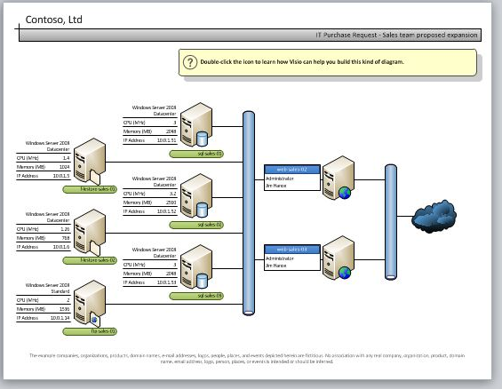
Drawing Software
Used to create and edit
Two-dimensional, line-based drawings
Technical diagrams
Animations
Creative drawings
Adobe Illustrator
Technical drawings
Microsoft Visio
Visio
Notes:
Drawing software (or illustration software) lets you create or edit two-dimensional, line-based drawings such as technical diagrams or original nonphotographic drawings, animations, and illustrations using standard drawing and painting tools such as pens, pencils, and paintbrushes.
Drawing software is used in both creative and technical drawings. Applications such as Adobe Illustrator include tools that let you create professional-quality creative and technical illustrations.
There are many software packages to help plan the layout of rooms, homes, and landscapes, such as those offered by Broderbund. Microsoft Visio is a program used to create technical drawings, maps, basic block diagrams, networking and engineering flowcharts, and project schedules.

Slide 37
Buying Software
Software can be purchased
From retail stores
Online
Request CD or DVD, if available
Create backup
Through catalogs
At auction
Custom-developed software
Notes:
You can find software in almost any retail environment. In addition, you can purchase software online, through catalogs, and at auctions.
When buying software from the Internet, you should also request that the software be sent to you on CD or DVD, if this is available. Without a physical copy of the software, it is much more difficult to reinstall the software if you change computers or if your hard drive crashes. If a physical copy is not available, make sure you create a backup and keep it in a safe place.
You also can use the Internet to buy software that is custom developed for your specific needs. Companies such as Ascentix Corporation (www.ascentix.com) act as intermediaries between you (the software user) and a software developer, who tweaks open source software code to meet your particular needs.

Slide 38
Software Licenses
Agreement between user and company
You buy a license, not the software itself
Ultimate owner of software
If copies can be made
Number of installations allowed
Warranties
Multiuser licenses might be available
Use on more than one computer in household
Businesses and educational institutions
Notes:
A software license is an agreement between you, the user, and the software company. You accept this agreement before installing the software on your machine. It is a legal contract that outlines the acceptable uses of the program and any actions that violate the agreement.
Generally, the agreement will state who the ultimate owner of the software is, under what circumstances copies of the software can be made, and whether the software can be installed on any other machine. Finally, the license agreement will state what, if any, warranty comes with the software.
Family or multiuser licenses might also be available. Some multiuser licenses are per-seat and limit users to a specific number, whereas concurrent licenses limit the number of users accessing the software at the same time.
Businesses and educational institutions often buy multiuser licenses that allow more than one person to use the software.
Open source software programs can be tweaked by another user and redistributed. A free software license, the GNU General Public License, is required and grants the recipients the right to modify and redistribute the software. Without such license, the recipient would be in violation of copyright laws. This concept of redistributing modified open source software under the same terms as the original software is known as copyleft. Thus, all enhancements, additions, and other changes to copyleft software must also be distributed as free software.

Slide 39
Pre-Installed Software
New computers come with an operating system and some application software
Some sort of productivity software
Multimedia computers may offer graphics software
Some manufacturers include applications they hope you will try
Trial versions expire after short-term and must then be purchased for continued use
Notes:
Virtually every new computer comes with an operating system as well as some form of application software, although the particular applications depend on the hardware manufacturer and computer model.
You usually can count on your computer having some form of productivity software preinstalled, such as Windows Live Essentials, which includes Photo Gallery, Movie Maker, Mail, and Messenger, as well as Microsoft Office Starter.
Multimedia-enriched computers also may offer graphics software or a productivity suite that includes Web page authoring software.
Some manufacturers can include applications on your new computer that they hope you will try, so as to build interest in their product. Some of these applications, especially virus protection software, are trial versions for which a user gets a short-term temporary software license. When the license expires, the software disables (but is still installed), and a permanent license must be purchased to reinstate the software.

Slide 40
Discounted Software
Students and educators
Campus and college bookstores
Online software suppliers
Used software
Online auction sites such as eBay
Computer shows
Assure you purchase licensed programs
Notes:
Software manufacturers understand that students and educators often need to use software for short periods of time because of specific classes or projects. In addition, they want to encourage you to learn with their product, hoping you’ll become a long-term user of their software. Therefore, if you’re a student or an educator, you can purchase software that is no different from regularly priced software at prices that are sometimes substantially less than general consumer prices.
Campus computer stores and college bookstores sometimes offer discounted prices to students and faculty who possess a valid ID.
Online software suppliers such as Journey Education Marketing (www.journeyed.com), CampusTech, Inc. (www.campustech.com), and Academic Superstore (www.academicsuperstore.com) also offer popular software to students at reduced prices.
Often you can buy software through online auction sites such as eBay. If you do so, be sure that you are buying licensed (legal) copies.
Computer shows that display state-of-the-art computer equipment are generally good sources for software. However, here, too, you must exert a bit of caution to make sure you are buying licensed copies and not pirated versions.

Slide 41
Freeware and Shareware
Freeware: Copyrighted software you can use for free
Beta versions: Programs still under development
Shareware: Software that allows users to run it for a limited time for free
Notes:
Freeware is any copyrighted software you can use for free.
Some software developers offer beta versions of their software free of charge. Beta versions are still under development. By distributing free beta versions, developers hope to have users report errors or bugs they find in the program. This helps them correct any errors before they launch the software on the market at retail prices.
Software that allows users to test software (run it for a limited time free of charge) is referred to as shareware. Shareware is not freeware. If you use the software after the initial trial period is over, you will be breaking the software license agreement.

Slide 42
Software Versions
Numbers indicate major and minor upgrades
Major upgrade: Version 2.0
Minor upgrade: Version 2.1
Years (Microsoft Office 2010) and letters (WordPerfect Office X5) are also used
Consider if upgrade adds important features before purchasing
New versions are backward compatible
Notes:
Software companies change their programs to repair problems (or bugs) or add new or upgraded features. Generally, they keep the software program’s name but add a number to it to indicate that it is a different version.
Originally, developers used numbers only to indicate different software versions (major upgrades) and releases (minor upgrades). Today, however, they also use years (such as Microsoft Office 2010) and letters (such as WordPerfect Office X5) to represent version upgrades.
Depending on the software, some upgrades may not be sufficiently different from the previous version to make it cost-effective for you to buy the newest version. Unless the upgrade adds features that are important to you, you may be better off waiting to upgrade every other release. You also should consider whether you use the software frequently enough to justify an upgrade and whether your current system can handle the new system requirements of the upgraded version.
Software vendors recognize that people work on different versions of the same software. Vendors, therefore, make new versions backward compatible, meaning that they can recognize (open) files created with older versions. However, some software programs are not forward compatible, so older versions cannot recognize files created on newer versions of the same software.

Slide 43
System Requirements
Every program has a set of system requirements of minimum standards
Operating system
Primary memory (RAM)
Hard drive capacity
Sometimes there are specifications for video card, monitor, CD drive and peripherals
Ensure that your system setup meets minimum requirements
Notes:
Every software program has a set of system requirements that specify the minimum recommended standards for the operating system, processor, primary memory (RAM), and hard drive capacity.
Sometimes there are other specifications for the video card, monitor, CD drive, and other peripherals. These requirements generally are printed on the software packaging or are available at the manufacturer’s Website.
Before installing software on your computer, ensure that your system setup meets the minimum requirements by having sufficient storage, memory capacity, and processing capabilities.

Slide 44
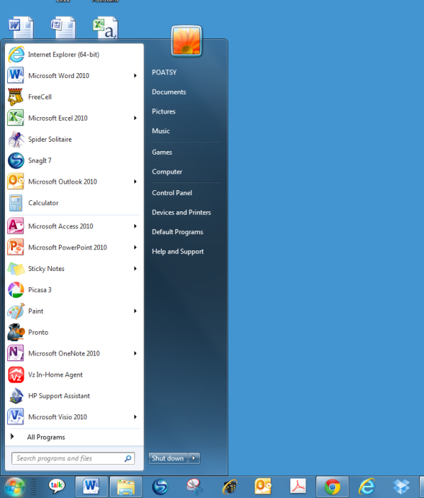
Installing, Uninstalling and Starting Software
Most software must be permanently installed on your system
Installing from CD or DVD
Downloading from the Internet
Uninstalling software
Use uninstall utility
Starting software
Click icon in All Programs list
Use shortcuts
Start menu
Notes:
Before you use most software, you must permanently place it, or install it, on your system. The installation process will differ slightly depending on whether you’ve purchased the software from a retail outlet and have an installation CD or are downloading it from the Internet. Deleting or uninstalling software from your system requires that you take certain precautions to ensure you remove all associated programs as well.
When you buy software, you insert the CD or DVD that contains the program files, and for most programs being installed on a PC, an installation wizard automatically opens. By simply following the steps indicated by the wizard, you can install the software application on your system.
When you download software from the Internet, everything you need is contained in one zipped file. For the most part, these downloaded files unzip themselves and launch the setup program.
Uninstalling software in Windows requires using the uninstall utility. Most software programs load a series of files into different system locations to support their operation. When uninstalling, all of these files need to be removed, and the only good way to do this is through the uninstall utility.
The simplest way to start an application is by clicking its icon in the All Programs list found on the Start menu. Every program that you install on your system is listed in All Programs on the Start menu. However, in Windows 7, if you find you use only a few programs often, you can place a shortcut to those programs on the taskbar or pin it to the Start menu.

Slide 45
Getting Help with Software
Frequently asked questions (FAQS)
Online help & support
Screen tips
Integrated help
Help menu on File tab of most Microsoft applications
Microsoft Office gives you tips on tasks you’re working on.
Notes:
If you need help while you are working with software, you can access several different resources to find answers to your questions.
For general help or information about a product, many manufacturers’ Websites offer answers to frequently asked questions (FAQs).
Some programs offer online help and support. Online help may consist of documentation comparable to a user’s manual. However, many applications’ online help allows you to chat over the Internet with an online support team member.
Some applications are context sensitive and offer task-specific help or screen tips to explain where your cursor is resting.
In Microsoft Office applications, you will see a question mark icon on the far top right of the program screen. This icon takes you to the main Help interface.
Integrated help means that the documentation for the product is built directly into the software so you don’t need to keep track of bulky manuals. You can type your question, search for a term, or browse the Help topics. Like many software packages, Microsoft Office offers help documentation, which is installed locally on your machine, and online help resources, which are updated continually.
Finally, the Help menu, found in the File tab of most Microsoft applications, lets you choose to search an index or content outline to find out the nature of almost any Microsoft application feature.

Slide 46
Summary Questions (1)
What’s the difference between application software and system software?
What are Web-based applications, and how do they differ from traditional modes of software distribution?
What kinds of applications are included in productivity software?
What kinds of software do small and large businesses use?
What are the different types of media and entertainment software?
What are the different types of drawing software?
How can I purchase software or get it for free?
Where can I go for help when I have a problem with my software?

Slide 47
Summary Questions (2)
What’s the difference between application software and system software?
Application software is the software you use to do everyday tasks at home, school, and work. Application software includes productivity software, such as word processing and finance programs; media software, such as applications used for image and video editing; home and entertainment software, such as games or educational programs; and business software for small and large businesses.
System software is the software that helps run the computer and coordinates instructions between application software and the computer’s hardware devices. System software includes the operating system and utility programs.
What are Web-based applications, and how do they differ from traditional modes of software distribution?
Web-based applications are those that are hosted online by the vendor and made available to the customer over the Internet. This distribution model of on-demand software deployment is also referred to as Software as a Service (SaaS). Unlike traditional software that needs to be installed on individual machines or network servers, Web-based applications are accessed via an Internet connection to the host server. The appeal of Web-based applications is that they can be accessed from any machine that has an Internet connection and they can facilitate collaboration because many people can access the same file and work together in real time.

Slide 48
Summary Questions (3)
What kinds of applications are included in productivity software?
Productivity software programs include word processing, spreadsheet, presentation, note taking, personal information manager (PIM), and database programs. You use word processing software to create and edit written documents. Spreadsheet software enables you to do calculations and numerical and what-if analyses easily. Presentation software enables you to create slide presentations. Note taking software provides a convenient means to take extensive notes or to just jot down a few thoughts. You can easily organize and search your notes. PIM software helps keep you organized by putting a calendar, address book, notepad, and to-do lists within your computer. Database programs are powerful applications that allow you to store and organize data. Individuals can also use software to help with business-like tasks such as preparing taxes and managing personal finances.
What kinds of software do small and large businesses use?
Businesses, including home businesses, use software to help them with finance, accounting, strategic planning, marketing, and Web-based tasks common to most businesses. In addition, businesses may use specialized business software (or vertical market software) that is designed for their specific industry.

Slide 49
Summary Questions (4)
What are the different types of media and entertainment software?
Multimedia software includes digital image, video, and audio editing software; animation software; and other specialty software required to produce computer games. Many software programs are available for playing, copying, recording, editing, and organizing multimedia files. Because modern users have so many audio, video, and image files, many software solutions are available for organizing and distributing these types of files.
What are the different types of drawing software?
Drawing software includes a wide range of software programs that help you create and edit simple line-based drawings or create more complex designs for both imaginative and technical illustrations. Floor plans, animations, and mind maps are some of the types of images that can be created.

Slide 50
Summary Questions (5)
How can I purchase software or get it for free?
Almost every new computer system comes with some form of software to help you accomplish basic tasks. You must purchase all other software unless it is freeware or open source code, which you can download from the Web for free. You can also find special software called shareware you can run free of charge for a test period. Although you can find software in many stores, as a student you can purchase the same software at a reduced price with an academic discount. When you purchase software, you are actually purchasing the license to use it, and therefore must abide by the terms of the licensing agreement you accept when installing the program.
Where can I go for help when I have a problem with my software?
Most software programs have a Help feature built into the program with which you can search through an index or subject directory to find answers. Some programs group the most commonly asked questions into a single frequently asked questions (FAQ) document. In addition, many free and fee-based help and training resources are available on the Internet and through booksellers.

Slide 51
End of Chapter

