Slide 1
AEIS 408.
Extension Organization and Management
(Credit hour: 3)
Md. Mahbubul Alam, PhD
Dept. of AEIS
Sher-e-Bangla Agricultural University

Slide 2
Extension Programme Planning, Monitoring & Evaluation

Slide 3
Concepts (1)
What is extension?
  Teaching, educating, informing
  A programme based activities performed to accomplish its purpose
  Thereby, success of extension service largely depends on the quality of programme.
What is programme?
  List of events
  A plan of procedures, or
  A course of action
  A logical sequence of operations to be performed in solving a problem
  Total sum of multiple projects and activities that have an impact on the same sector or geographical area

Slide 4
Concepts (2)
What is planning?
  Designing a course of action to achieve ends/goals
  Process of studying past & present, in order to forecast the future, and in the light of future determining the goals to be achieved, and what must be done to reach them (G. L. Ray, 1991)
  e.g., Five year plan, Millennium Development Plan (MDG), Vision 2020-21
What is programme planning?
  A decision making process, which involves
    Critical analysis of existing situation and problems
    Evaluation of various alternatives
    Selection of the relevant one and give necessary priorities based upon needs and resources

Slide 5
Concepts (3)
What is extension programme?
  A statement of situations, objectives, problems & solutions
Situations
  Statements regarding the culture, social, economic & physical conditions
    Demographics
      Population numbers, ages, gender, density, rural vs. urban distribution
    Physical environment
      Nature, agro-ecological zones, climate, nature resources, major crops, livestock, vulnerability or susceptibility of natural disasters,
    Infrastructure
      Roads, schools, heath care facilities, water & sanitation conditions,
    Beliefs & practices
      Culture, religious, social, political
    Economics
      Wealth, distribution of economic classes, source of income, employment potential

Slide 6
Concepts (4)
Problems
  A specific negative situation related to human condition
  However, problem is not the absence of solution
Objectives
  Future desired situation that will be achieved by solving the problems.
  Positive achievements are in fact objectives.
Three levels
  Output: Lower level of objectives achieved immediately after taking action
  Purpose: Objectives achieved immediately after solving the problem
  Goal: Higher level objective towards which the programme is expected to contribute or impact of the programme.
Solutions
  Strategies which will be used to achieve the desired objectives
Notes:
Output: e.g. provide training, trained farmers
Purpose: increase production
Goal: increase income

Slide 7
Programme Planning: Importance/Objectives
To solve a problem or satisfy a need
  Present situation vs. desired situation
To identify what is to be done and why
To measure and evaluate the progress of the program
To ensure continuity of the program
To avoid waste of time and resource
To justify expenditure and ensure flow of funds
To present in written form statement for public use

Slide 8
Extension Programme Planning: Principles (1)
Analysis of the facts in a situation
  land, crops, economic trends, social structure, economic status of people, their habits, traditions & culture, etc.
Identify problems based on people’s needs & interests
  Select problems that are genuine & urgent & have wider concern
  Select problem based on farm families’ needs and interests, educational level & resources
  People join together because of mutual interests & needs
Determination of definite objectives & solution which offer satisfaction
  Set objectives & offer solutions that are within reach & give satisfaction
  People must see how they are going to be benefited by the proposed solution

Slide 9
Extension Programme Planning: Principles (2)
Permanence with flexibility
  Programme must be forward looking & permanent
  Ordinary events may subject to change
Balance with emphasis
  Should cover majority of people’s interests
  Comprehensive to embrace all aged groups, creeds & races
Definite plan of work
  Good organization & careful planning for action
  A plan of work is an outline of procedure enabled efficient execution of the entire programme
Educational values
  NOT only solve problem but the focus should be development of people
  Capable people to identify and solve problem by themselves
  Provide an opportunity to learn about their own community & area

Slide 10
Extension Programme Planning: Principles (3)
Continuous process
  In a changing environment, extension must adjust & plan for the future to serve the people
  Five steps:
  Keep close with the people
  Be flexible & ready to grasp with firmness new problems as they arise
  Work with people in seeking practical solutions of their problems
  Keep abreast of technological & social change
  Close the gap between research discovery & practical application
Coordinating process
  Coordinating the efforts of all interested leaders, groups & agencies, and considering use of resources,
  i.e. working with people

Slide 11
Extension Programme Planning: Principles (4)
Involves local people & their institutions
  Involvement of local people & institutions in planning is essential for the success of any programme
  People become interested and give better support to the programme when they are involved in the planning process
Provides for evaluation of results
  Evaluation is important in order to make intelligent decisions at achieving the stated objectives
  Effective evaluation depends on clear objectives
  Both concurrent & ex-post facto types of evaluation should be carried out.

Slide 12
Extension Programme Planning & Evaluation
Extension programme
  A written statement that contains four elements.
Objectives
  that an extension agent expected to be achieved in the area within a specified period of time
  often a one-year period
  it enables the agent to review the programme at the start of each farming year
Means
  way of achieving the objectives
Resources
  funds & facilities that are needed to fulfill the programme
Work plan
  schedule of extension activities that lead to fulfill the programme objectives

Slide 13
Why extension programme planning is needed?
For farmers
  What they can expect from extension service
  How effective the extension service/agent is
For extension agent/worker
  Provide a firm basis for planning extension activities on a monthly & weekly basis
  Anticipate well in advance what resources will be needed
  Familiarize the new agent with the programme
For senior extension personnel
  Assess the agent’s performance
  Offer advice for improvement and justify requests for additional staffs, equipments and funds
For external organizations
  Helps to coordinate their activities with what the extension agent is doing

Slide 14
How to plan extension programme?
Depends on whether plans are made at local or national level. Two forms/approaches
Planning from below
  Bottom-up approach
  Farmers along with extension agent formulate plan on the basis of local needs or problems
  Make requests for specific assistance from national and regional authorities.
Planning from above
  Top-down approach
  Expected to implement plans made at national level
  e.g., a target numbers of hectares to be planted with improved seeds, a specified farmers of farmers’ groups to set up

Slide 15
Which approach is the best? Local or National?
National policies and programmes provide framework for planning local programmes, and set priorities.
  If national priority is to increase crops than livestock, the local agent should give the crops a higher priority in his programme.
National programmes also make funds & inputs available for particular kinds of activity, however
  Local needs provide the motivation for agricultural development
  Improvement comes from the willing action of farmers, as they try to increase their own output and living standards
  When agent’s freedom to make decision is limited by national priority, he must still prepare a programme that fulfill these directives within his area
The best approach is: balancing national and local requirements
  Local requirement helps to analysis of local problems, increase motivation & self-confidence,
Notes:
1. Both should be integrated.
2. Balancing national and local requirements: should consider national requirements but also focus on how local people reflects their needs, and what they want to happen in the locality.

Slide 16
Extension Programme Planning: Steps
Analyze the present situation
  Collecting facts
  Analyzing facts
  Identification of problems and potential
Set objective(s)
  Finding solutions
  Selecting solutions
  Stating objectives
Develop plan of work
Project Appraisal & Project Approval
Implement the programme
Evaluate the programme

Slide 17
1. Analyze the present situation
Collecting facts
  Socioeconomic condition of the area
  Problems related to socioeconomic conditions
  Agriculture: land, crops, cropping patterns, soil fertility and type, livestock & fisheries, etc.
  Health: medical facilities, nutrition & sanitation
  Education: literacy rate, academic institutions, adult education, mass education
  Income: Income generating activities, business
  Infrastructure: roads, culverts, irrigation channels
  Living standard: residential areas, family library, electronic goods
  Organizations: Cooperatives, groups, clubs, association, village library, etc.
Analyzing facts
  Surveys (social & economic), census repots, PRA, RRA, focus group discussion
Identification the problem & potential
  Principle core problems that affects the situation severely
  Secondary core problems
  Factors responsible for the problems
  Cause-effect-relationship

Slide 18
2. Set objective(s)
Finding solutions
  Brain storming
  Objective chart
  Expert opinion
  Subject matter specialist
  Books, journals, & other written materials
Selecting solutions
  Acceptable to farmers in the area
  Technically sound and tested by research & experience elsewhere
  Consistent with national policy, & with the local activities of other agencies
  Feasible within the time and with the resource
  Within the scope of the agent’s ability & job description
Stating objectives
  Based on the national priorities, prepare a hierarchy of objectives
  Objectives should be expressed in numbers and amounts (i.e. SMART) rather than general statements

Slide 19
3. Develop plan of work
Is a written outline of activities to be done by efficiently execution of the entire programme.
Indicates what activities to be done by whom, when, where and how.
For detail description, please refer to your Practical Class

Slide 20
4. Project Appraisal & Project Approval
Project appraisal
  A pre-investment of a project to determine whether the project should be implemented or not
  A stage where a decision is made whether a project will implement or not
  Involves comparison of costs and benefits
  If benefits outweighs the costs, the project is considered to be viable and accepted.
Project approval
  Once the project is prepared, it submits for the approval to donor agencies or higher administration.
  Extension programme plan is approved by the District Administrator
  Once approved, the district administer advises upazila level officers to implement the local extension plan.

Slide 21
5. Implement the programme
The extension agent executes or carries out the activities specified in the work plan.
An extension programme should be flexible enough to allow the agent to respond to the circumstances. However, unnecessary changes or adjustments should not be made.
The success of implementation lies on how the executors are systematic, persistent, perseverance & patient in performing the project activities.
Points to be considered during implementation
  Starting of work timely as per plan of work
  Providing training to the staffs, if necessary
  Procuring required inputs & technical information
  Facilitating to modify the plan
  Providing progressive report to the staffs time to time
  Seeking help & coordination from sister organizations

Slide 22
6. Evaluate the programme
Is a process of determining the extent to which objectives have been attained.
Must have a built-in system of evaluation to know how well the work is done.
Evaluation helps how far an activity has progressed & how much further it should be carried to accomplish objectives.
Evaluation should measure not only the end results but also ensure that all steps are correctly followed.
Types: Ex-ante, on-going and ex-post
Ways of collecting information for evaluation:
  Agent’s reports
  Supervision
  Discussions
  Questionnaires
  observation

Slide 23
Indicators of Evaluation
Output indicators are the symptoms of the results after implementation of the programme
  Production: quantity/weights, numbers & qualities of crops, livestock, fisheries, forestry, etc.
  Cost of production: Cost of production of inputs-cash & kinds
  Investment: land, capital, human resources & others
Economic indicators are expressed in terms of income of the beneficiaries
  Purchase of inputs of agricultural production
  Purchase of foods & drinks and dress & clothing
  Building of houses
  Medical treatment, investment in business, savings, etc.
Quality of life indicators means the degree of standard of life an individual leads for his economic life.
  Mortality status, child nutrition, school enrolment, pure drinking water facilities, energy and electricity facilities, marketing facilities

Slide 24
Good Programme: Characteristics
Suitable for use by the users concerned with the programme
Should clearly state situation, problems, objectives and solutions
Should state both long & short term objectives clearly & meaningfully
Should specify the subject matter related to achieve each objective
Should be used as a basis for developing an annual plan of work
Should be circulated by appropriate means & made available so that users can get it easily

Slide 25
Why programme fail?
Lack of people’s participation & commitment
Lack of coordination among extension services, client system & other organizations
Lack of clarity of objectives & goals
Lack of appropriate project/programme planning
Failing to diagnose existing problems & analyzing the situation properly
Failing to pay equal attention to resource rich and resource poor farmers
Lack of trained & skill personnel
Unavailability of inputs & other materials at the right time
Lack of organization support with timely budget allocation
Lack of establishing rapport with opinion leaders & local people
May be failed due to political reason & natural reasons

Slide 26
Modern Data Collection Methods (1)
The success of project or programme largely depends upon
  how efficiently data are collected
  in what extent people participated in project/programme planning
Conventional methods of data collection
  Interview schedule
  Mailed questionnaire
  Case studies
  Tape recorded interview
  Observation
  Group interview
  & so on

Slide 27
Modern Data Collection Methods (2)
Modern data collection methods
  Rapid Rural Appraisal (RRA)
  Participatory Rural Appraisal (PRA)
  Participatory Rapid Rural Appraisal (PRRA)
  Participatory Technology Development (PTD)
  & others

Slide 28
Participatory Rural Appraisal (PRA)
A process of involving local people in the analysis and interpretation of a rural situation (Ray, 1998).
Objectives
  to capable local people for critical analysis & assessment of their own situation
  to make a profile of the local area on various aspects of village situations
  to ensure people’s participation in programme planning
When do you need it?
  To design need based project with people’s participation
  To get a realistic, clear & fair view of rural & urban people
  For empowering and building capacity of participants
  To supplement formal survey
  To use as a basis for further investigation and project redesign

Slide 29
PRA: Techniques
Physical Mapping
Social Maps
Transect Walks
Wealth Ranking
Venn Diagram
Daily Routine
Seasonal Diagram
Matrix Ranking & Matrix Scoring
Problem Census
Focus Group Discussion

Slide 30
Physical Mapping
Objectives:
  To establish relationship between natural resources and farmers activities
  To identify problems & opportunities
Steps:
  First, select a village
  Ask farmers to join/participate
  Ask them to prepare an outline of what the area looks like
  Ask them to point out the roads, fields, rivers, important buildings, etc.
  Ask them to identify the agricultural practices including crops, livestock, etc.
  Ask them to mark changes occurred over the years, why & how these changes occurred.

Slide 31
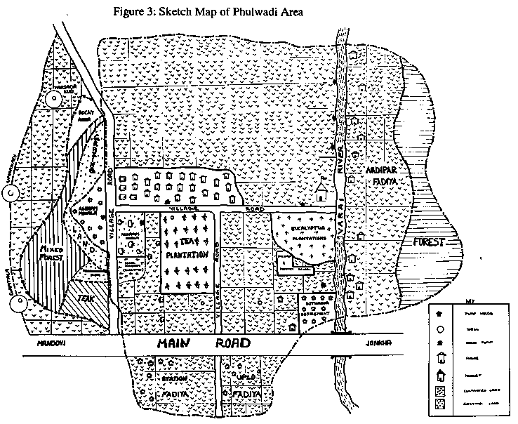
Physical map

Slide 32
Social Maps
Objectives
  To show different categories of households in relation to each other
  To locate community facilities in order to identify issues to be tackled by extension.
Steps:
  Identify people who live in an area
    How many households, how do they classify households?
      as male or female headed, by extension, by farm size or income
  Make an outline map of the selected area mark with roads, rivers & fields
  Identify where each household lives and what is the pattern
    Do smaller farmers live nearer the river, do larger farmers live by the market, do female headed households live near land with low or high productivity & why, what is the implication for local extension programme?

Slide 33
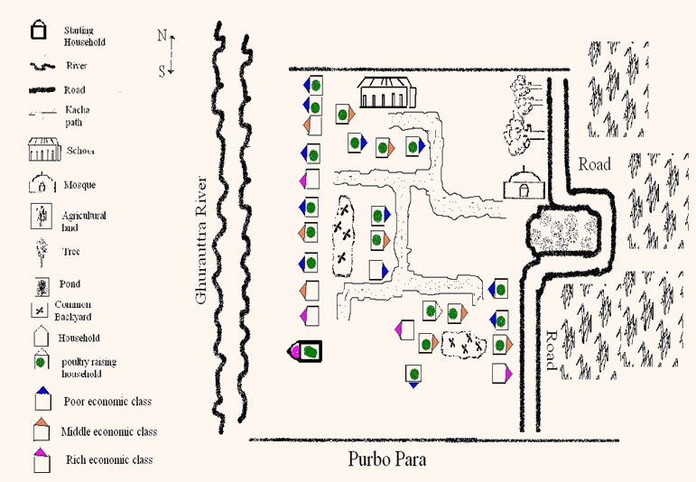
Social map

Slide 34
Transect Walks
Objectives
  To provide first hand information about an area and establish relationship between different resources,
  To identify opportunities & problems to be addressed,
Steps:
  Ask a small group of farmers to choose a route to walk through
  Make a list of things for look for- trees, crops, livestock, land quality, problems & opportunities
  Observe changes in land use, problems & opportunities
  Make a diagram at the end of the walk.

Slide 35
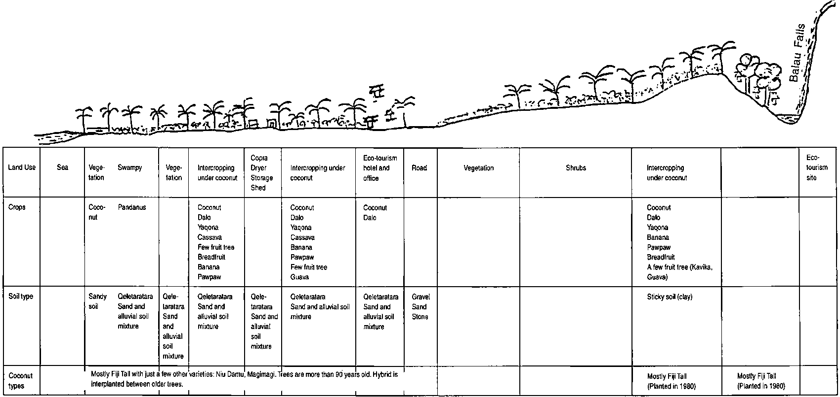
Transect Walks

Slide 36
Wealth Ranking
Farmers make inventory of wealth (occupation, farm size, income) of each household in a card separately to explore problems of each category of households realistically.
Steps
  Make a list of all households and prepare a card for each household
  Categorized households
    by occupation- farming, business, government jobs
    by farm size- large, small, landless
    by income- high, medium, low
  Sort the cards (i.e. households) into their categories
  Identify what different extension support each category needs
  Identify what different problems and opportunities each category has

Slide 37
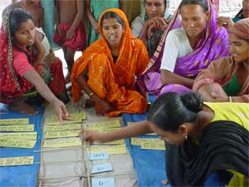
Wealth ranking

Slide 38
Venn diagram
Analyze organizations in an area and identify existing groups that extension should work with.
Analyze how DAE’s relationship with farmers could be improved.
Steps:
  Make a list of all organizations
  Identify the importance and relationship of these organizations with the farmers by drawing circles
    Big circles- most important
    Small circles- less important
    Near circles- indicates good relationships
    Far away circles- indicates weak relationships

Slide 39
Daily routine
Understand how people use & allocate time
What are their priorities
Helps DAE staff to identify the best time to arrange visits with farmers
Steps
  Select an individual or a farm family
  Discuss all things he/she is involved in doing.
  Ask what time they begin his day and what does he do first.
  Write the all tasks he used to do in a day and duration of performing each task.
  How does the daily routine change with the seasons?
  Identify what time is appropriate for DAE staff to visit.

Slide 40
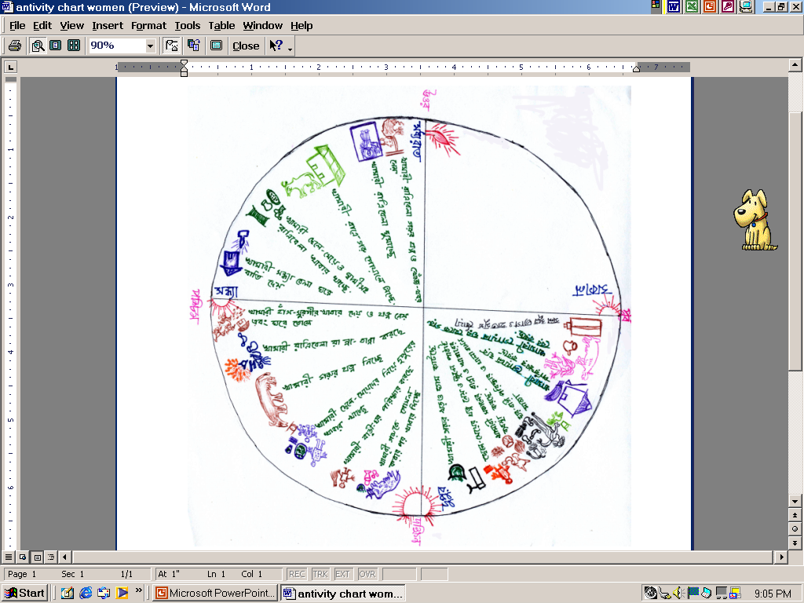
Daily routine of a farm woman
Midnight
Sunset
Sunrise
Noon

Slide 41
Seasonal diagram
Investigates seasonal trends, critical points in seasons or months when the income, credit, market price of produce, labour requirements etc. are high or low, so that the problem can be addressed efficiently and timely.
Often presented in a bar chart or a line graph.

Slide 42
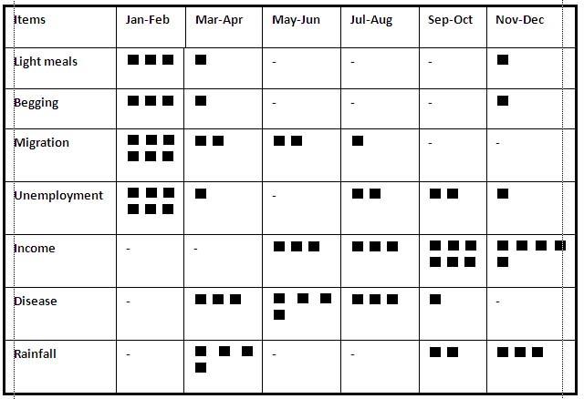
Seasonal diagram

Slide 43
Matrix ranking & matrix scoring
Compare the advantages and disadvantages of products or services and rank them in order to choose which one is better over others.
Scale: 1-10, here, 1o= most preferable, 1= least preferable
Facilitates taking right decision to choose products or services.

Slide 44
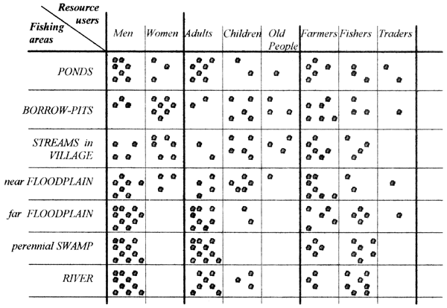
Matrix ranking & matrix scoring

Slide 45
Problem census
Identify farmers’ information needs (FINA)
For detail, please refer to your practical class

Slide 46
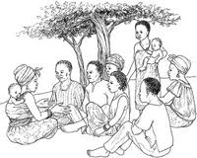
Focus Group Discussion
A form of qualitative data collection tool by which a group of people are asked about their perceptions, opinions, beliefs, attitudes towards a subject matter or problem-matter.

Slide 47
References
FAO. “The planning and evaluation of extension programmes”, from http://www.fao.org/docrep/t0060e/T0060E09.htm#Stages in programme planning
DAE. January, 1999. Agricultural Extension Manual. pp. A-43 to A-51.
Bhuiyan, M.H., Miah, M.A.M., Akanda, M. G.R. & Bashar, M.A. 2014. Agricultural Extension Education. Dept. of Agricultural Extension & Information System, Sher-e-Bangla Agricultural University, Dhaka.

