Slide 1
Lecture 1 Fundamentals to Remote Sensing
Md. Mahbubul Alam, PhD
Dept. of AEIS, SAU
Notes:
GeoInformatics-> three subjects, e.g. GPS, GIS and Remote Sensing.
Common in these three are: 1. digital, 2. Spatial (related to location specific data handling) and 3. Generic (apply in many application areas)
Application in: Natural resource management, disaster management

Slide 2
Intended Learning Outcomes (ILOs)
Earth observation: Concept and needs
Remote Sensing: Concept and types
Platforms of remote sensing
Global Satellite Observation System
History of Remote Sensing
Electromagnetic radiation

Slide 3
Earth Observation: Concept
A process of gathering information about physical, chemical, biological, geometrical properties of the planet.
Assess the status and monitor changes of the natural and cultural environment.
Geospatial data acquisition is central to earth observation.
Mapping, monitoring and forecasting are the uses of earth observation.

Slide 4
Geospatial Data: Needs
For up-to-date record of property boundaries,
To design a highway,
For urban planning to identify areas of informal settlement and to furnish infrastructural improvements based on development plan,
For forecasting the overall agricultural production of a large area,
To observe soil properties and monitoring degradation,
To find out the waste disposal site and detect the dump composition with volumes,
To understand the El Niño phenomenon and track spatial patterns of sea surface temperature, sea levels and sea currents.

Slide 5
Remote Sensing: What?
Remote sensing is the science (and to some extent, art) of acquiring information about the Earth’s surface without actually being in contact with it (©CCRS/CCT).
This is done by sensing and recording reflected or emitted energy and processing, analyzing, and applying that information.
It involves an interaction between incident radiation and the targets of interest.
An imaging systems where seven elements are involved.
Notes:
1. Best example of RS is our “eyes”, many things we watch without touching them BUT eyes are not sensitive to all parts of Electromagnetic spectrum (EMS), only sensitive to visual part of EMS.

Slide 6
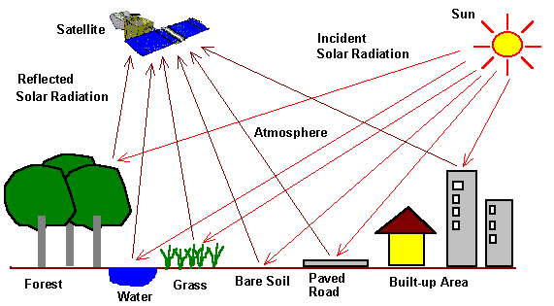

Slide 7
Energy Source or Illumination (A)
First requirement for remote sensing is to have an energy source which illuminates or provides electromagnetic energy to the target of interest.
Radiation and the Atmosphere (B)
Energy travels from its source to the target and interact.
Interaction with the Target (C)
Recording of Energy by the Sensor (D)
Mostly remote-not in contact with the target
Transmission, Reception, & Processing (E)
Transmitted by electronic form, processed into an image
Interpretation and Analysis (F)
Processed images are interpreted and information are extracted about the target.
Application (G)
Fig. Illumination-Electromagnetic Radiation

Slide 8
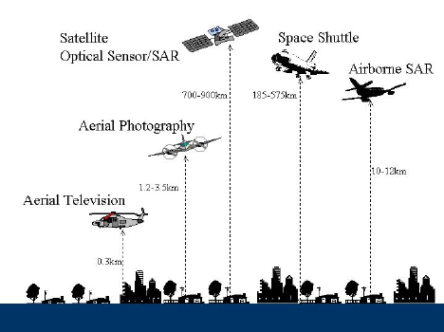
Platforms and sensors of satellite and airborne remote sensing
© F.Yamazaki
Notes:
SAR=> Synthetic-aperture Radar
Latest=>UAV-> Unmanned Aerial Vehicle.

Slide 9
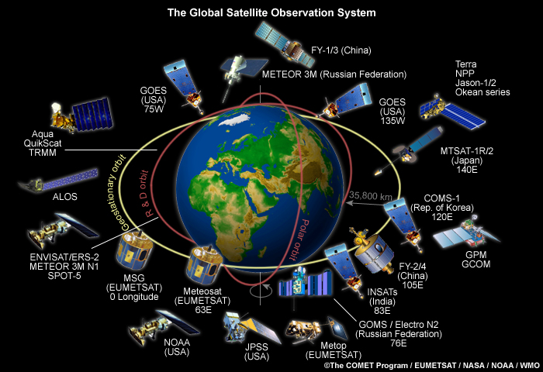

Slide 10
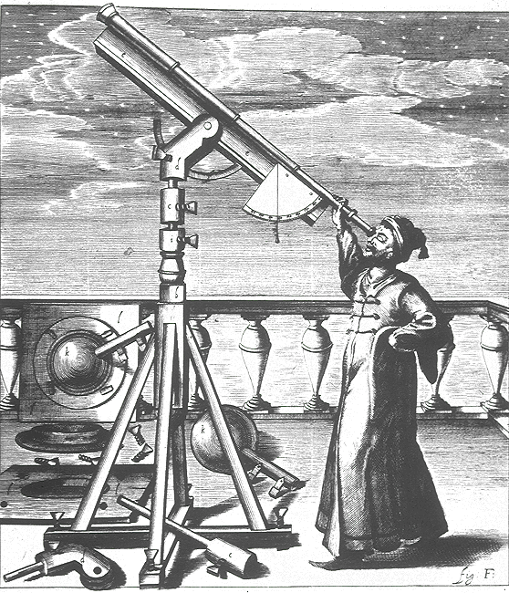
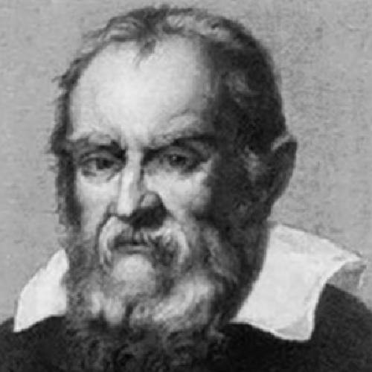
History of Remote Sensing
Galileo
1609 - Invention of the telescope

Slide 11
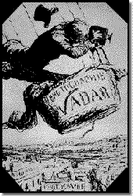
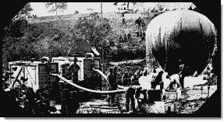
History of Remote Sensing (cont’d)
1862 - US Army balloon corp
1859 - First aerial photographer, Gaspard Felix Tournachon, also known as Nadar

Slide 12
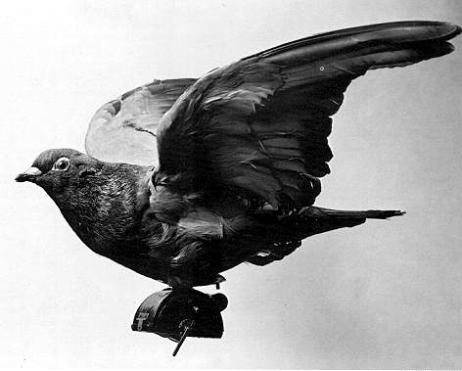
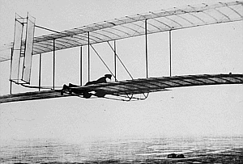
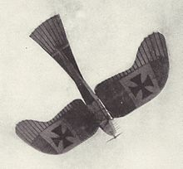
History of Remote Sensing (cont’d)
First flight, Wright Bros., Dec. 1903
1908 - First photos from an airplane
1903 - The Bavarian Pigeon Corps
A German observation plane (Rumpler Taube) in World War I

Slide 13
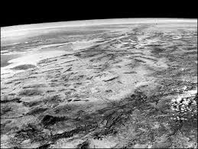
Remote Sensing: Development
First space-based photo taken on March 7, 1947.
It was taken at an altitude of 100 miles over New Mexico.
This photo was taken by an automatic K-12 Camera from VIKING SOUNDING ROCKET.

Slide 14
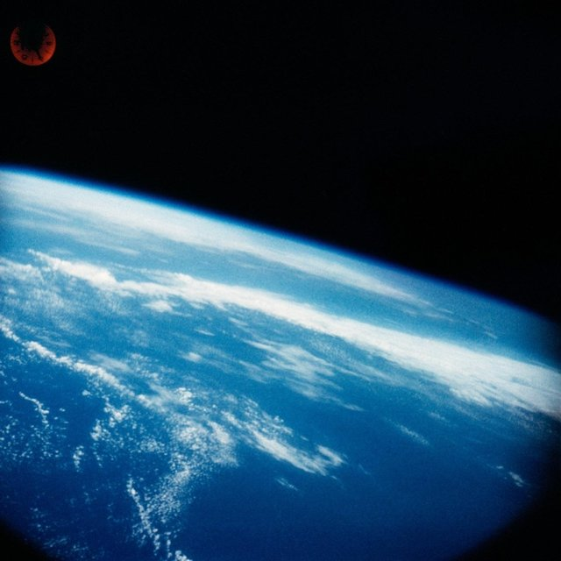
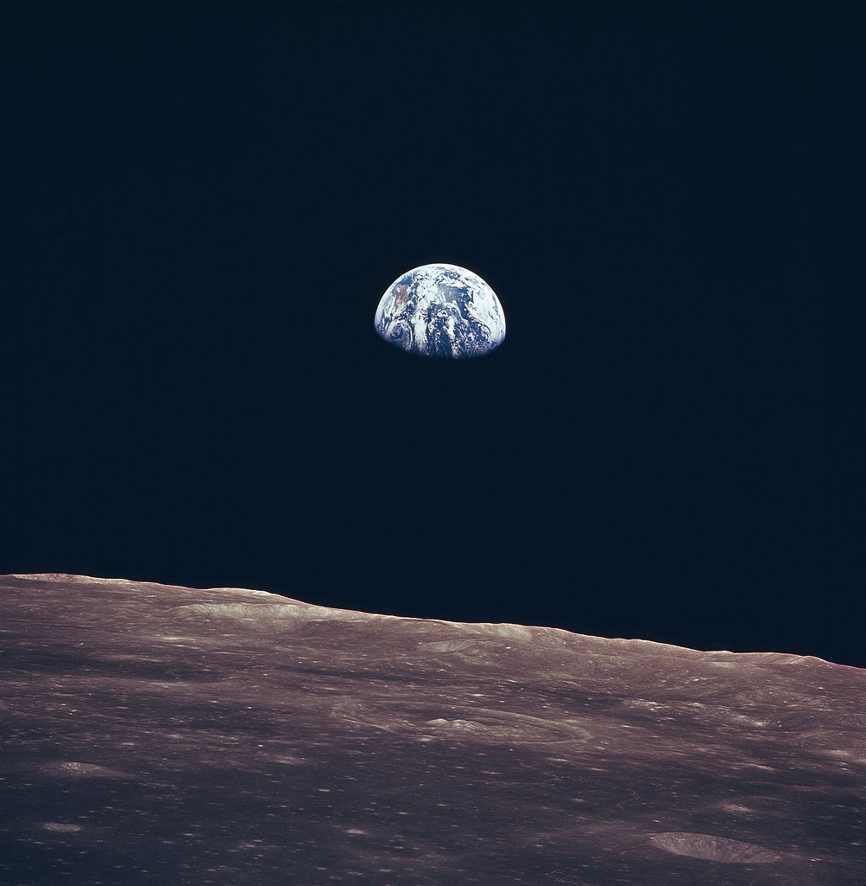
Remote Sensing: Development (cont’d)
Photo was taken from Mercury-Redstone 3 (MR-3) spacecraft on May 5, 1961, the first US manned spaceflight
Earthrise, seen from the moon surface by the Apollo Lunar Landing Mission in July, 1969.

Slide 15
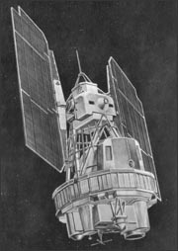
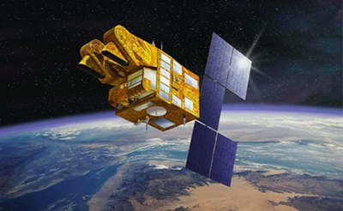
Remote Sensing: Development (cont’d)
1970s, Rapid advances in Digital Image Processing
1980s, Development of Hyperspectral sensors
1990s, Global Remote Sensing Systems (GPS)
Bangabandhu-I was launched in May 11, 2018
Rocket: Falcon 9 Block 5
SPOT French Earth Observation Satellite in 1986 (10 PAN & 20 mtr spatial resolution)
Landsat-1 (July 23, 1972)
Notes:
Landsat old name was ERTS=> Earth Resources Technology Satellite.
SPOT-> higher spatial resolution

Slide 16
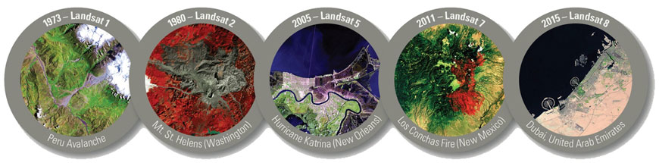
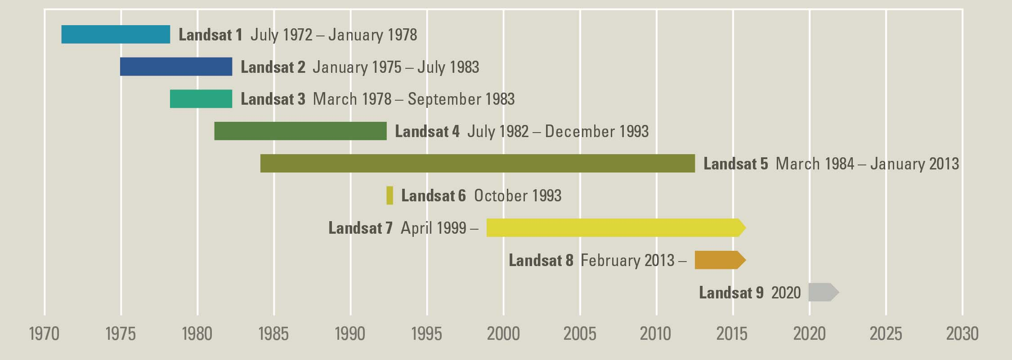
Landsat Mission Timeline

Slide 17
Satellite Remote Sensing vs. Aerial Photograph
Satellite Remote Sensing
Aerial Photograph
Speed: very high, high temporal resolution
Level of details: 50 cm in Geo Eye-1 satellite
Weather condition: cloud is big hindrance in optical data
Type of data: less, as each new data type needs new satellite launching
Location: cross boarder images and large swath images can be easily taken
Post processing: easy because of single image covering large area
Speed: slow, needs more time to cover an area, not regular
Level of details: may go upto 2.5 cm
Weather condition: may work in high cloud and thin cloud
Type of data: high, as new data type needs new sensors to be mounted in aircraft
Location: cross boarder images cannot be taken without permission
Post processing: tough due to large numbers of images covering a small area
© IITR

Slide 18
Types of Remote Sensing
Passive RS
Active RS
Don’t have any external sources of energy
Worked at either reflected radiation from sun, thus can work at night or emitted radiation from the target object/surface.
Suffers from variable illumination conditions of Sun and influence of atmospheric conditions.
Has its own source of energy
Active sensors emit a controlled beam of energy to the surface and measure the amount of energy reflected back to the sensor.
Controlled illumination signals.
Can be done at day/night.
© IITR

Slide 19
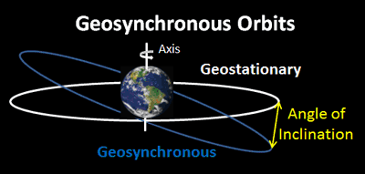
Notes:
Normal remote sensing is being done by Sun-synchronous Orbit, 840 km away from the earth, near polar orbit
Geostationary, Far deeper. 35,786 km away from equator, keep looking same part of the world all time. All the earth moves, the satellite moves.
GPS satellite, geosynchronous, synchronous with earth rotation.

Slide 20
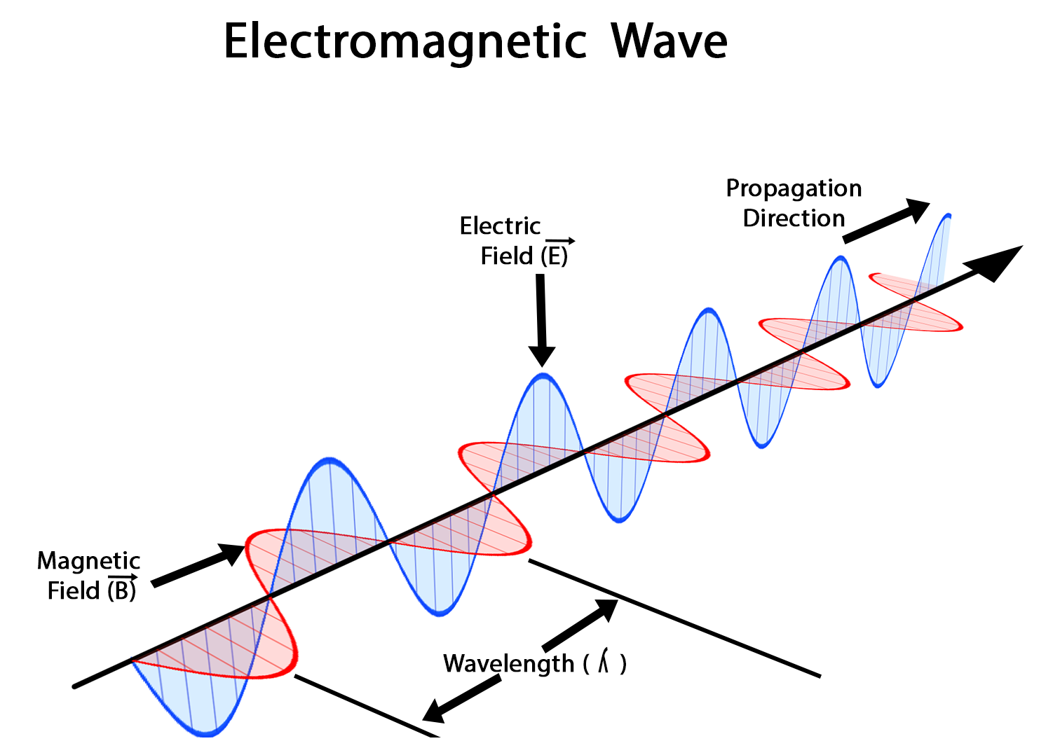
Electromagnetic Radiation
A kind of radiation including visible light, radio waves, gamma rays, and X-rays, in which electric and magnetic fields vary simultaneously.
Energy source is the first requirement for remote sensing.
Two characteristics of EM radiation viz. wavelength and frequency are most important for understanding of remote sensing.

Slide 21
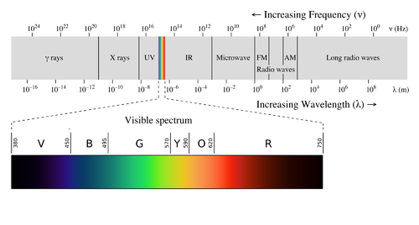
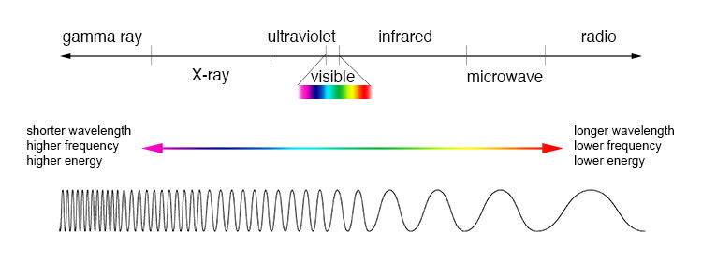

Slide 22
Wavelength λ = Distance between adjacent wave tops [m]
Frequency f = Frequency refers to the number of cycles of a wave passing a fixed point per unit of time.

Slide 23
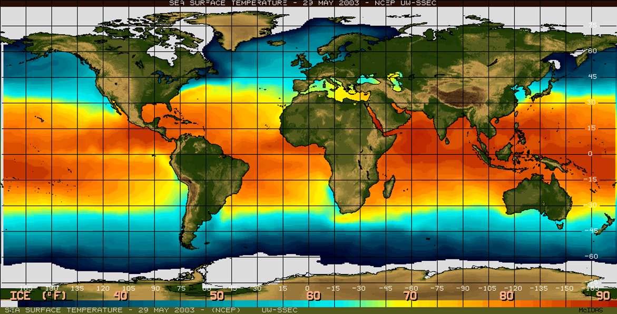

Slide 24
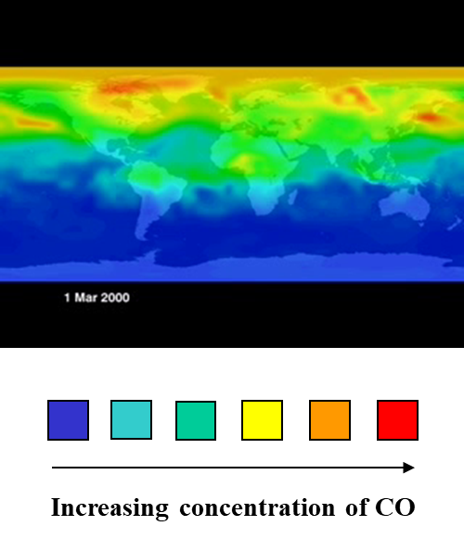

Slide 25
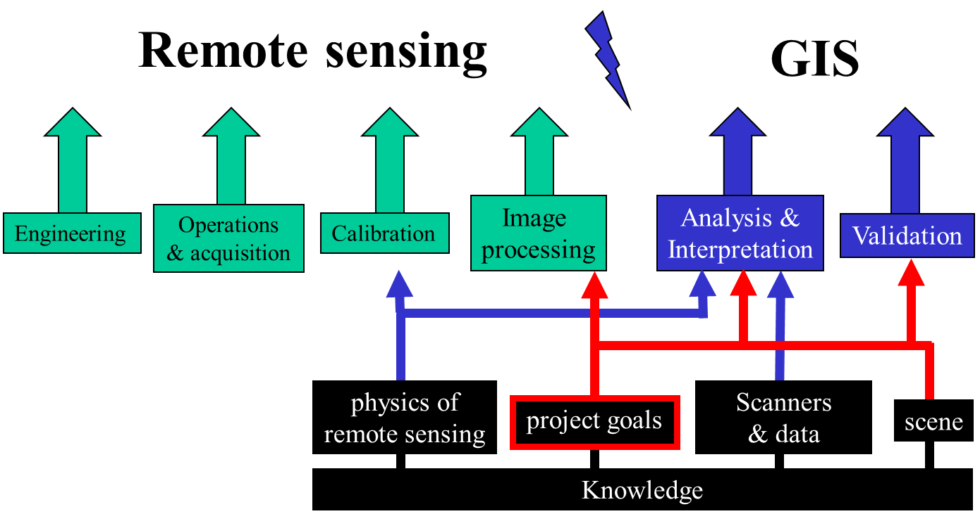
RS Vs. GIS

