Slide 1
MIS 107: Information Systems & Computing
Lecture 3:
Information Systems, Organizations, and Strategy by
Prof. Md. Mahbubul Alam, PhD

Slide 2
Learning Objectives
Identify and describe important features of organizations that managers need to know about in order to build and use information systems successfully.
Demonstrate how Porter’s competitive forces model helps companies develop competitive strategies using information systems.
Explain how the value chain and value web models help businesses identify opportunities for strategic information system applications.
Demonstrate how information systems help businesses use synergies, core competencies, and network-based strategies to achieve competitive advantage.
Assess the challenges posed by strategic information systems and management solutions.

Slide 3
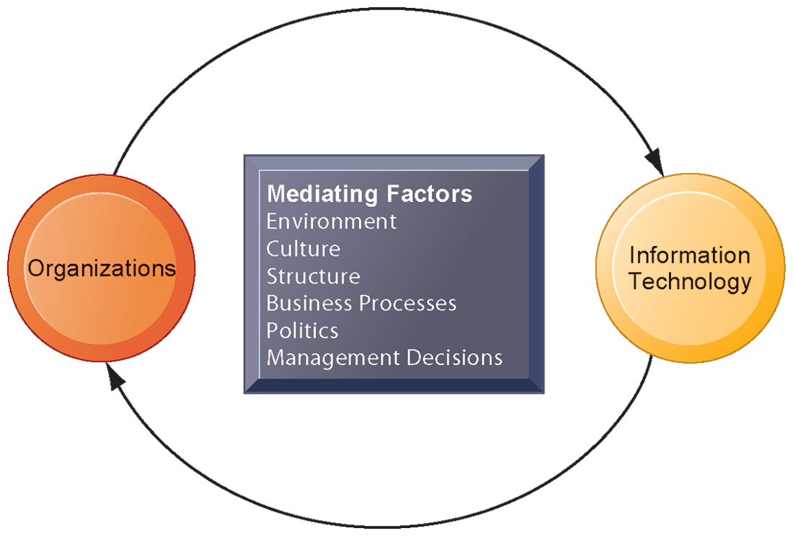
Relationships between Organizations & IT
This complex two-way relationship is mediated by many factors.
Other factors mediating the relationship include the organizational culture, structure, politics, business processes, and environment.
Need to understand how IS can change social & work life in the firm.
Notes:
Unless you understand your firm, you may not be able to design new systems or understand new systems.
As a manager, you have to decide which systems will be built, what they will do and how they will be implemented.
the relationship between these two and its effects on the future of a business are difficult to predict. For example, very few people could have predicted the prominence of e-mail and instant messaging in business communication 15 years ago.

Slide 4
What is an organization?
  Technical definition
    Stable, formal social structure that takes resources from environment and processes them to produce outputs.
    A formal legal entity with internal rules and procedures, as well as a social structure.
  Behavioral definition
    A collection of rights, privileges, obligations, and responsibilities that is delicately balanced over a period of time through conflict and conflict resolution.

Slide 5
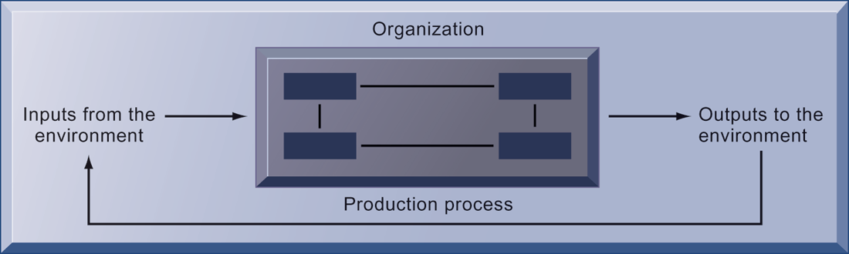
Technical view of organization
Inputs (capital and labor, the primary production factors provided by the environment) are transformed by the firm through the production process into products and services (outputs to the environment). The products and services are consumed by the environment, which supplies additional capital and labor as inputs in the feedback loop.

Slide 6
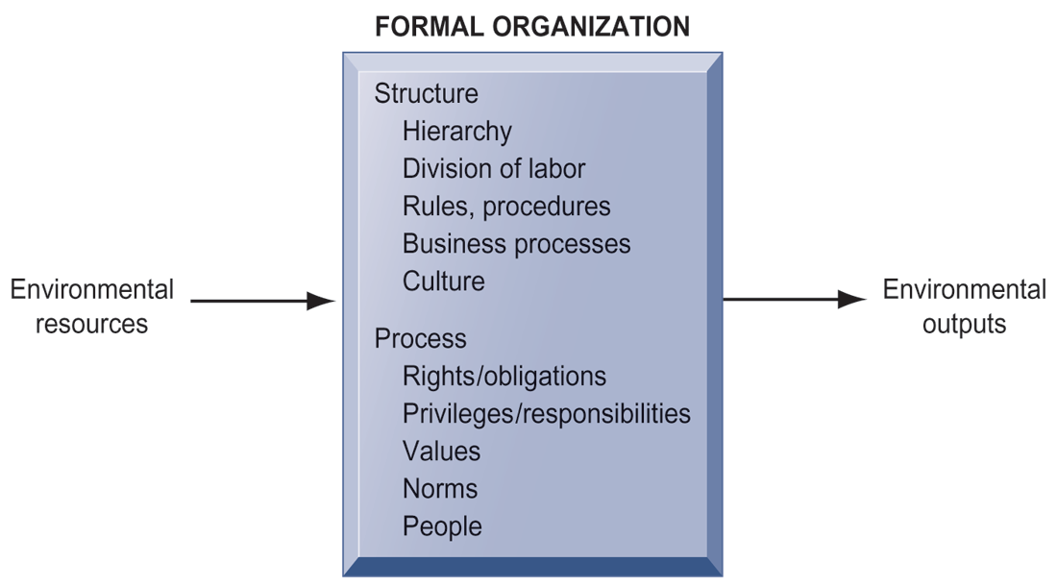
Behavioral view of organization
Firms operate with an existing structure & processes. Therefore, changing any element can take a long time, and will be disruptive, requires more resources to support training & learning.
The view suggests that building or re-building a system will be complex since it changes the organizational balance of rights, privileges, obligations & so on.
Notes:
So, which view is perfect?
In fact, both the views are not contradictory rather complementary.
Technical view tells how thousand of firms in competitive markets combine capital, labor & IT. While behavioral view shows how that technologies affect org’s inner workings.

Slide 7
Features of organization
Routines & business processes
  Routine: standard operating procedures- precise rules, procedures, & practices.
  Business process: collections of routines.
  Business firms: collections of business processes.
Organizational politics
  Divergent viewpoints lead to political struggle, competition, & conflict.
  Political resistance greatly hampers organizational change.
Organizational culture
  Set of assumptions that define goal & product
  What products the organization should produce, how & where it should be produced, for whom the products should be produced?
  It is a powerful unifying force that promotes common understanding as well as restraint change, especially technological changes. Since, it threatens commonly held cultural assumptions.
Organizational environments
  Organization and environments have a reciprocal relationship.
  Organization depends on environments, and also influence their external environments.
  Organization must respond to legislative & other requirements imposed by Govt. as well as the actions of customers and competitors.
Organizational structure: five types

Slide 8
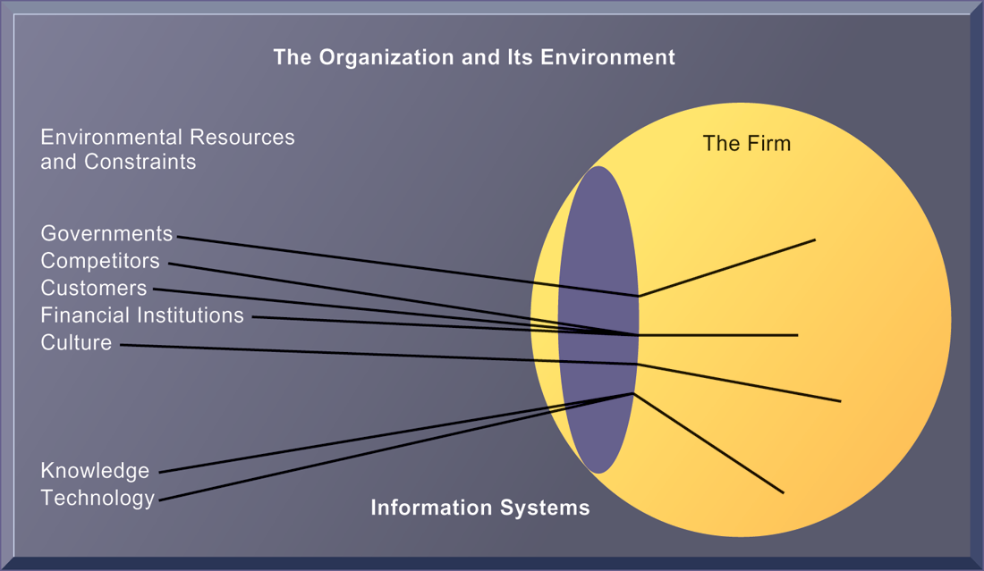
Relationship between organization & environment
Environments shape what organizations can do, but organizations can influence their environments and decide to change environments altogether.
Information systems are the key instruments for environmental scanning, play a critical role in helping organizations perceive environmental change and identify external changes that might require an organizational response.

Slide 9
Organizational structures: Types
Entrepreneurial
  Young, small firm, simple structure, first-changing environment
  e.g., small start-up business
Machine bureaucracy
  Centralized management & decision-making, slowly changing environment
  e.g., mid-size manufacturing firm
Divisionalized bureaucracy
  Combination of multiple machine bureaucracy, multiple products
  e.g., Fortune 500 firms, such as General Motors
Professional bureaucracy
  Knowledge-based organization, depend on expertise & knowledge
  e.g., Law firms, school systems, hospital
Adhocracy
  Groups of specialist organized into short-lived multidisciplinary teams, weak central management.
  e.g., consulting firm

Slide 10
Others Organizational Features
Goals
  Coercive goal (e.g., prison)
  Utilitarian goal (e.g., businesses)
  Normative goal (e.g., universities, religious groups)
Constituency
  e.g., some benefitting members, clients, stockholders, or the public.
Leadership styles
  Democratic. Autocratic, Laissez-faire leadership
Tasks
  Routine (e.g., manufacturing auto parts)
  Non-routine (e.g., consulting firms)
Technology

Slide 11
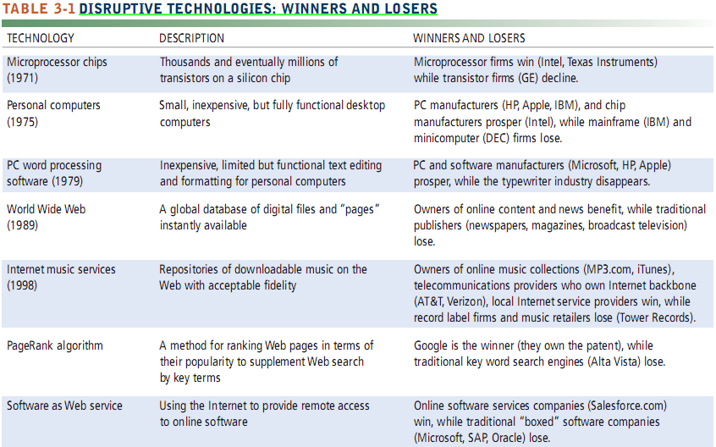
Disruptive Technologies: Winners Vs. Losers

Slide 12
IS impact on Business
Economic impacts
  Transaction costs, agency costs
  Shrink in size
Organizational and behavioral impacts
  IT flattens organizations
Post-industrial organizations
  Flattens shape of organization or fattens hierarchies
  Rely on knowledge & competencies rather formal positions
  e.g., Accenture, where employee move location to location assigned for specific tasks
Organizational resistance to change
  IT requires change in personal, individual routine, increases switching cost
The Internet and organizations
  Increases communication efficiency, reduces distribution cost
Implications for the design and understanding of information systems
  Matching between IS design and business process
Notes:
Transaction cost: search cost, information cost, or bargaining cost
Agency cost: Principle (CEO)- Agent (Manager) problem, Arises due to the ‘conflict of interest between shareholders and managers’.

Slide 13
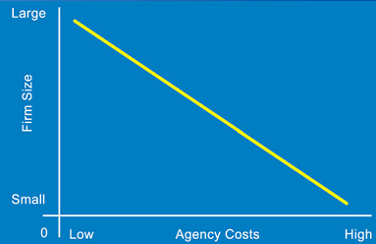
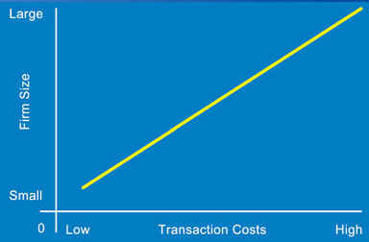
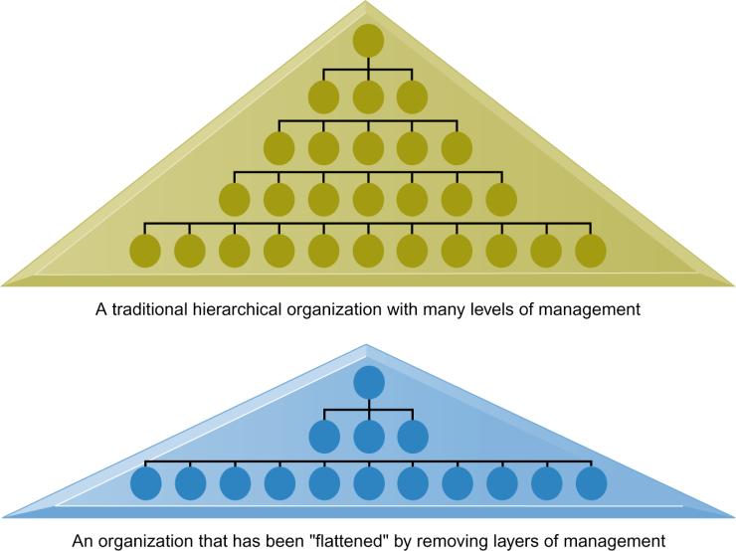
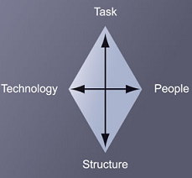
IT reduces internal management (supervision & monitoring) cost
IT reduces transaction costs as well as shrinks firm size
To implement change, all these 4 components must be changed simultaneously.
IT makes an organization flat by reducing levels in an organization.
Balance all 4!
Notes:
Information systems can reduce the number of levels in an organization by providing managers with information to supervise larger numbers of workers and by giving lower-level employees more decision-making authority.
Managers receive so much more accurate information on time, become much faster at making decisions, so fewer managers are required.

Slide 14
IS & Competitive Advantage
Why do some firms become leaders in their industry?
  Automobile: Toyota
  Offline retail: Walmart
  Online retail: Alibaba, Taobao
  Web search: Google (worldwide), Baidu (China), Yahoo (Japan)
They either have access to special resources that others do not have, or
They are able to use commonly available resources more efficiently-usually have superior knowledge and information assets.
BUT, how do you assess a business and identify its strategic advantage?
  Porter’s Competitive Forces Model

Slide 15
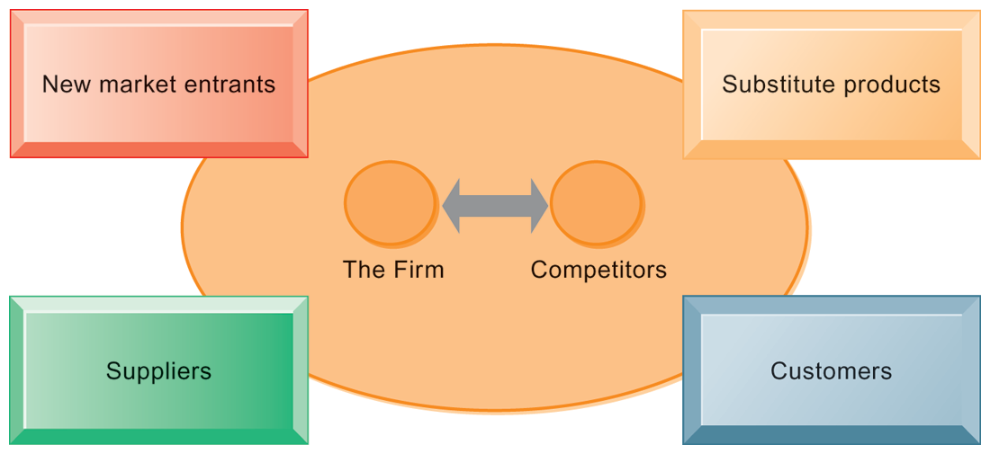
Porter’s Competitive Forces Model
In Porter’s competitive forces model, the strategic position of the firm and its strategies are determined not only by competition with its traditional direct competitors but also by four other forces in the industry’s environment: new market entrants, substitute products, customers, and suppliers.
Notes:
Substitute products/service: Gas replace oil, iTune replaces CD rooms. Etc.

Slide 16
IT enabled competitive strategies
Strategy | Description | Example
Low-cost leadership | Use information systems to produce & services at a lower price than competitors while enabling quality & level of service. | Big Bazaar
Product differentiation | Use information systems to differentiate products, & enable new services & products. | Nike (NIKEid), Apple, eBay
Focus on market niche | Use information systems to enable a focused strategy on a single market niche, specialize service. | Hilton Hotels, Taj Hotels (CRM)
Customer & supplier intimacy | Use information systems to develop strong ties & loyalty with customers and suppliers. | Tata Motors , Amazon.com, rediffbooks.com
Notes:
1. NIKEid: customized products. Customers can select the type of shoe, colors, material, outsoles,

Slide 17
How much do credit card companies know about you?
What competitive strategy are the credit card companies pursuing? How do information systems support that strategy?
What are the business benefits of analyzing customer purchase data and constructing behavioral profiles?
Are these practices by credit card companies ethical? Are they an invasion of privacy? Why or why not?

Slide 18
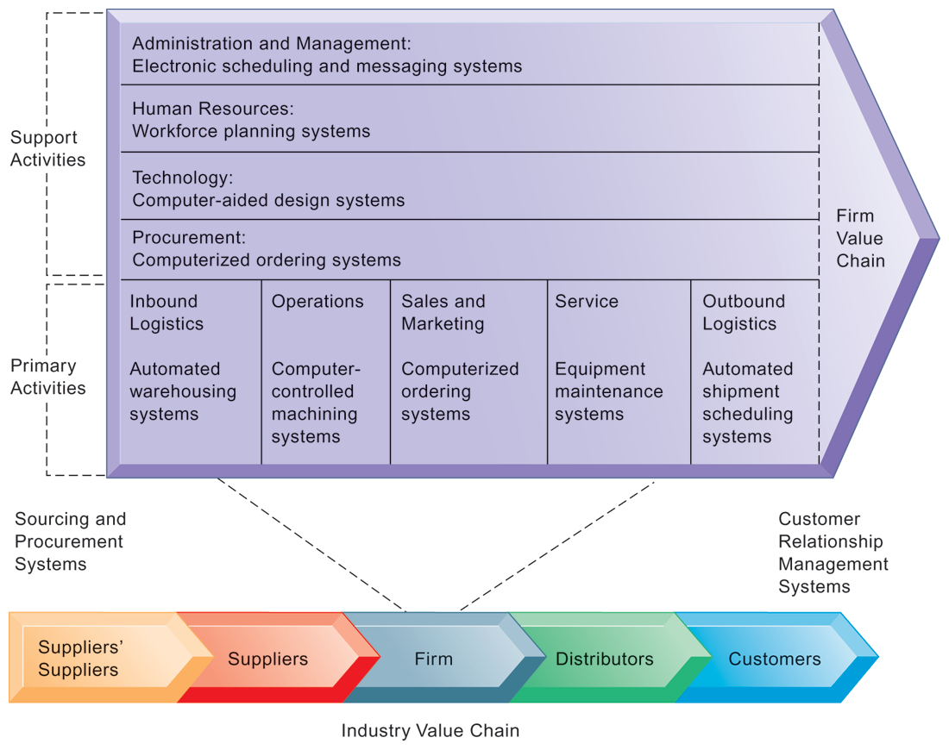
The Business Value Chain Model
Primary activities: directly related to production & distribution.
Support activities: make the primary activities possible.
Emphasize the relationship between the primary and support activities of this firm and explain how information systems are critical to the success of each activity.
Highlights specific activities in the business where competitive strategies can best be applied.
Notes:
Porter model vs. Value chain model: Porter model is very helpful for identifying competitive forces and suggest generic strategies. It not very specific what exactly to do and how? While, to achieve operational excellence, business value chain model is helpful.

Slide 19
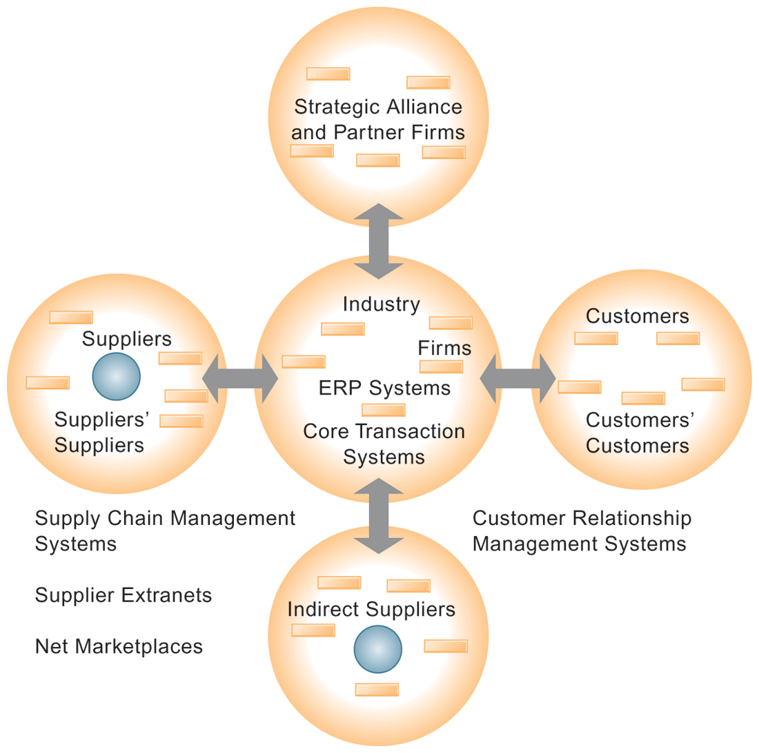
The Value Web
  Collection of independent firms using highly synchronized IT to coordinate value chains to produce product or service collectively.
  More customer driven, less linear operation than traditional value chain.
  A value web is flexible and adapts to changes in supply and demand and changing market conditions.
  The value web is a networked system that can synchronize the value chains of business partners within an industry to respond rapidly to changes in supply and demand.
Notes:
Performance depends not only on what goes on inside a firm but also on how well the firm coordinates with direct and indirect suppliers, delivery firms, and customers.

Slide 20
IS and Organizational Performance
Synergies, output of some units can be used as inputs to other units.
  Merger of Bank of NY and JP Morgan Chase
  Purchase of YouTube by Google
Enhancing core competencies
  P&G’s InnovationNet (a KMS), working on similar problems, share ideas & expertise.
Network-based strategies
  Network Economics
    Law of diminishing return: The more any given resource is applied to production, the lower the marginal gain in output, until a point is reached where the additional inputs produce no additional outputs.
    TV subscribers, The Social Networking effect
  Virtual Company Model
    Hong Kong-based Li & Fung, manages production, shipment of garments , outsourcing all work to over 7500 suppliers
  Business Ecosystem
    Keystone (dominate ecosystem and create platform, e.g., Microsoft)
    Niche Firms (rely on platform developed by keystone firm, e.g., software developers)
Notes:
Marginal cost of adding new participant almost zero, with much greater marginal gain
Value of community grows with size
Value of software grows as installed customer base grows
Law of diminishing value not work for Internet. The larger the numbers the larger the value.

Slide 21
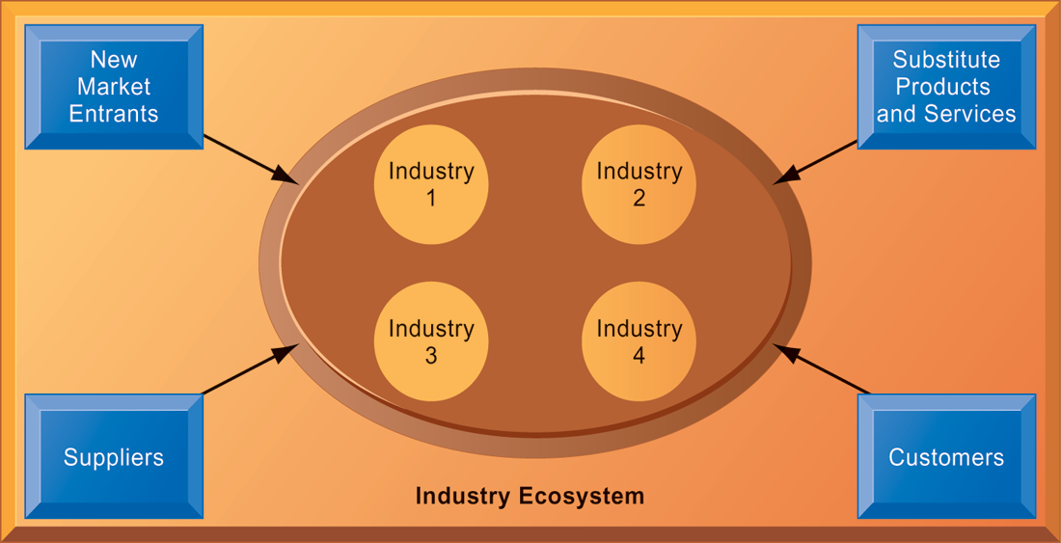
An Ecosystem Strategic Model
The digital firm era requires a more dynamic view of the boundaries among industries, firms, customers, and suppliers, with competition occurring among industry sets in a business ecosystem.
In the ecosystem model, multiple industries work together to deliver value to the customer. IT plays an important role in enabling a dense network of interactions among the participating firms.

Slide 22
IS for Competitive Advantage: Management Issues
Sustaining Competitive Advantage
Aligning IT With Business Objectives
Management Checklist
  Details in the textbook, page 114
Managing Strategic Transitions
  Change in business goals, relationships with customers & suppliers, business processes.
  A movement between levels of sociotechnical systems.
  Affect both social and technical elements of the organization.
Notes:
Difficult to sustain competitive adv. Amazon.com is pioneer in e-commerce but now facing competition from eBay, Rediffbooks, Alibaba, Taobao, Baidu.
Other competitive IT: American Airlines SABRE computerized reservation system, Citibank’s ATM system, FedEx’s package tracking system. Indian railway reservation system,
Alignment: only one-quarter firms succeed. Employee find it difficult and ultimately find workaround.

Slide 23
Question Please
?

