Slide 1
MIS 107: Information Systems & Computing Lecture 9: Ethical and Social Issue in IS by Prof. Md. Mahbubul Alam, PhD

Slide 2
Learning Objectives
What ethical, social, and political issues are raised by information systems?
What specific principles for conduct can be used to guide ethical decisions?
Why do contemporary information systems technology and the Internet pose challenges to the protection of individual privacy and intellectual property?
How have information systems affected everyday life?

Slide 3
Privacy: You’re the Target!!!
Is somebody trailing you on the web, or watching your every click?
Why do you start seeing display ads & pop-ups just after you have been searching the web for a product/service?
You are being tracked and targeted on the web so that you are exposed to certain ads.
Google is the largest web tracker, monitors thousand of web sites.
Behavioral targeting allows businesses and organizations to more precisely target desired demographics.
How?
Cookies, flask cookies, Web beacons (i.e., web bugs)
Beacon, a small software placed on your computer when you visit any websites. And, report back to the servers operate by the beacon owners the domains and web pages you visited, what ads you clicked on, & other online behavior.
Google knows more about you than your mother does!!!
Notes:
Behavioral targeting -> double-edged sword, source of many benefits (by showing ads relevant to your interests) as well as creating opportunities for invading your privacy.

Slide 4
What is Ethics?
Principles of right and wrong that individuals, acting as free moral agents, use to make choices to guide their behaviors.
Information systems raise new ethical questions because they create opportunities for
Intense social change, threatening existing distributions of power, money, rights & obligations.
Achieving social progress but committing crimes and threatening cherished social values.
Recent cases of failed ethical judgment in business
Lehman Brothers, Minerals Management Service, Pfizer, Siemens
In many, information systems used to bury decisions from public scrutiny.

Slide 5
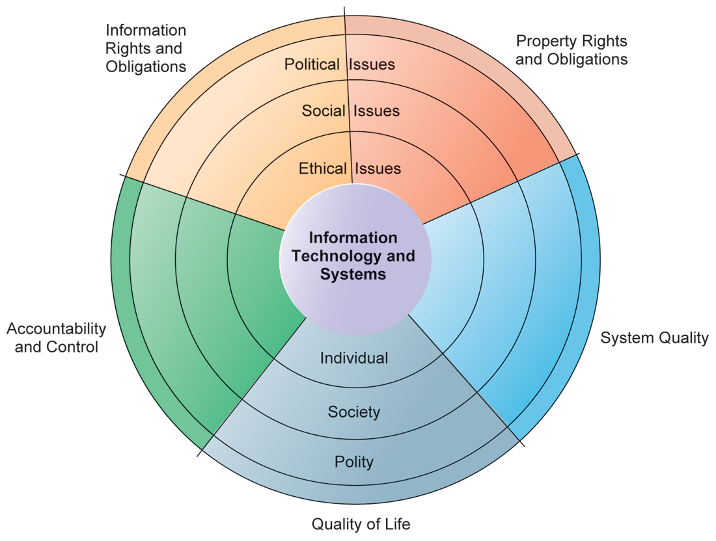
Ethical, Social & Political Issues related to IS
IT has a ripple effect, raising new ethical, social and political issues that must be dealt with on the individual, social & political levels.
However, social institutions cannot respond overnight to these ripples- it may take years to develop etiquette, expectations, social responsibility, politically correct attitudes or approved rules.

Slide 6
Five Moral Dimensions of Information Age
Information rights and obligations
What rights do individuals possess with respect to themselves? What can they protect?
Property rights and obligations
How will traditional intellectual property rights be protected in a digital society?
Accountability and control
Who can and will be held accountable and liable for the harm done to individual & collective information and property rights?
System quality
What standards of data and system quality should we demand to protect individual rights and the safety of society?
Quality of life
What values should be preserved in an information- and knowledge- based society?

Slide 7
Key Technology Trends that Raise Ethical issues
Doubling of computer power every 18 months
More organizations depend on computer systems for critical operations. Our dependence on systems, & vulnerability to system errors & poor data quality have increased.
Rapidly declining data storage costs
Organizations can easily maintain detailed databases on individuals. Therefore, routine violation of individual privacy becomes cheap and effective.
Networking advances and the Internet
Copying data from one location to another and accessing personal data from remote locations is much easier
Advances in data analysis techniques
Companies can analyze vast quantities of data gathered on individuals for:
Profiling, combining data from multiple sources to create dossiers of detailed personal information on individuals.
Nonobvious relationship awareness (NORA), combining data from multiple sources to find obscure hidden connections that might help identify criminals or terrorists.

Slide 8
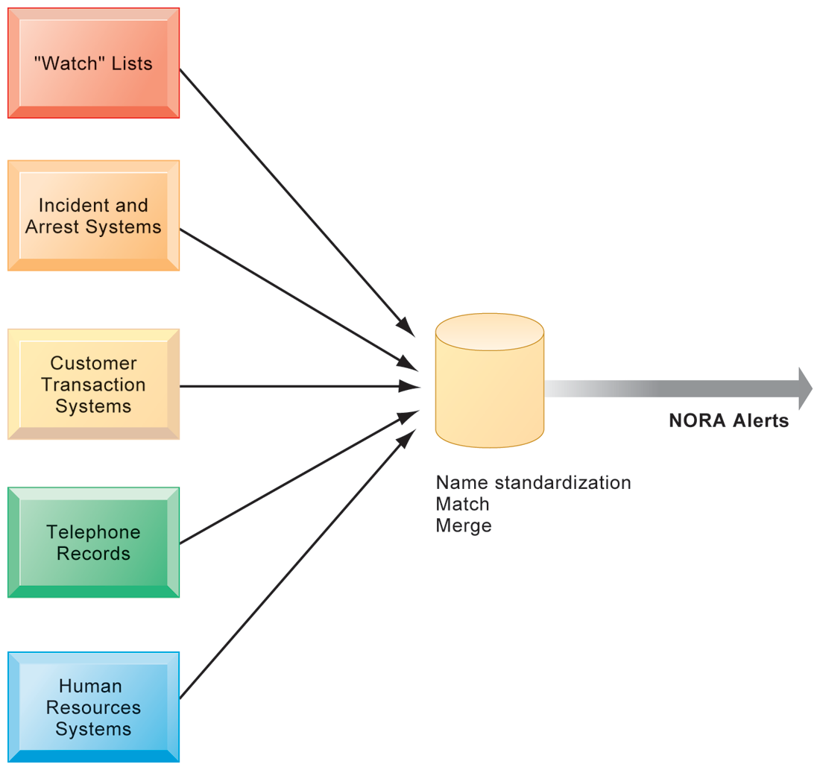
Nonobvious Relationship Awareness (NORA)
NORA technology can take information about people from disparate sources and find obscure, nonobvious relationships. It might discover, for example
An applicant for a job at a casino shares a telephone number with a known criminal and issue an alert to the hiring manager.
An airline can identify potential terrorists attempting to board a plane.
Government can identify potential terrorists by monitoring phone calls.

Slide 9
Concepts of Ethical Analysis
Responsibility
Accepting the potential costs, duties, and obligations for decisions.
Accountability
Mechanisms for identifying responsible parties.
Liability
Permits individuals (and firms) to recover damages done to them.
Due process
Laws are well known and understood, with an ability to appeal to higher authorities.
Ethical analysis: A five-step process
Identify and clearly describe the facts
Define the conflict or dilemma and identify the higher-order values involved
Identify the stakeholders
Identify the options that you can reasonably take
Identify the potential consequences of your options

Slide 10
Six Candidate Ethical Principles
Golden Rule
Do unto others as you would have them do unto you.
Immanuel Kant’s Categorical Imperative
If an action is not right for everyone to take, it is not right for anyone.
Descartes’ Rule of Change
If an action cannot be taken repeatedly, it is not right to take at all.
Utilitarian Principle
Take the action that achieves the higher or greater value.
Risk Aversion Principle
Take the action that produces the least harm or least potential cost.
Ethical “no free lunch” Rule
Assume that virtually all tangible and intangible objects are owned by someone unless there is a specific declaration otherwise.

Slide 11
Information Rights
Privacy
Claim of individuals to be left alone, free from surveillance or interference from other individuals, organizations, or state. Claim to be able to control information about yourself.
Fair Information Practices (FIP)
Set of principles governing the collection and use of information.
Basis of most U.S. and European privacy laws.
Based on mutuality of interest between record holder and individual.
Mutuality of interest: providing personal information for the purpose of completing transaction.
Restated and extended by FTC in 1998 to provide guidelines for protecting online privacy
Used to drive changes in privacy legislation
COPPA (Children’s Online Privacy Protection Act), parental permission before collecting information on children under 13.
Gramm-Leach-Bliley Act, privacy protection for consumers of financial services.
HIPAA (Health Insurance Portability & Accountability Act), privacy protection for medical record.

Slide 12
FTC’s FIP principles
Notice/awareness (core principle)
Web sites must disclose practices before collecting data.
Choice/consent (core principle)
Consumers must be able to choose how information is used for secondary purposes.
Access/participation
Consumers must be able to review, contest accuracy of personal data.
Security
Data collectors must take steps to ensure accuracy, security of personal data.
Enforcement
There must be a mechanism to enforce FIP principles.
Notes:
FTC=Federal Trade Commission, FIP=Fair Information Practice

Slide 13
Internet Challenges to Privacy
Cookies
Tiny files downloaded by Web site to visitor’s hard drive to help identify visitor’s browser and track visits to site.
Allow Web sites to develop profiles on visitors.
e.g., Amazon.com, rediffbooks.com, imdb.com.
Web beacons/bugs
Tiny graphics embedded in e-mail and Web pages to monitor who is reading message.
Captures and transmit information such as IP address, frequency, duration & type of Web page viewed by user.
Beacons are placed on popular websites by “third party” firms who pay the Websites a fee for access to their audience.
Spyware
Surreptitiously installed on user’s computer.
May transmit user’s keystrokes or display unwanted ads.
Notes:
Google’s collection of private data; behavioral targeting.

Slide 14
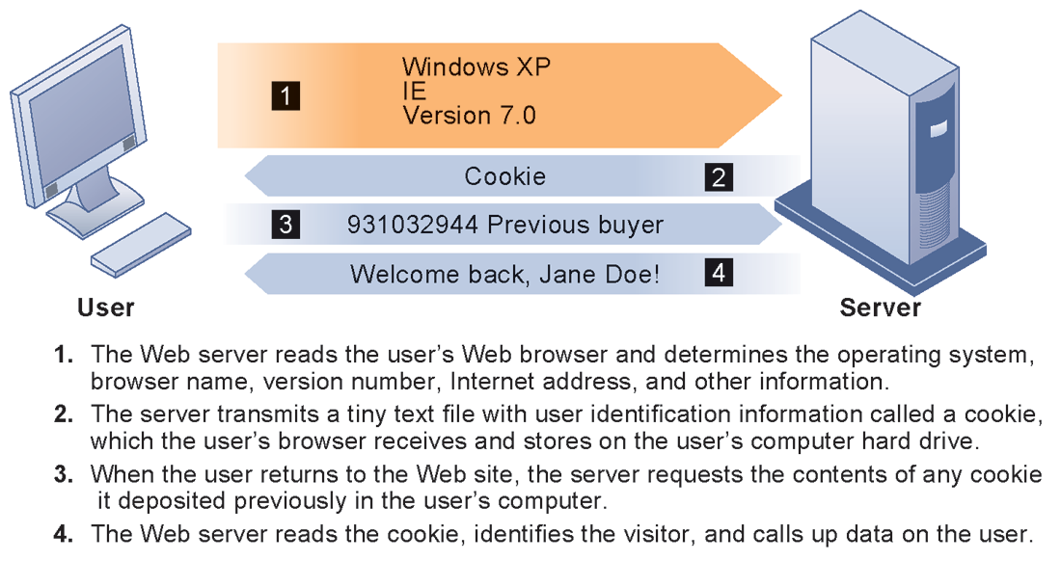
How Cookies Identify Web Visitors?
Cookies are written by a Web site on a visitor’s hard drive. When the visitor returns to that Web site, the Web server requests the ID number from the cookie and uses it to access the data stored by that server on that visitor. The Web site can then use these data to display personalized information.

Slide 15
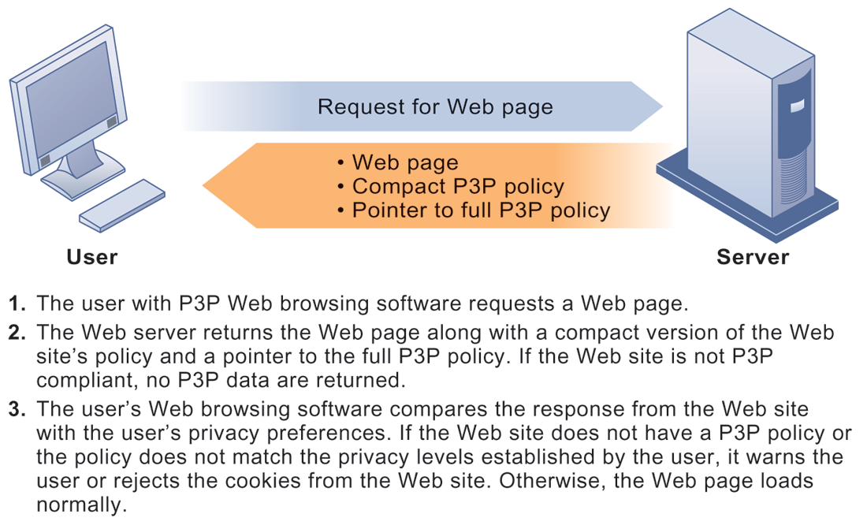
Technical Solutions
The Platform for Privacy Preferences (P3P)
Provides a standard for communicating a Web site’s privacy policy to Internet users and for comparing that policy to the user’s preferences or to other standards.
Allows users to select the level of privacy they wish to maintain when interacting with the web site.
P3P enables Web sites to translate their privacy policies into a standard format that can be read by the user’s Web browser software.
The browser software evaluates the Web site’s privacy policy to determine whether it is compatible with the user’s privacy preferences.

Slide 16
Property rights: Intellectual property
Intellectual property
Intangible property of any kind created by individuals or corporations.
Three main ways that protect intellectual property
Trade secret: Intellectual work or product belonging to business, not in the public domain.
Copyright: Statutory grant protecting intellectual property from being copied for the life of the author, plus 70 years.
Patents: Grants creator of invention an exclusive monopoly on ideas behind invention for 20 years.
Notes:
Do students believe that the property rights guaranteed by trade secrets, copyrights, and patents are strong enough to avoid the theft of intellectual property online? Give an example of a trade secret (the formula for Coke; a method of doing business or business process). Give an example of a copyright (which could include the copyright of an online business process like Amazon’s One Click shopping). And give an example of a patent.

Slide 17
Challenges to intellectual property rights
Digital media different from physical media (e.g. books)
Ease of replication
Ease of transmission (networks, Internet)
Difficulty in classifying software
Compactness
Difficulties in establishing uniqueness
Digital Millennium Copyright Act (DMCA)
Makes it illegal to circumvent technology-based protections of copyrighted materials

Slide 18
Accountability, Liability, Control
Computer-related liability problems
If software fails, who is responsible?
If seen as part of machine that injures or harms, software producer and operator may be liable
If seen as similar to book, difficult to hold author/publisher responsible
What should liability be if software seen as service? Would this be similar to telephone systems not being liable for transmitted messages?
System Quality: Data Quality and System Errors
What is an acceptable, technologically feasible level of system quality?
Flawless software is economically unfeasible
Three principal sources of poor system performance
Software bugs, errors
Hardware or facility failures
Poor input data quality (most common source of business system failure)

Slide 19
Quality of life: Equity, access, and boundaries
Negative social consequences of systems
Balancing power: Center Vs. Periphery
Although computing power decentralizing, key decision-making remains centralized.
Rapidity of change: Reduced response time to competition
Businesses may not have enough time to respond to global competition.
Maintaining boundaries: Family, work & leisure
Computing, Internet use lengthens work-day, infringes on family, personal time.
Dependence and vulnerability:
Public and private organizations ever more dependent on computer systems.

Slide 20
Quality of life (cont’d)
Computer crime and abuse
Computer crime: Commission of illegal acts through use of computer or against a computer system – computer may be object or instrument of crime.
Computer abuse: Unethical acts, not illegal
Spam: is a junk e-mail sent by an organization or individual to a mass audience of Internet users who have expressed no interest in the product or service being marketed.
High costs for businesses in dealing with spam
Employment:
Reengineering work resulting in lost jobs.
Equity and access – the digital divide:
Certain ethnic and income groups in the United States less likely to have computers or Internet access.

Slide 21
Quality of life (cont’d)
Health risks
Repetitive stress injury (RSI)
Carpal Tunnel Syndrome (CTS)
Largest source is computer keyboards
Computer vision syndrome (CVS)
Technostress
Role of radiation, screen emissions, low-level electromagnetic fields.

Slide 22
Question Please
?

