Slide 1
SPSS: Data Transformation
Prof Md Mahbubul Alam, PhD
Dept. of Agricultural Extension & Information System
Sher-e-Bangla Agricultural University

Slide 2
Compute

Slide 3
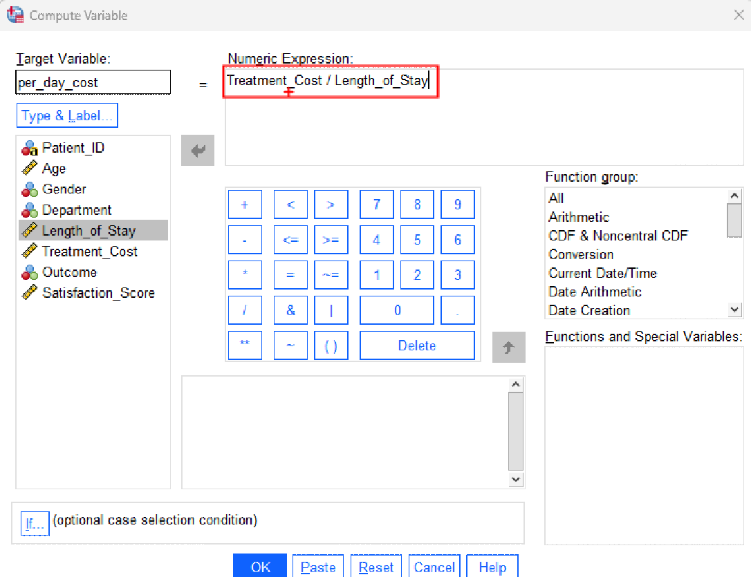
Compute: per_day_cost
Transform-> compute->select variable(s) in the expression-> Name in target variable

Slide 4
Recode

Slide 5
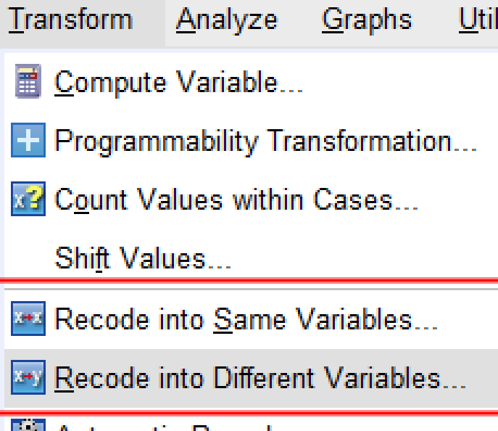
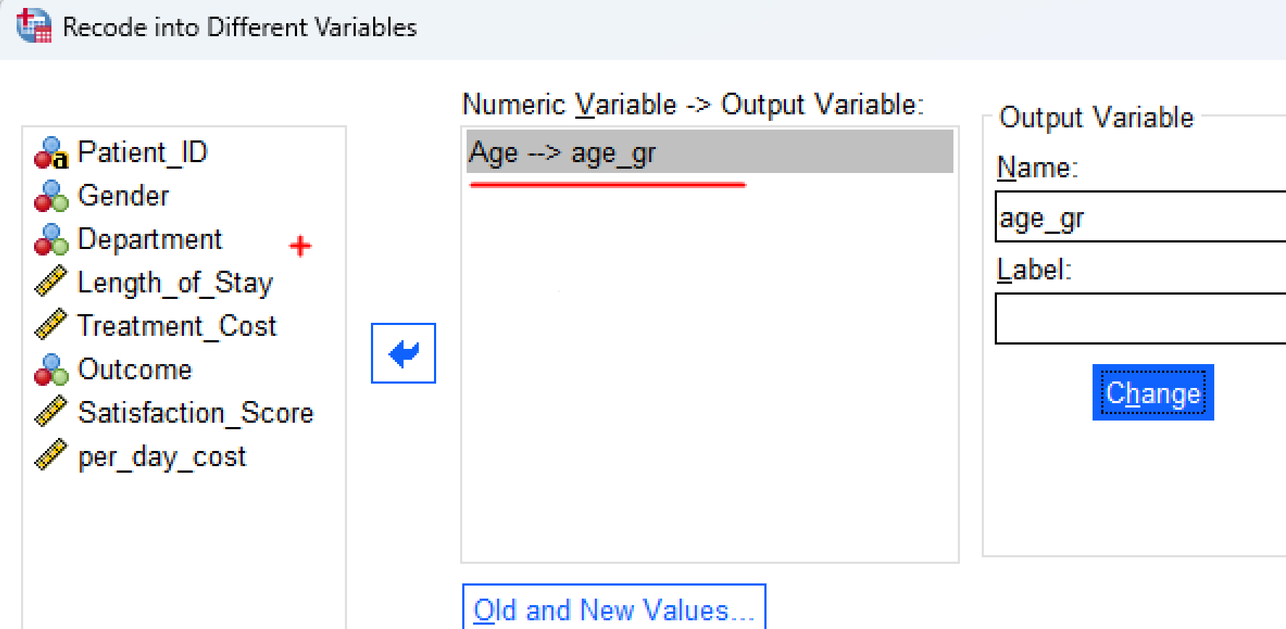
Record into same/different variable
Transform-> Record into Different variables [e.g., age]-> old and new values

Slide 6
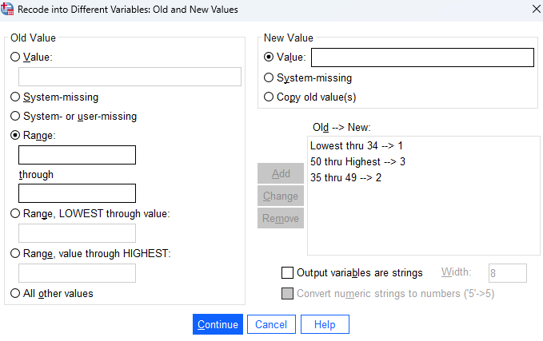
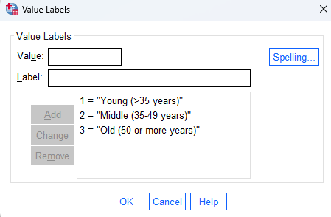
Recode: Continue

Slide 7
Count

Slide 8
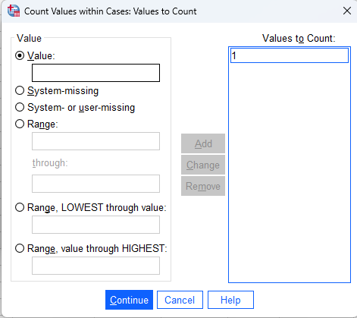
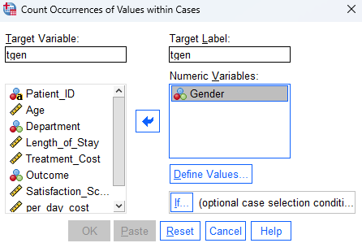
Count within cases
Transform-> count values within cases -> target variable & level -> Define values -> value [put 1] -> continue -> OK

Slide 9
RANK

Slide 10
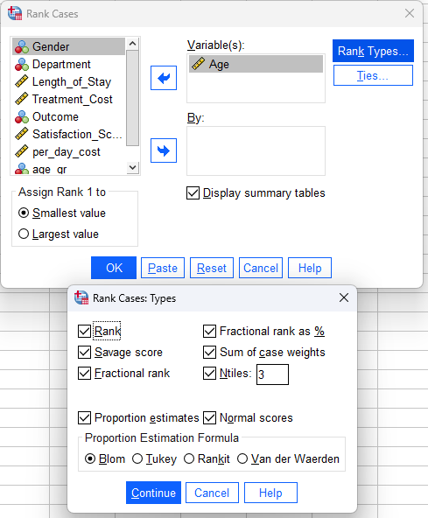
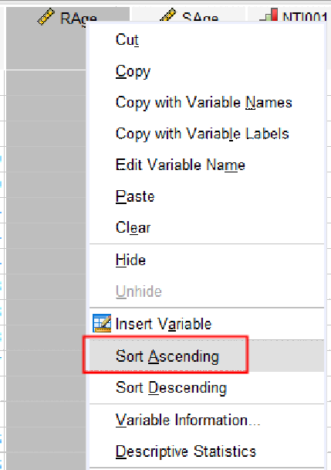
Rank Cases
Transform -> Rank Cases -> Set Variables [Age] -> Set by [optional] -> Rank Types [choose appropriate] -> Continue [Assign Rank Smallest Value with Display Summary tables]-> OK
Use Rage and Sort Ascending

Slide 11
Create & Editing Graph

Slide 12
Creating Graph
Graph -> Chart Builders -> OK -> Gallery [Choose Bar] -> Drag the option to Chart Preview -> Satis_gr on X-axis -> Filler [Gender]
Click Titles & Uncheck Footnote 1
Change Title [Satisfaction by Gender], use Custom
Element Properties, Select Bar1, Display error bars [Percentage]

Slide 13
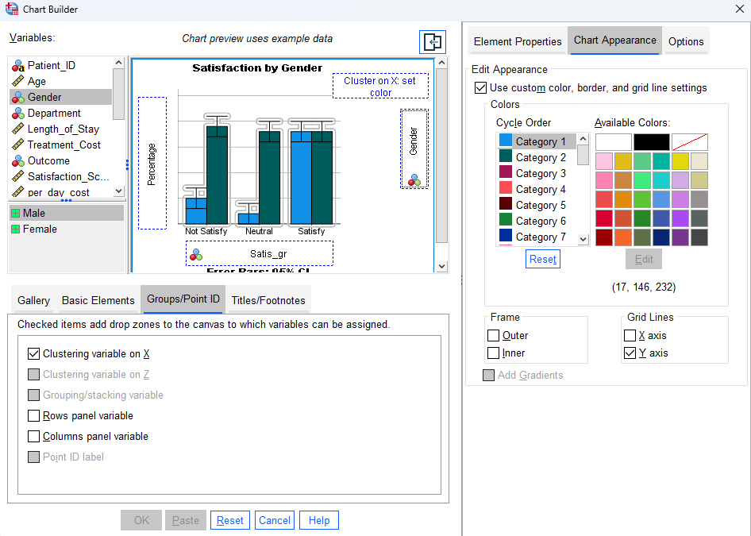

Slide 14
Thank You.
Web: https://mdmahbubulalam.com/

