Slide 1
SPSS Introductory
Prof Md Mahbubul Alam, PhD
Dept. of Agricultural Extension & Information System
Sher-e-Bangla Agricultural University

Slide 2
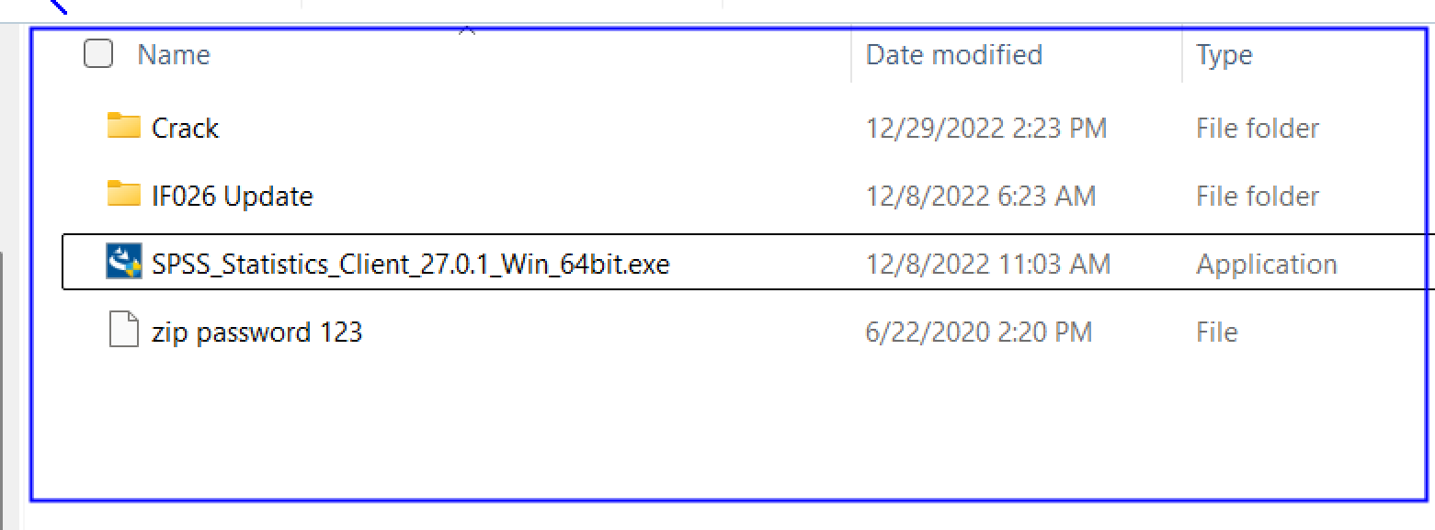
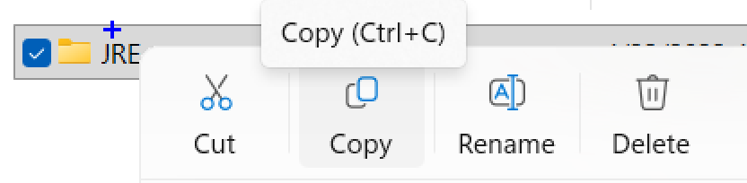
SPSS Set Up
Open Folder
Run .exe file as administrator OR double-click the .exe file
Copy JRE Folder and paste the copied file to the following path

Slide 3
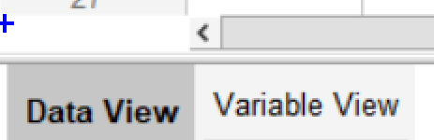
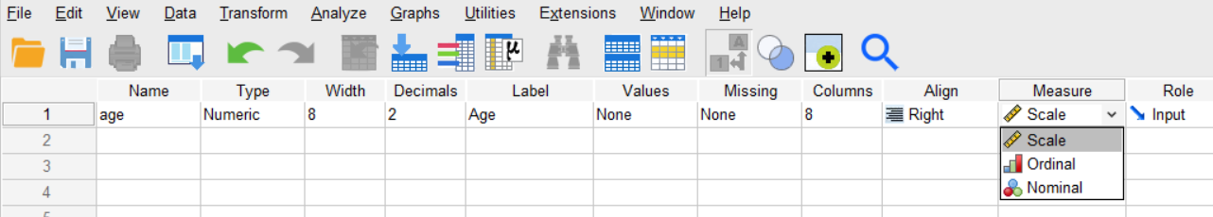
Open SPSS
Search and open SPSS File
Open Variable View
Add variable as follows: Carefully choose the type of data [Measure], in this case: Scale, using the drop-down menu.
Continue to add more variables.

Slide 4
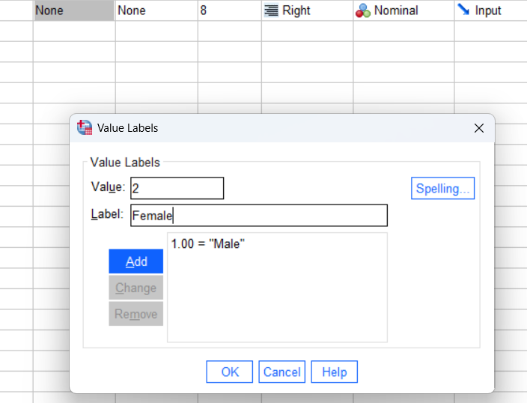
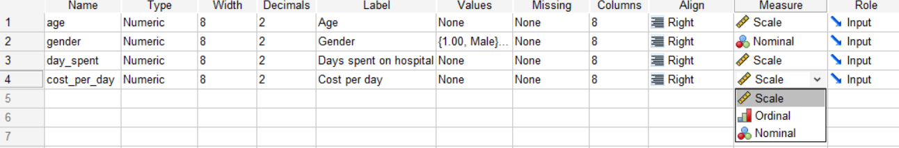
To add a Naming or Categorical Variable
Add gender as a variable, data type: Nominal
Click values, and add code: 1 for Male and 2 for Female. Then, hit OK
Add more Variables like the following
Continue the process
Can keep 0 in Decimal Value

Slide 5
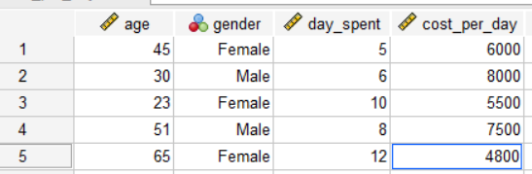
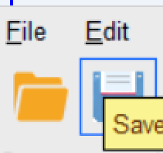
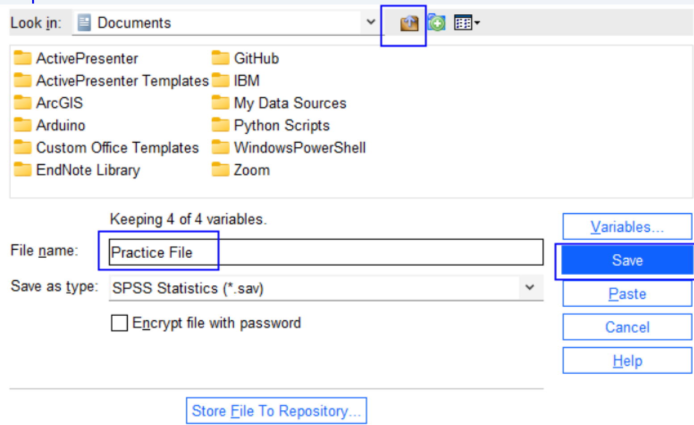
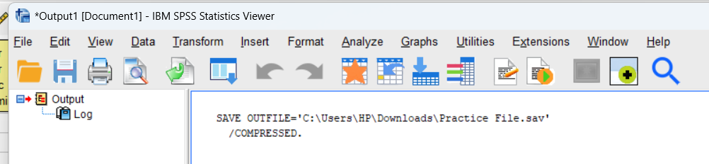
Switch to Data View
Enter/transfer data into the cells from the datasheet.
Save file using icon or [ctrl+s]
Give file [Practice File], choose the File Location Folder, and Press ‘Save’.
Save Output File, too

Slide 6
Select Cases

Slide 7
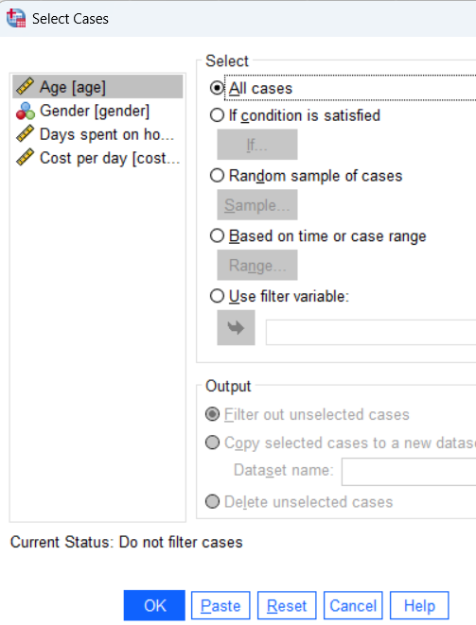
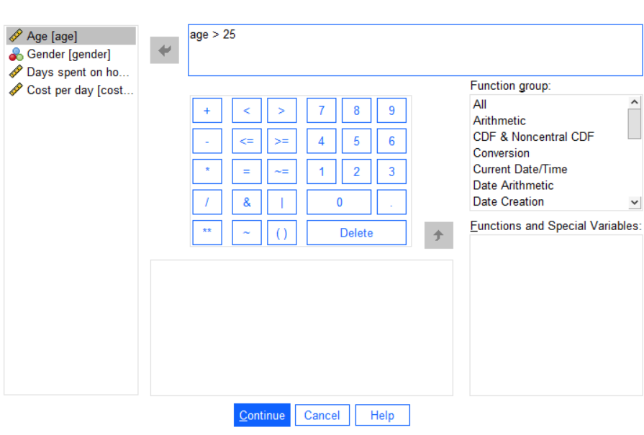
Select Cases
Data->Select Cases->Select option from drop-down menu based on your requirement
If condition is satisfied: click if…set condition like [age>25], click Continue, and then OK.
See changes in the data file, and run descriptive statistics to see the total number of cases excluded from the data set.

Slide 8
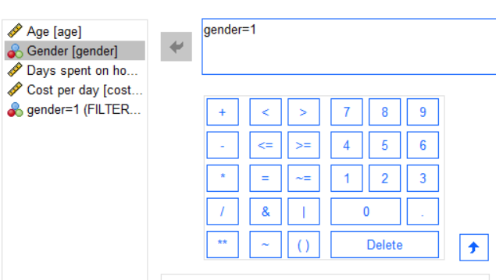
Select Cases: Continue
Select Gender and add an expression like: gender=1 and see the change and descriptive statistics.

Slide 9
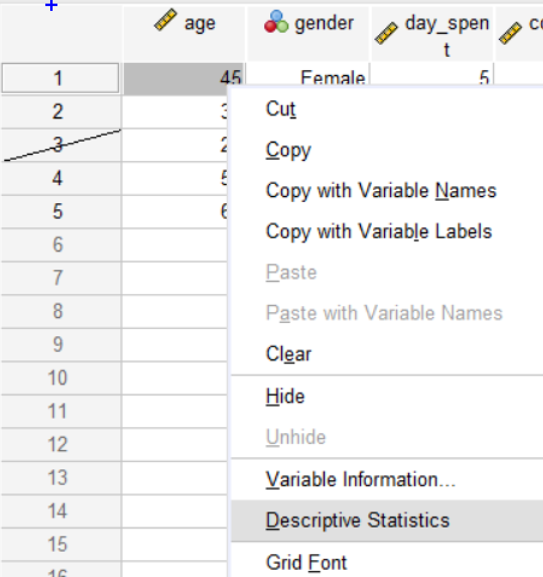
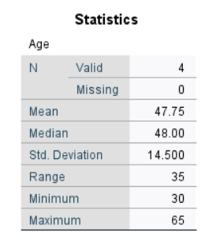
Select Cases

Slide 10
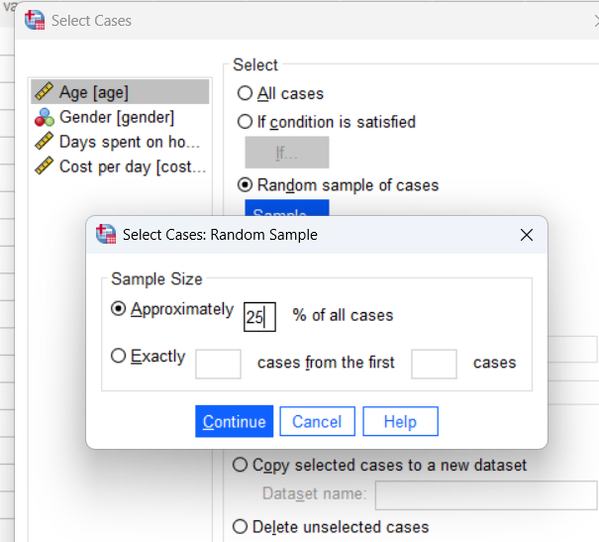
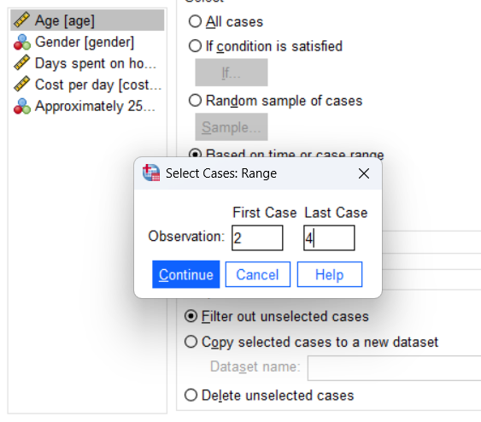
Select Cases: Random Sample Vs. Time or Case Range

Slide 11
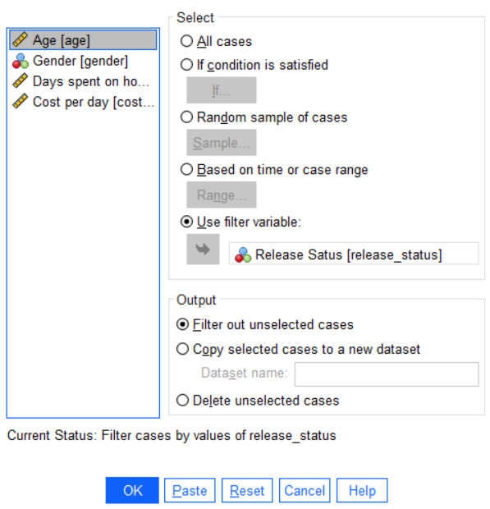
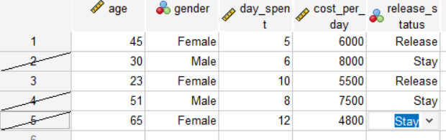
Select Cases: Use Filter Variable
Only use for a Binary [0/1] variable. Here, [1 for release, otherwise 0]

Slide 12
Merge Case

Slide 13
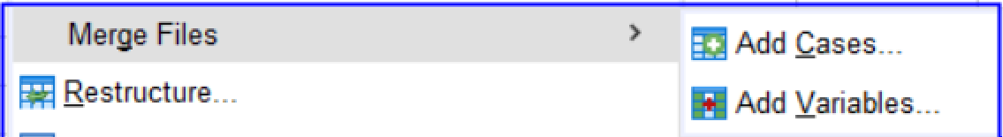
Merge Files:
Data-> Merge Files-> Two Option

Slide 14
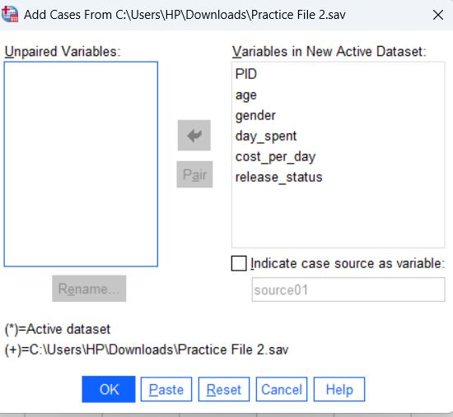
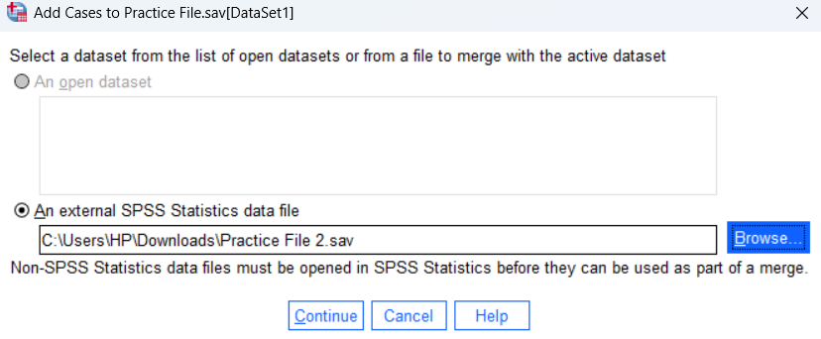
Using Add Cases
Add Cases: Two separate files MUST have a common Variable, for example, PID [Patient ID]
Use Browse and show the file you want to add [Practice File 2.sav] to the existing file [Practice File].
In case you don’t want to keep any variable or for any mismatched variable, place it in the Unpaired Variables Box.
Press, OK

Slide 15
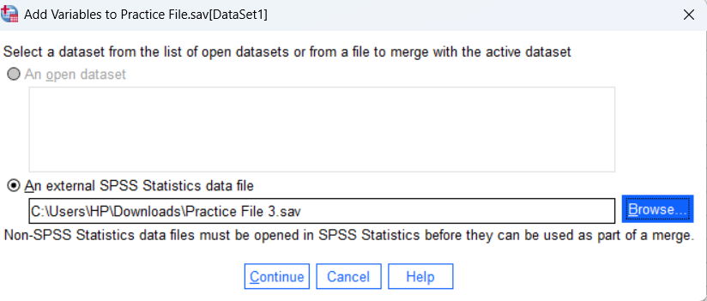
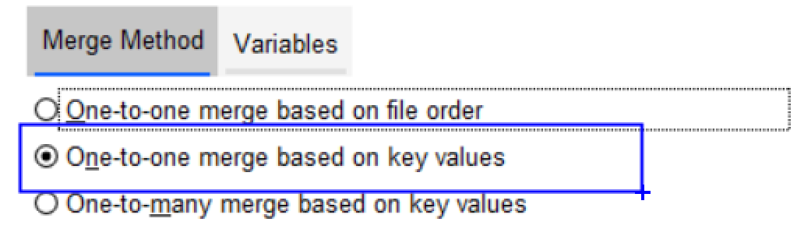
Using Add Variables
The cases should be the same. Only add new variables to the existing cases.
Browse and find the file [Practice File 3.sav] to enter new variables [Satisfaction]
Choose Merge Method [here, option 2]
Press, OK

Slide 16
Split Files

Slide 17
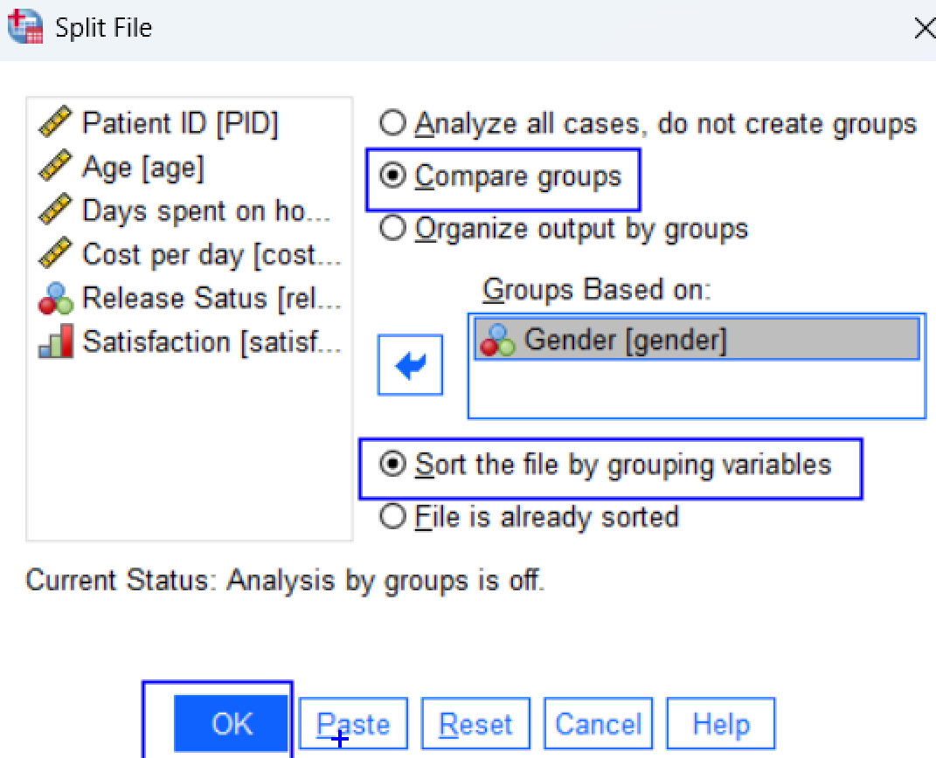
Split File
Data-> Split File-> Choose Compare groups-> Group Based on a Naming/Categorical/Binary variable [Gender]

Slide 18
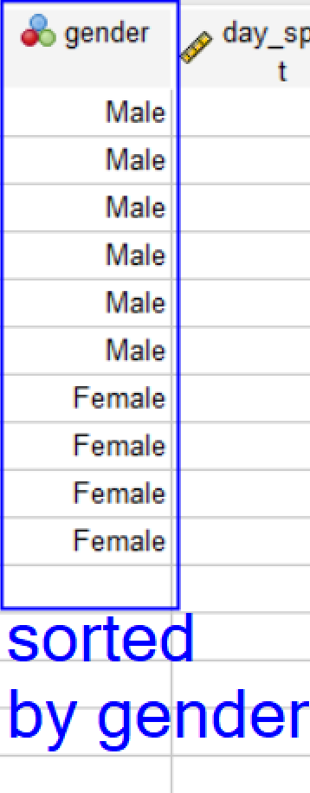
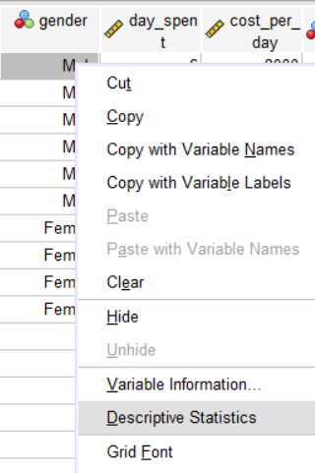
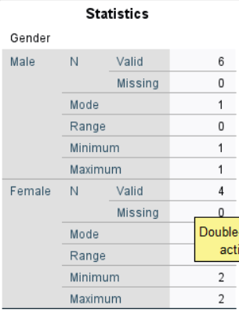
Split File: Continue

Slide 19
Sort CAses

Slide 20
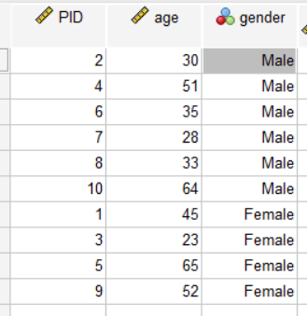
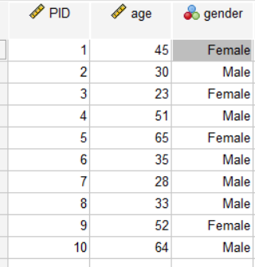
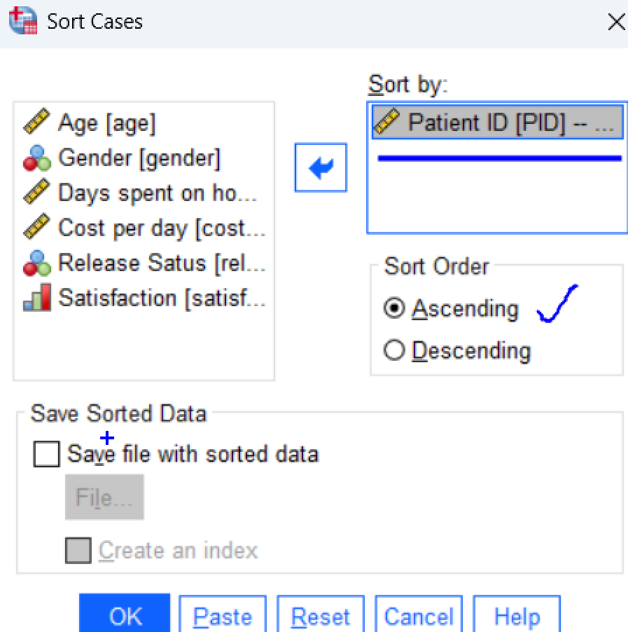
Sort Cases
Data-> Sort Cases->Choose Variable [PID]-> Order [Ascending]

Slide 21
Split into Files

Slide 22
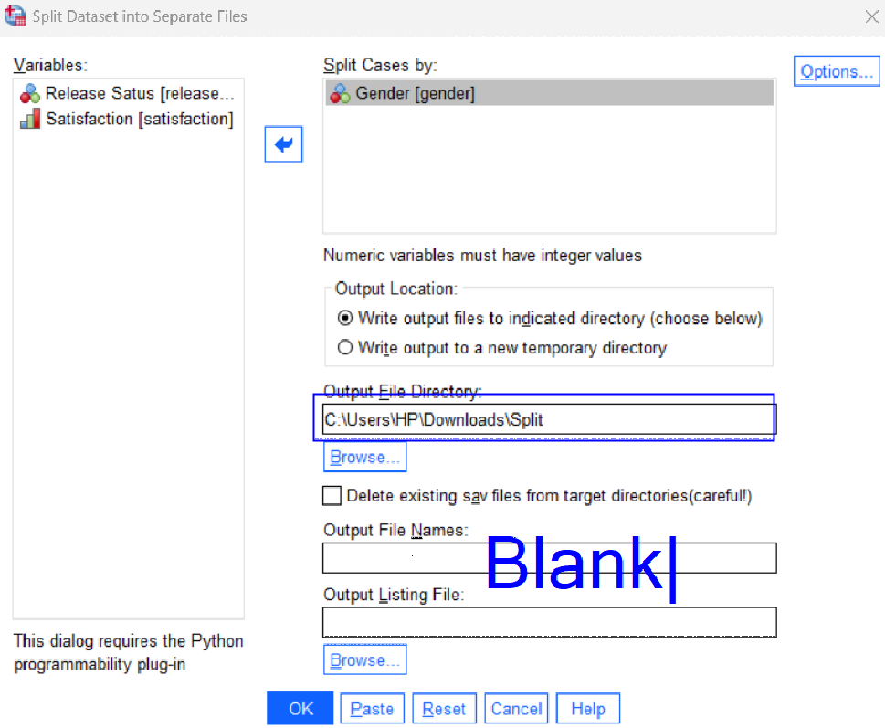

Split into Files
Create a Folder [Split] in any drive [Download]
Data-> Split into Files -> Choose Variable [Gender]
Open the File Directory and show the Folder created in the drive
No need to put the name of the Output Files
Press, OK and see the changes in the Folder.

Slide 23
Thank You.
Web: https://mdmahbubulalam.com/

