Slide 1
Lecture 2
E-Business Technology Basics
(Book Chapter 2)
Md. Mahbubul Alam, PhD
Professor
Notes:
1

Slide 2
Intended Learning Outcomes (ILOs)
Origin, growth, and current structure of the Internet
Packet-switched technologies and network structure
Internet protocols and Internet addressing work
Use of markup languages on the Web, including SGML, HTML, and XML
Internet2 project
Notes:
2

Slide 3
The Internet and the Web
Computer network
  Technology allowing people to connect computers
Internet
  Interconnected global computer networks (large)
  Is a set of interconnected networks.
  Type of internet (lowercase “i”)
World Wide Web (Web)
  Subset of computers on the Internet that are connected to one another in a specific way that makes them and their contents accessible to each other.
  Includes easy-to-use standard interfaces
  ARPANET: earliest network (became the Internet)
  Usenet: User’s News Network (1979), allows anyone to the network to read and post articles on a variety of subjects.
  HTML: Set of codes (tags) attached to text

Slide 4
How Does Internet Works?
Internet Standards

Slide 5
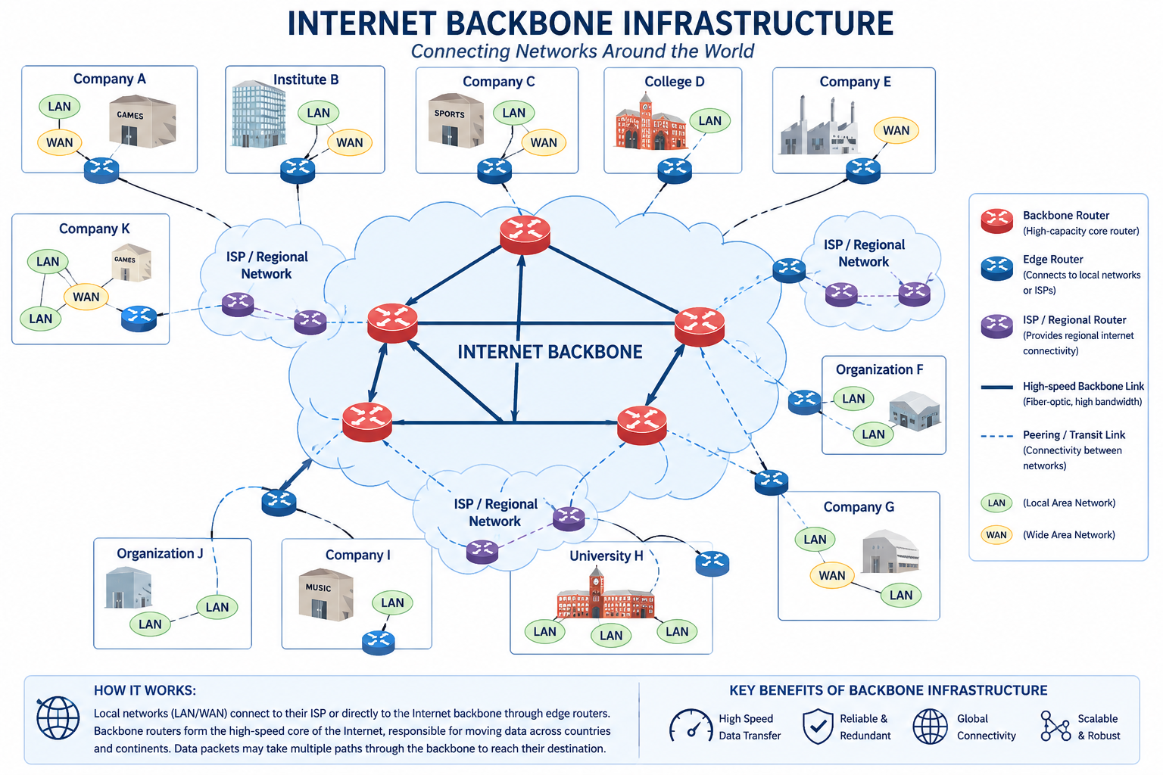

Slide 6
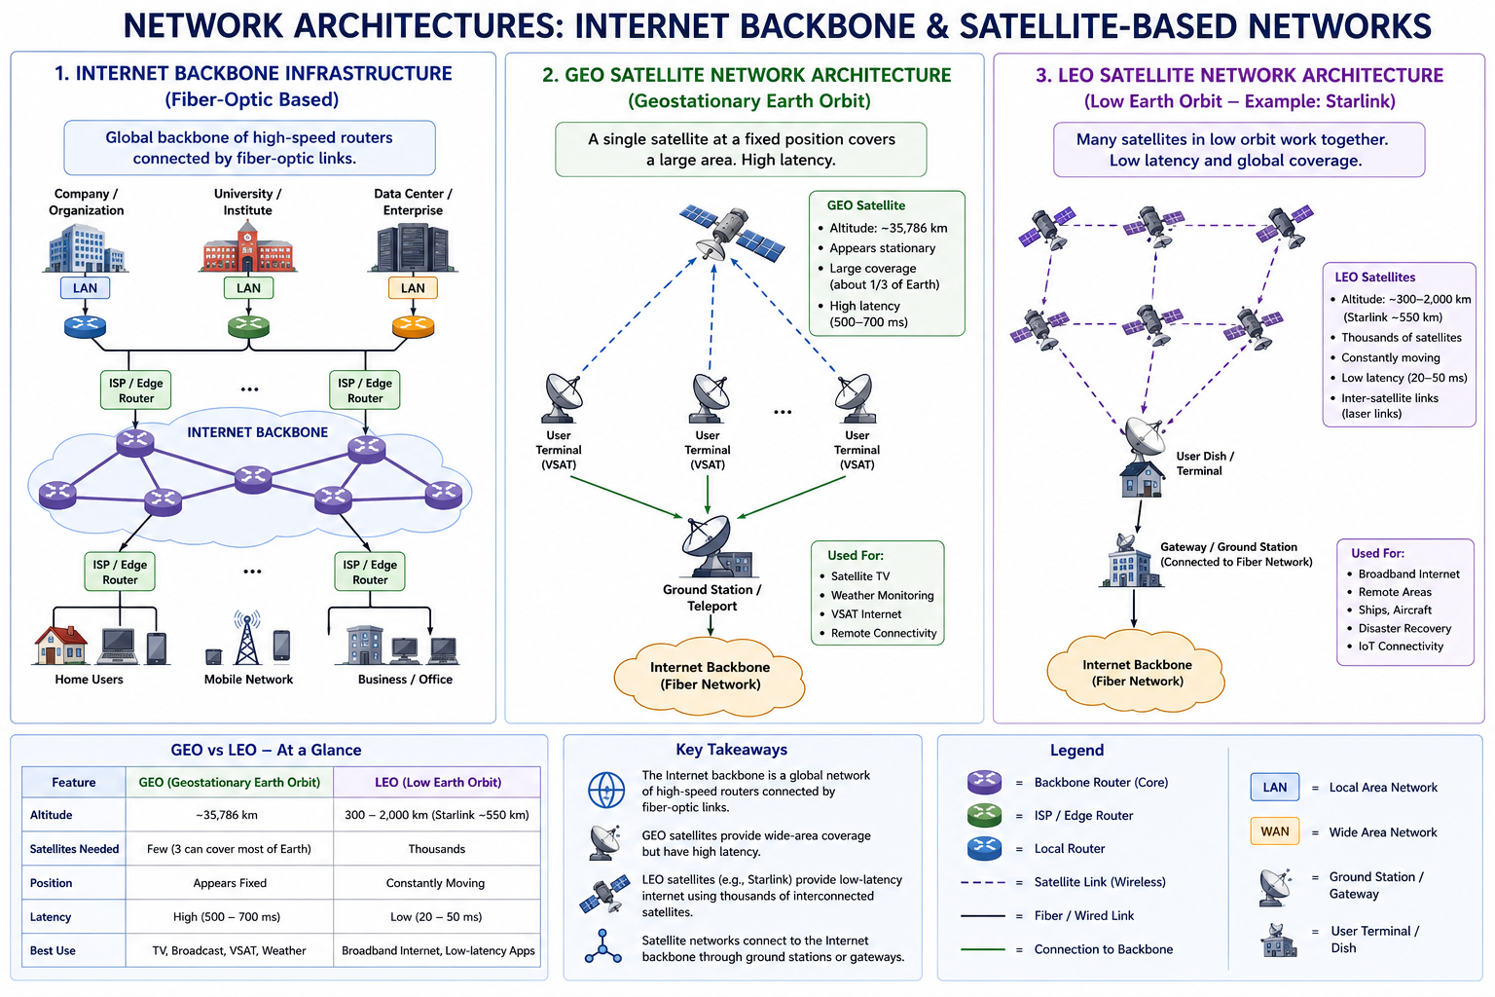

Slide 7
The Internet: Key Technology Concepts
Packet switching
      A method of slicing digital messages into packets, sending the packets along different communication paths as they become available, and then reassembling the packets once they arrive at their destination.
      Uses routers: special purpose computers that interconnect the computer networks that make up the Internet and route packets to their ultimate destination.
      Routers use computer programs called routing algorithms to ensure packets take the best available path toward their destination.
Notes:
1. Packets→ discrete units into which digital messages are sliced for transmission over the Internet.

Slide 8
The Internet: Key Technology Concepts (cont’d)
TCP/IP communications protocol
      Protocol: a set of rules for formatting, ordering, compressing and error-checking messages.
      TCP: Establishes the connections among sending and receiving Web computers, handles the assembly of packets at the point of transmission, and their reassembly at the receiving end. Controls moving of data between applications.
      IP: Provides the Internet’s addressing scheme
Client/server computing
      Model of computing in which very powerful personal computers (clients) are connected in a network with one or more server computers that perform common functions for the clients, such as storing files, software applications, etc.
Notes:
1. Packets→ discrete units into which digital messages are sliced for transmission over the Internet.

Slide 9
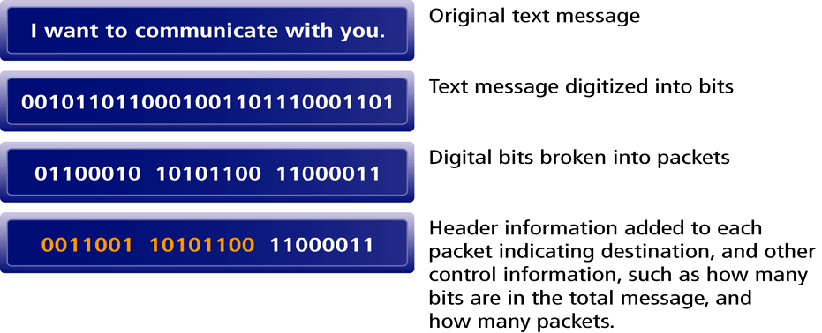
Packet Switching: Architecture

Slide 10
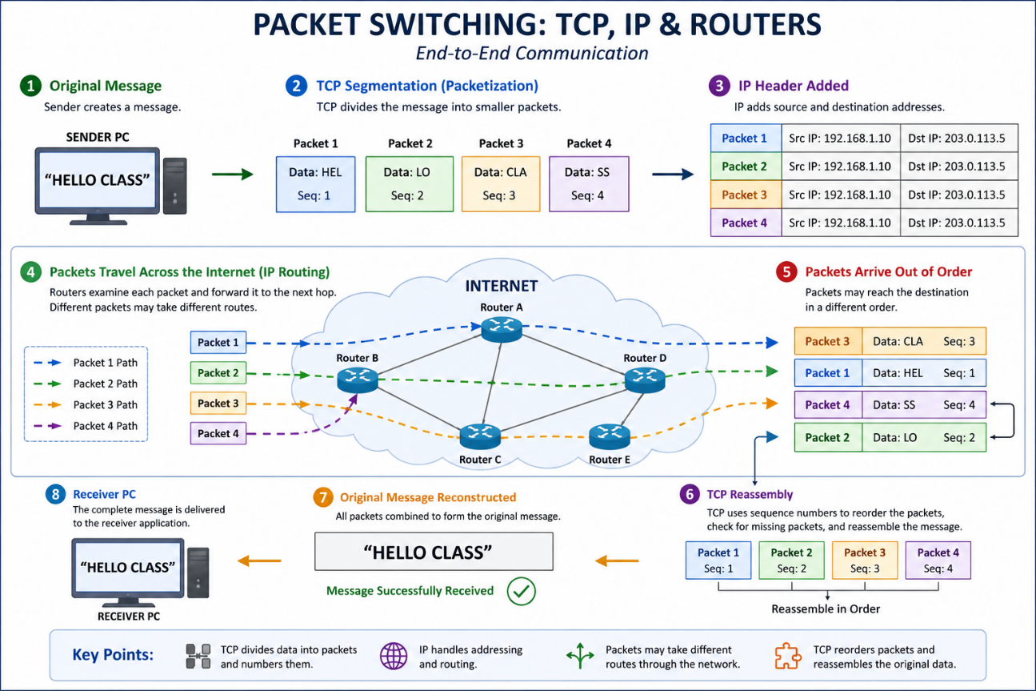
Routing Internet Messages: TCP/IP & Packet Switching
The Internet uses packet-switched networks and the TCP/IP communications protocol to send, route & assemble messages.
Messages are broken into packets, and packets from the same messages can travel along different routes.

Slide 11
IP Address
Two versions of IP currently in use.
IPv4 Internet address (also called IP address):
A 32-bit number expressed as a series of four separate numbers marked off by periods, such as 64.49.254.91
Each of the four numbers can range from 0-255.
IPv4 the current version of IP. Can handle up to 4 billion addresses
IPv6 (next generation of IP) will use 128-bit addresses and be able to handle up 1 quadrillion addresses.
Notes:
64.49.254.91 → first three sets of numbers (64.49.254) identifies the Network (Local Area Network Identification) and last number (91) identified a specific computer.
1 million = 10⁶, 1 billion = 10⁹ , 1 Trillion = 10¹² , 1 Quadrillion = 10¹⁵

Slide 12
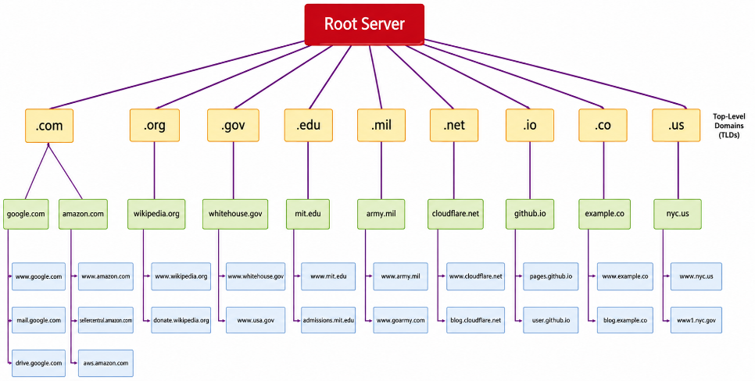
Domain Names, DNS, URLs
Domain name: IP address expressed in a natural language convention called a domain name.
Domain name system (DNS): allows numeric IP addresses to be expressed in natural language
    Example: cnet.com = 216.239.113.101
Uniform resource locator (URL): addresses used by Web browsers to identify location of content on the Web.
DNS is a hierarchical namespace. Root server at the top.
Top-level domains → organization type or geographic location.
Second-level Servers →organizations & individuals. (e.g., nyu.edu)
Third-level servers → a particular computer(s) of an organization. (e.g., www.finance.nyu.edu)

Slide 13
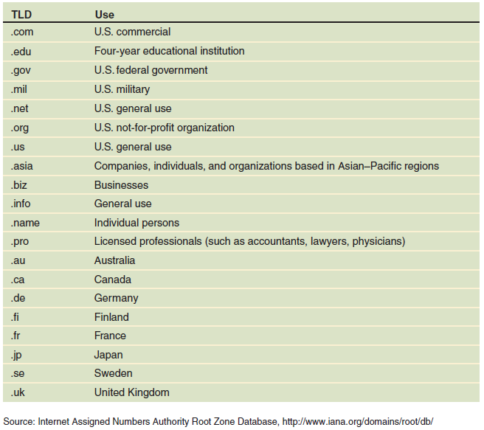
Commonly used domain names

Slide 14
Electronic Mail Protocols
Two common protocols
Electronic mail (e-mail)
  Formatted according to common set of rules
  Client/server structure
E-mail server
  Computer devoted to e-mail handling
  Stores, forwards e-mail messages
E-mail client software
  Reads and sends e-mail
  Communicates with e-mail server software
Standardization and rules very important
Simple Mail Transfer Protocol (SMTP)
  Specifies mail message format
  Describes mail administration e-mail server
  Describes mail transmission on the Internet
Post Office Protocol (POP)
  Sends mail to user’s computer, deletes from server
  Asks if new mail arrived
Interactive Mail Access Protocol (IMAP)
    Sends mail to user’s computer, does not delete

Slide 15
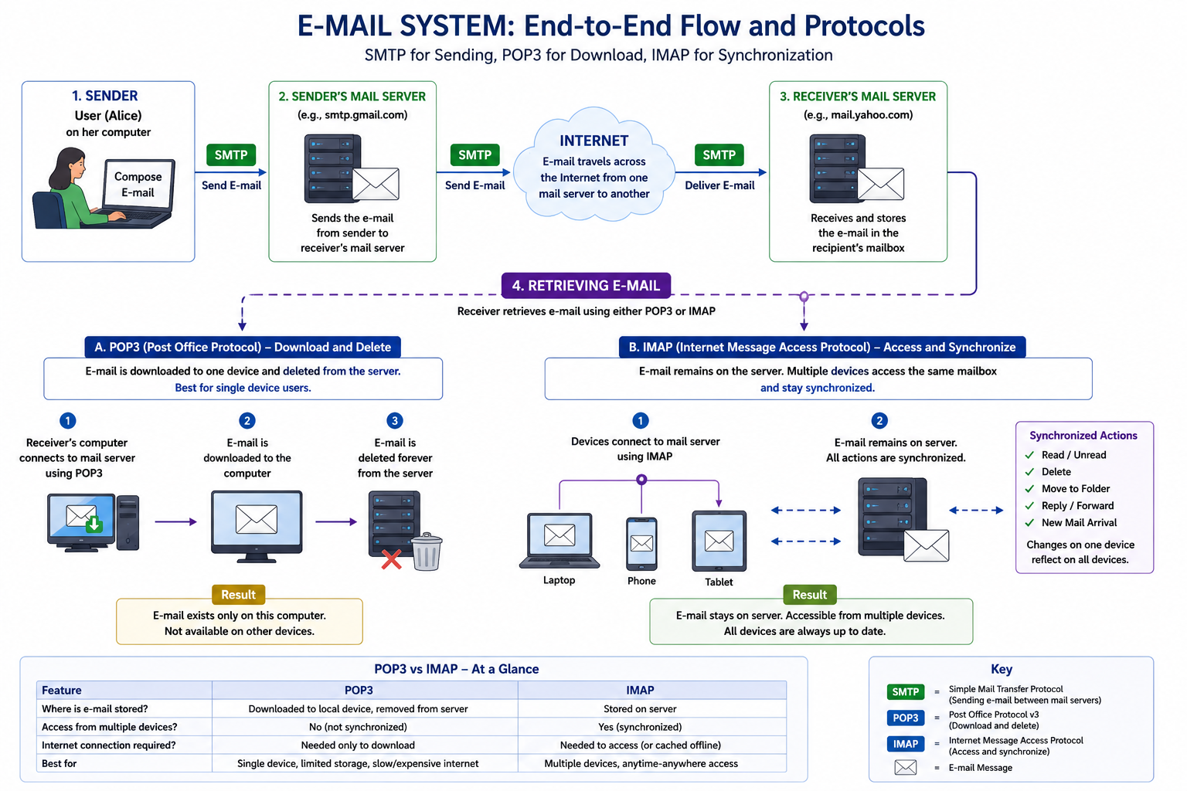

Slide 16
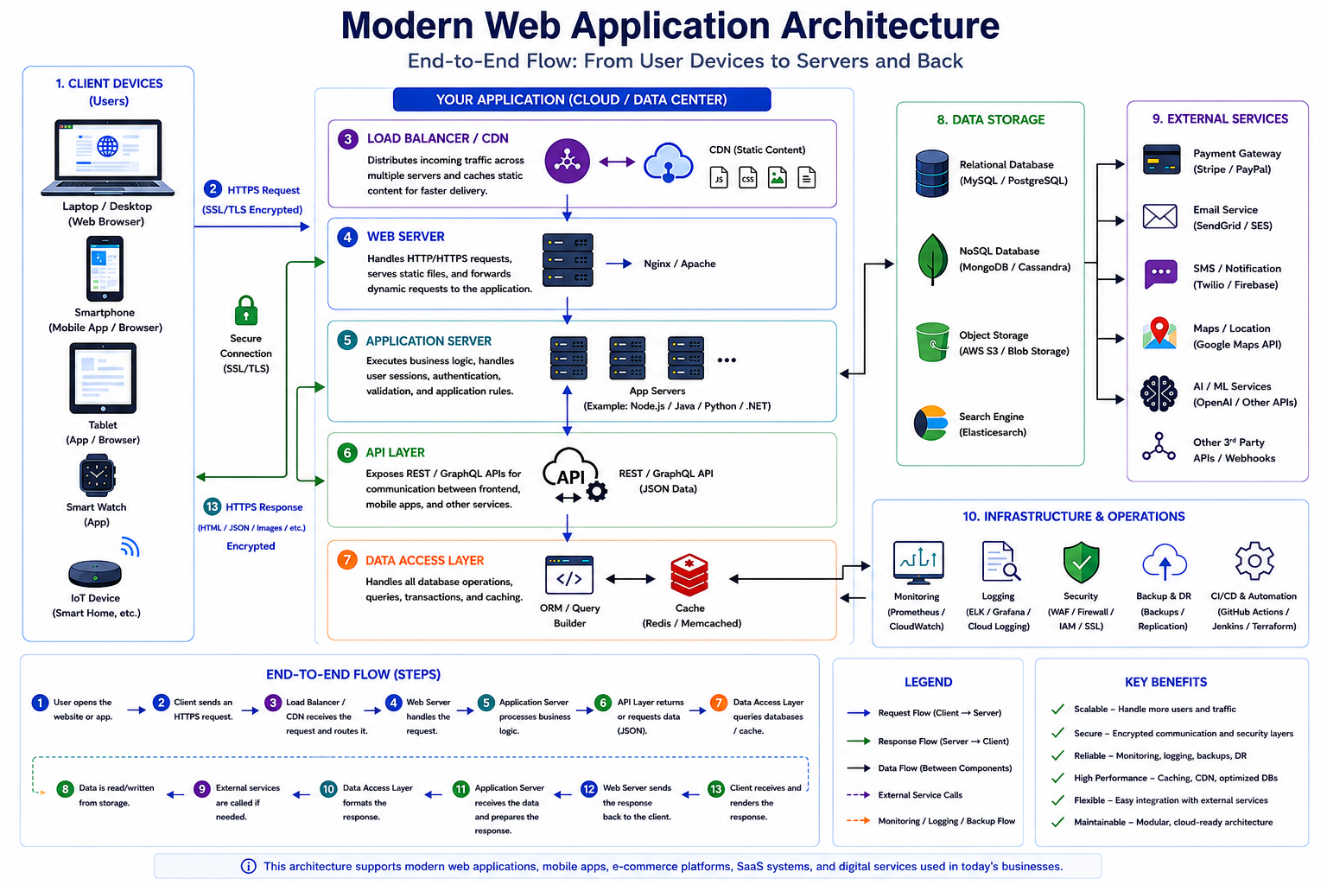

Slide 17
Internet Connection Options

Slide 18
Connectivity overview
Bandwidth: amount of data that can travel through a communication medium per unit of time.
  Symmetric connections, provide the same bandwidth in both directions,
  Asymmetric connections, provide bandwidth for each direction,
    Upstream bandwidth, amount of information that can travel from the user to the Internet in a given amount of time,
    Downstream bandwidth, amount of information that can travel from the Internet to a user in a given amount of time.
Notes:
IAP: Internet Access Provider

Slide 19
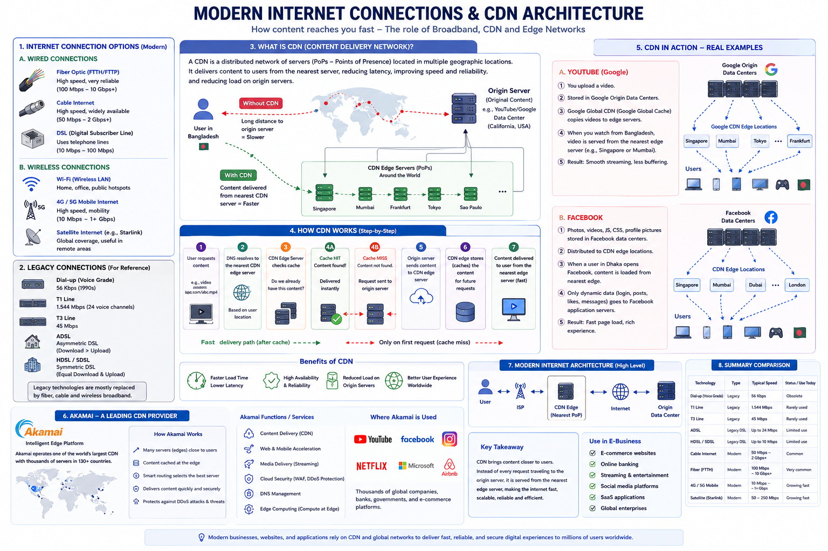

Slide 20
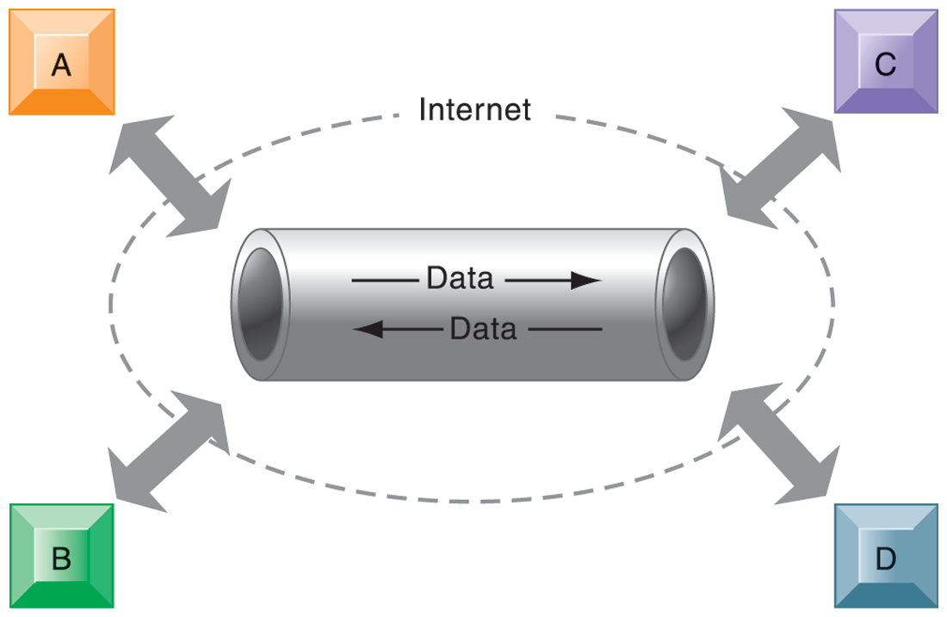
Virtual Private Network (VPN)
VPN is a secure, encrypted, private network that has been configured within a public network.
Tunnel: Point-to-Point Tunneling Protocol (PPTP)
It provides a network infrastructure for combining voice and data networks.
This graphic illustrates how a virtual private network works. The rectangles A, B, C, and D represent different computers on the VPN. In a process called tunneling, packets of data are encrypted and wrapped inside IP packets.
By adding this wrapper around a network message to hide its content, business firms create a private connection that travels through the public Internet.

Slide 21
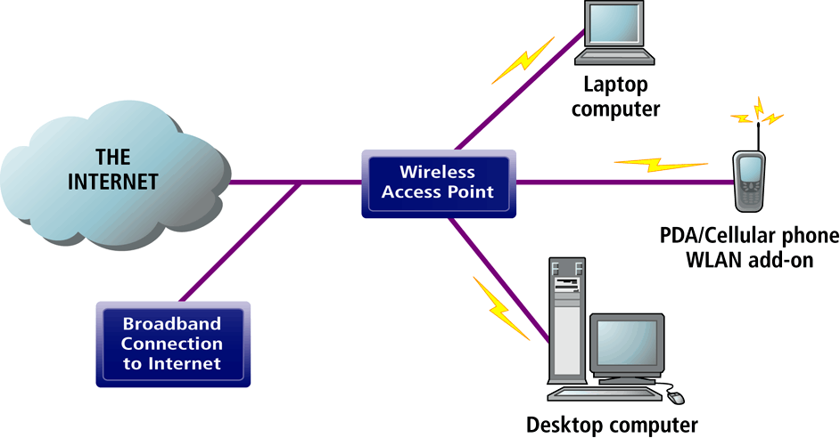
Wireless Local Area Network (WLANs)
Wi-Fi (802.11)
  Wireless standard for Ethernet networks with greater speed and range
  (Wireless Fidelity, also known as 802.11b): first commercially viable standard for WLANs
  wireless access points connect to Internet directly via a broadband connection and then transmit radio signals to transmitters/receivers installed in laptops or PDAs
  Offers high-bandwidth capacity, but limited range; is also inexpensive
Bluetooth (802.11)
  Technology standard for short-range wireless communication under 30 feet
  personal connectivity technology that enables links between mobile computers, phones, PDAs and connectivity with Internet; has much more limited range than Wi-Fi (30 feet vs. 300 meters, links up to 8 devices)
WiMax (802.16)
  Wireless access range of 31 miles

Slide 22
Internet2® Project

Slide 23
Internet2® Project
Advanced networking consortium of more than 350 member institutions including universities, corporations, government research agencies, and not-for-profit networking organizations, working in partnership to facilitate the development, deployment and use of revolutionary Internet technologies.
Primary goals:
  Create a leading edge very-high speed network for national research community (100 gigabit-per-second network)
  Enable revolutionary Internet applications
  Ensure the rapid transfer of new network services and application to the broader Internet community.

Slide 24
Areas of Focus of Internet2®
New networking capabilities: Projects include
  Deploying IPv6
  Developing and implementing new technologies
  Developing more effective routing practices
  Coordinating the interconnection of different components of the Internet2 infrastructure
  Creating an infrastructure to handle multicasting
Advanced applications
  distributed computation, virtual labs, digital libraries, distributed learning, telemedicine

Slide 25
Internet2®: Benefits
IP Multicasting
  Set of technologies that enables efficient delivery of data to many locations on a network.
Latency solutions
  Diffserve (differentiated quality of service) will be able to assign different levels of priority to packets depending on type of data being transmitted.
Guaranteed service levels
  Ability to purchase right to move data through network at guaranteed speed in return for higher fee.
Lower error rates
Declining costs

Slide 26
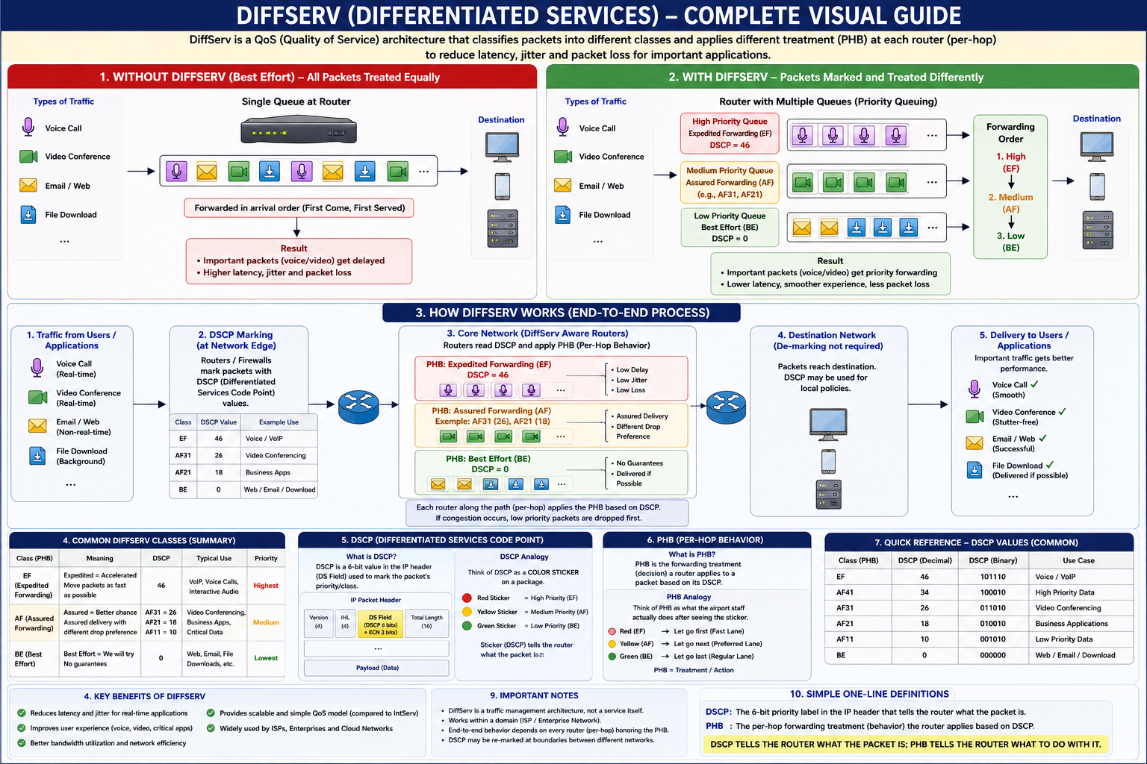

Slide 27
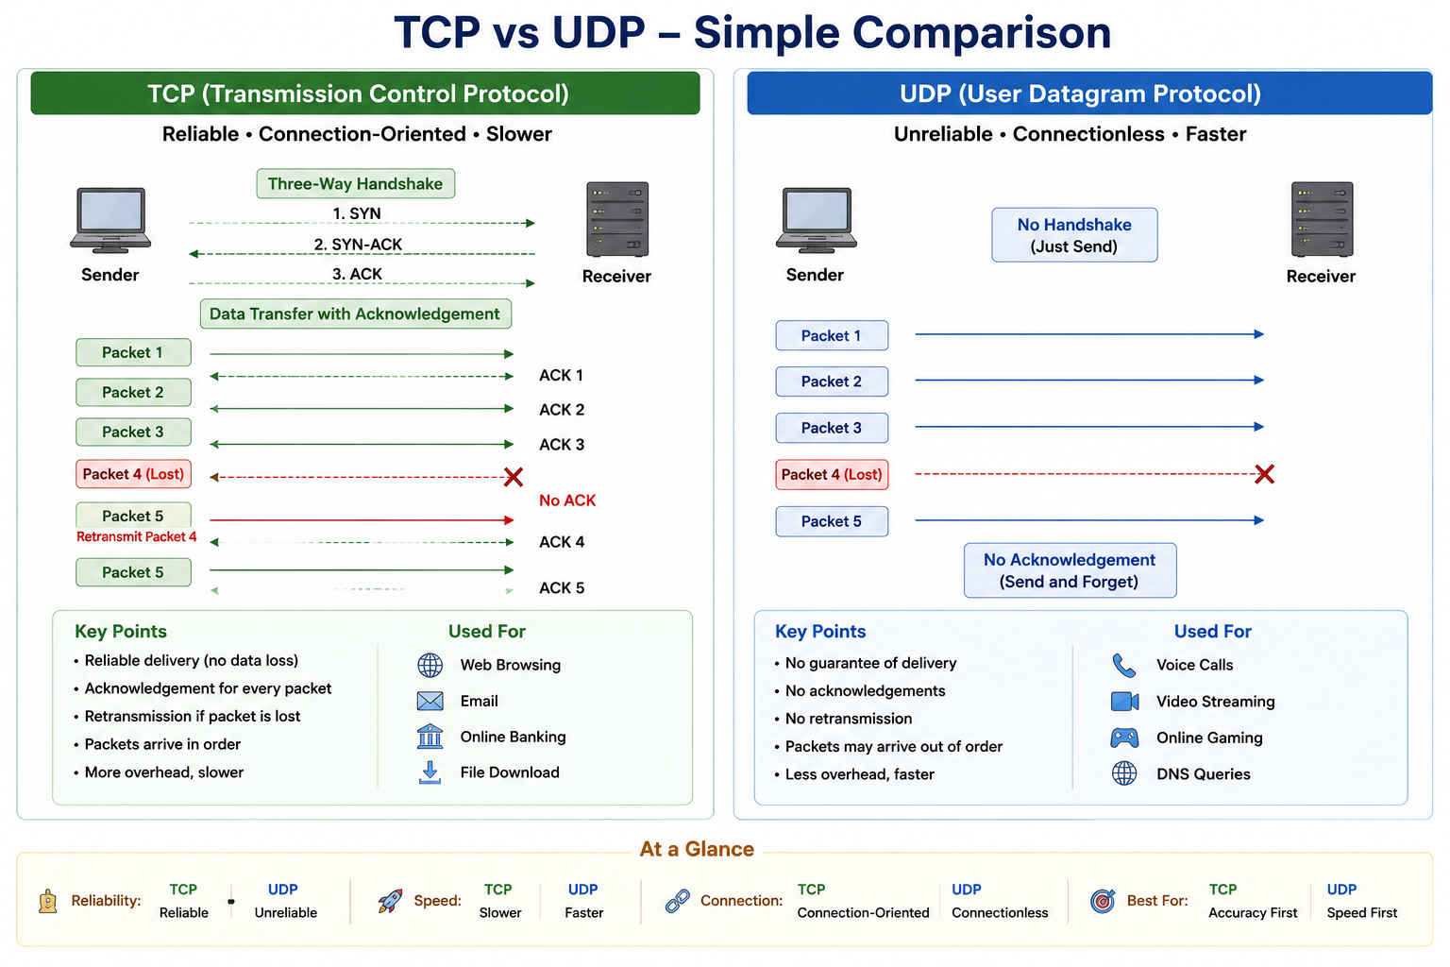

Slide 28
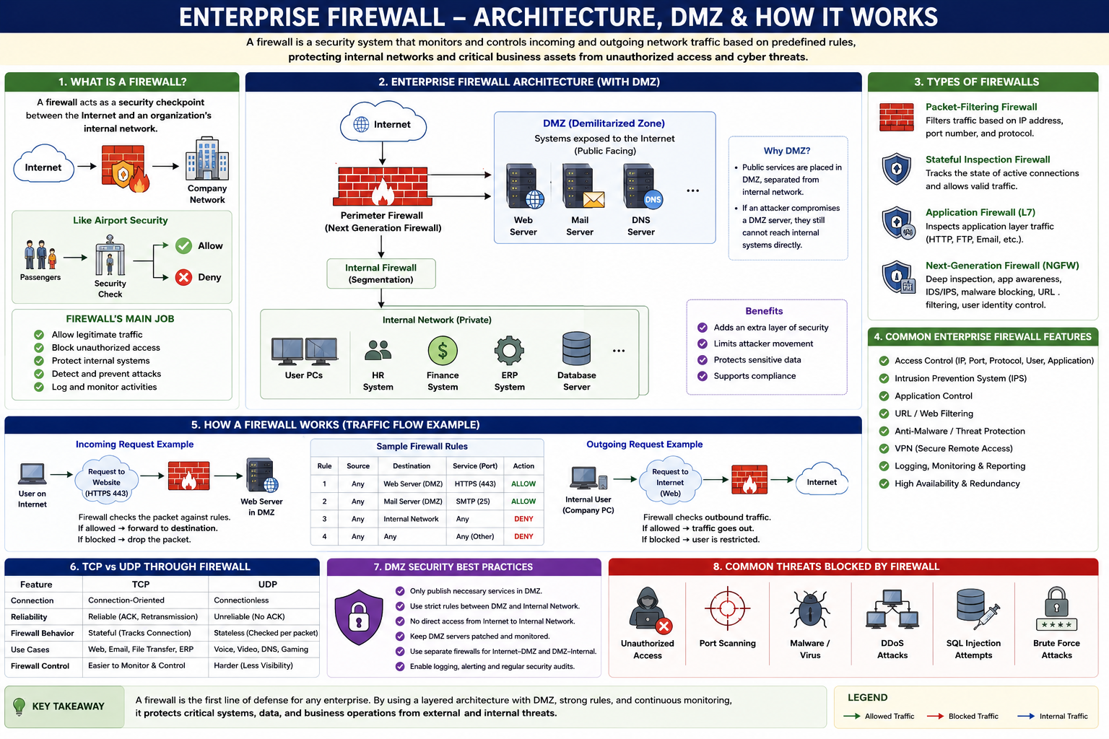

Slide 29
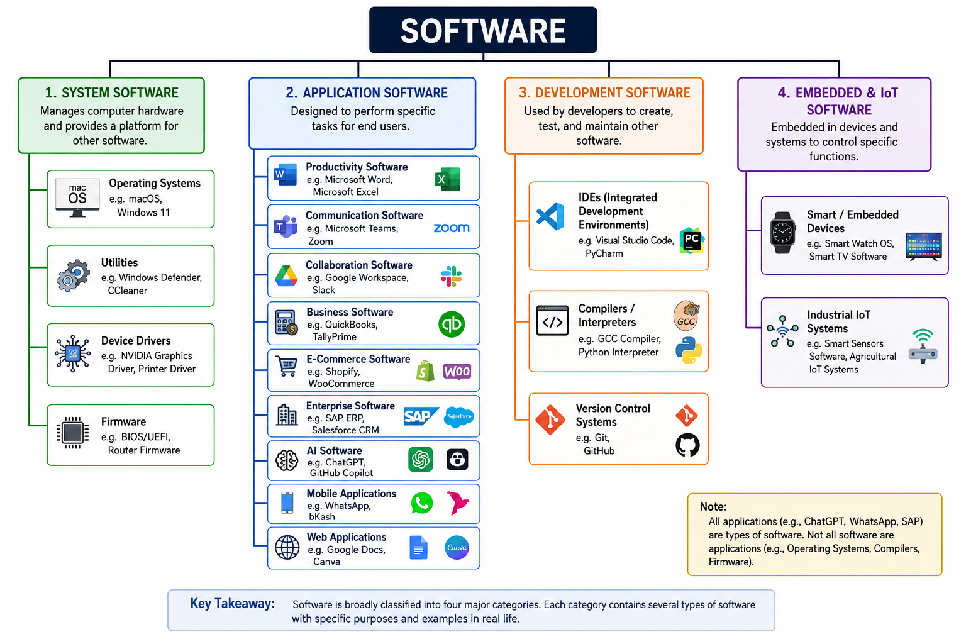

Slide 30

Acknowledgement:
Gary Schneider. E-Business. International Edition, Cengage Learning.
Laudon & Traver. E-Commerce (2014).

